Slide 1
Education
…the sorting out of children
The Population
of the UK
A different view of life in the United Kingdom
by Danny Dorling and Benjamin D. Hennig
Chapter 3

Slide 2
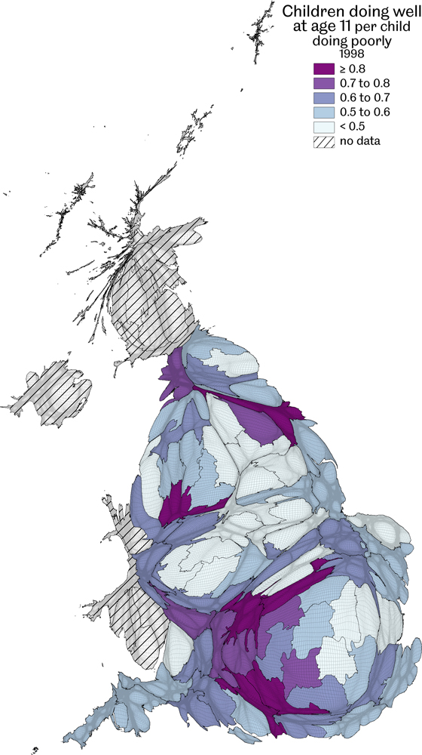
Children doing well at age 11
Ratio of numbers achieving a score greater than four to those achieving less than four in 1998
Data source: Key Stage 2 results from neighbourhood statistics website
Education…the sorting out of children
Figure 3.1

Slide 3
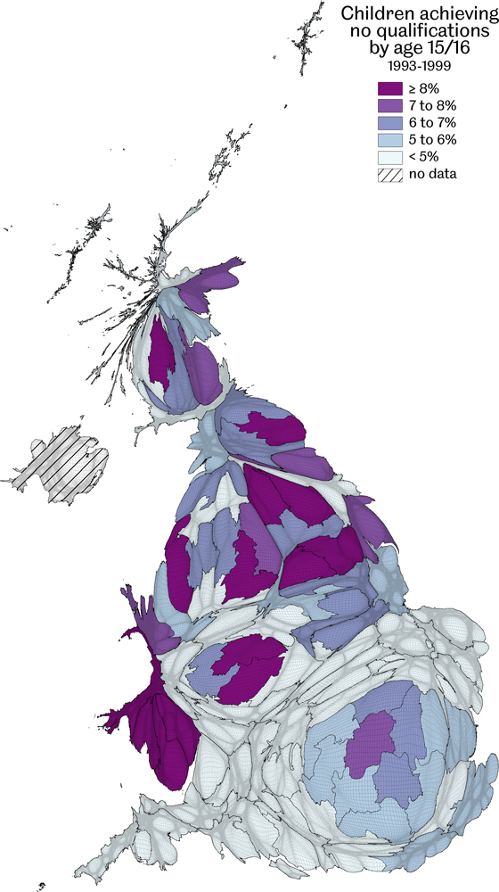
Children achieving no qualifications by age 15/16, 1993-1999
The proportions of children receiving no GCSE results are shown
Data source: Analysis of national school league tables for Britain 1993-99
Education…the sorting out of children
Figure 3.2

Slide 4
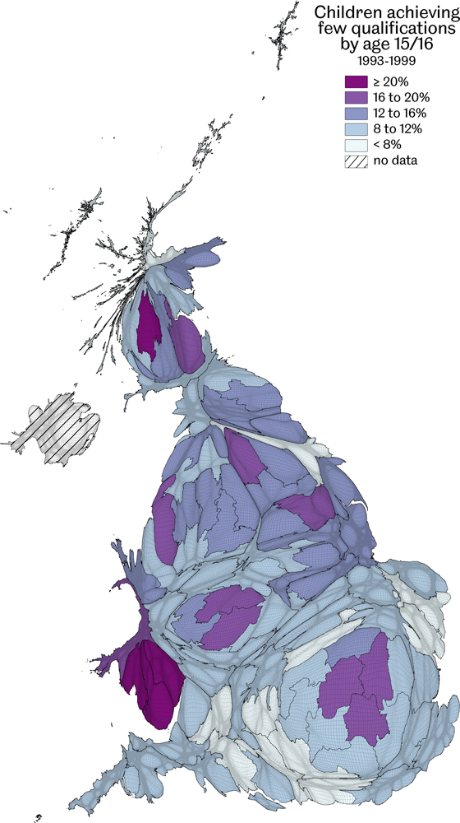
Children achieving few qualifications by age 15/16, 1993-1999
The proportions of children receiving less than five GCSEs at level A-G are shown
Data source: Analysis of national school league tables for Britain 1993-99
Education…the sorting out of children
Figure 3.3

Slide 5
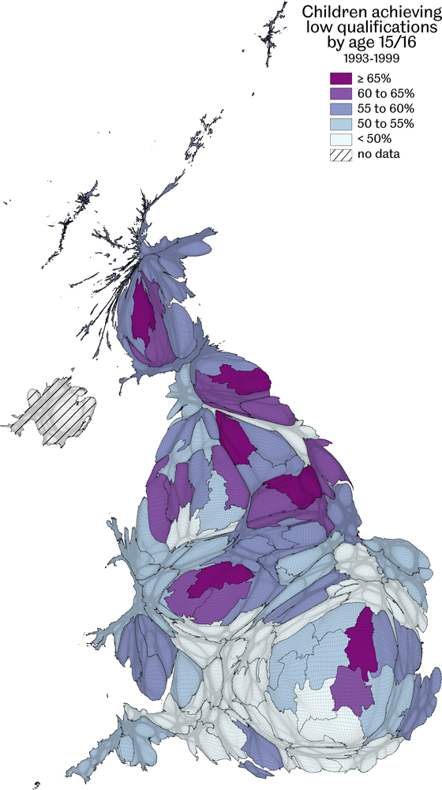
Children achieving low qualifications by age 15/16, 1993-1999
The proportions of all children receiving fewer than five A-C GCSE results are shown
Data source: Analysis of national school league tables for Britain 1993-99
Education…the sorting out of children
Figure 3.4

Slide 6
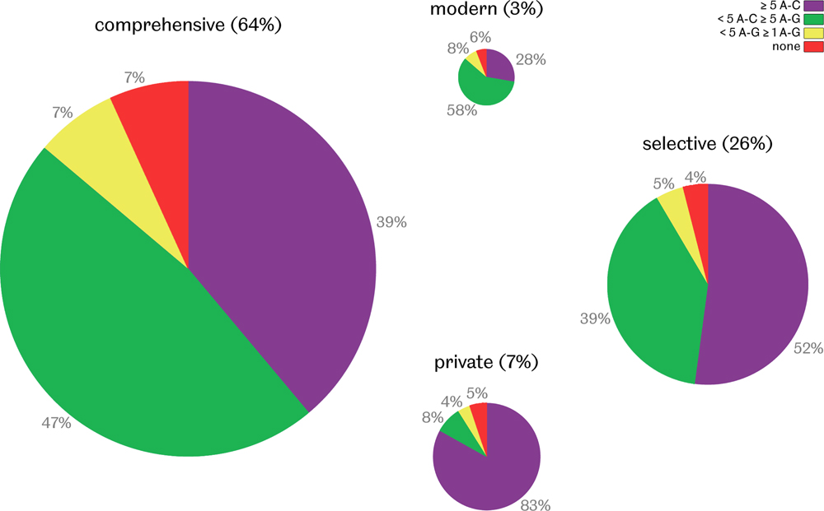
Children aged 15/16 1993-99 by school type & GCSEs
Charts are drawn in proportion to total numbers of children attending each type of school and shaded by the shares awarded particular grades - Data source: Analysis of national school league tables for Britain 1993-00
Education…the sorting out of children
Figure 3.5

Slide 7
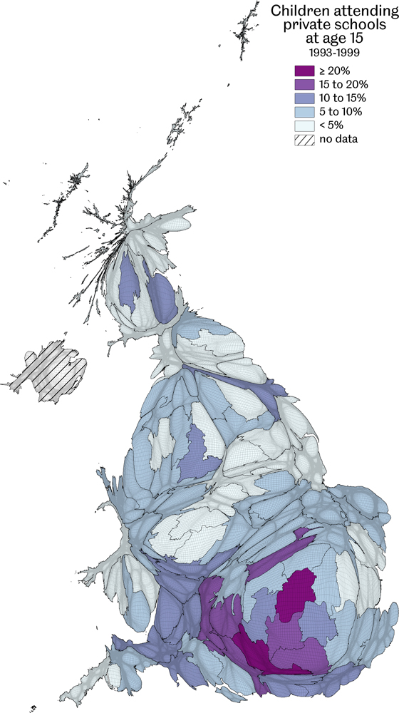
Children attending private schools at age 15, 1993-1999
Data source: Analysis of national school league tables for Britain 1993-99
Education…the sorting out of children
Figure 3.6

Slide 8
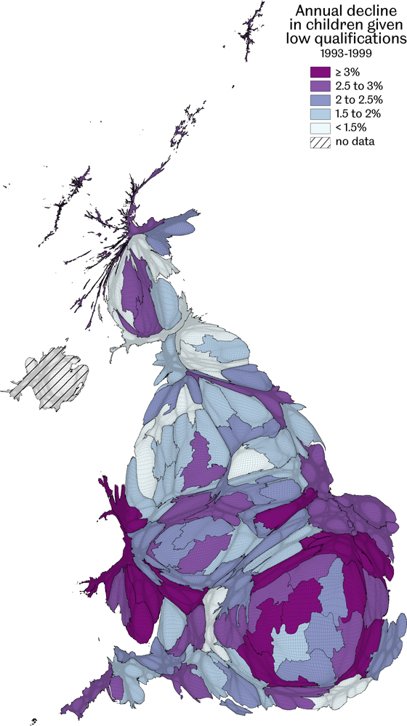
Annual decline in children given low qualifications, 1993-1999
Average fall in the numbers receiving lower than five A-C GCSE grades at age 15/16 as a proportion of those numbers
Data source: Analysis of national school league tables for Britain, 1993-99
Education…the sorting out of children
Figure 3.7

Slide 9
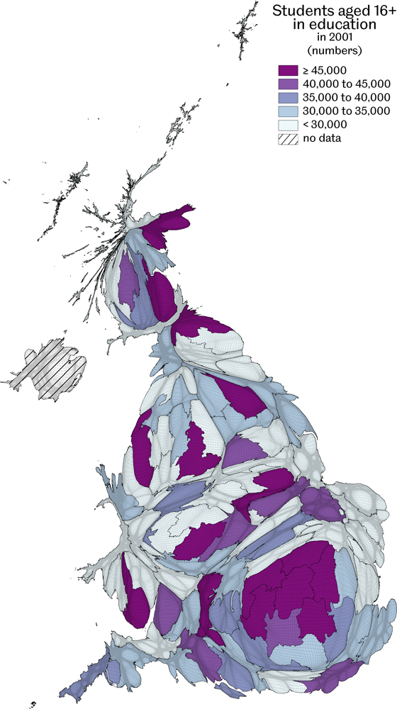
Students aged 16+ in education
Absolute counts in 2001 by European Constituency area
Data source: Analysis of the 2001 Census Key Statistics by local authority
Education…the sorting out of children
Figure 3.8

Slide 10
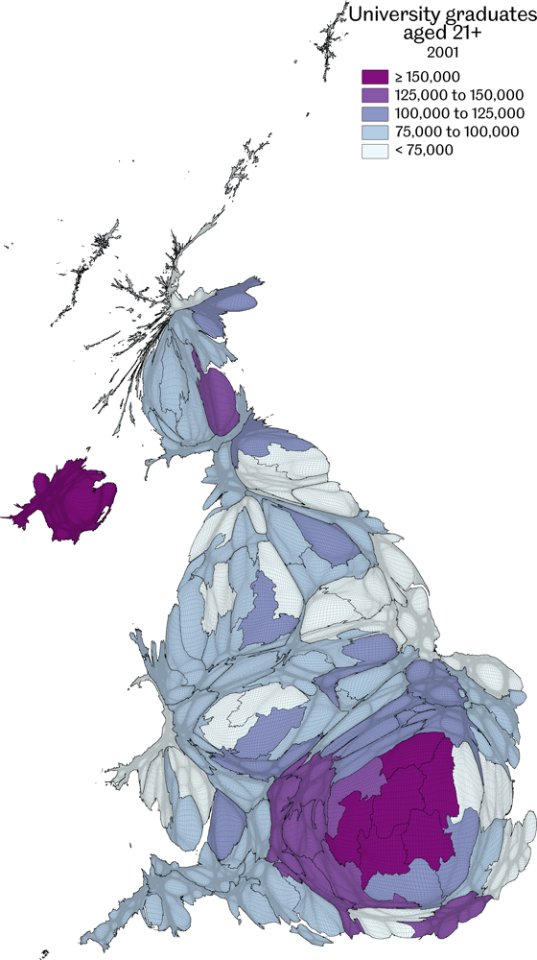
University graduates aged 21+
Absolute counts in 2001 by European Constituency area
Data source: Analysis of the 2001 Census Key Statistics by local authority
Education…the sorting out of children
Figure 3.9

Slide 11
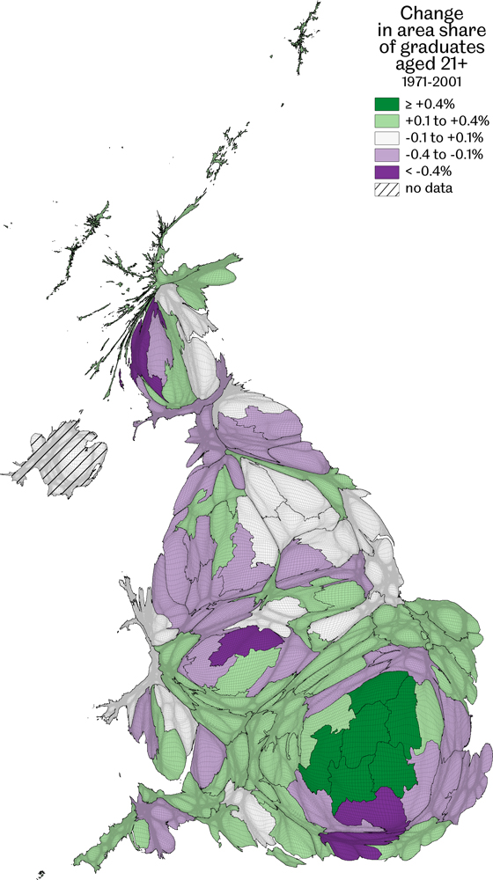
Change in area share of graduates aged 21+, 1971-2001
Figures show the 2001 share of the total graduate proportion less the 1971 share
Data source: Analysis of the 2001 Census Key Statistics by local authority and the 1971 Census
Education…the sorting out of children
Figure 3.10

Slide 12
Key Point Summary
• Most children in Britain either fail at school or are labelled second class at university
• The type of school a child in Britain attends has a huge influence on his or her exam results
• Getting high exam results is more about social sorting than about being clever
Education…the sorting out of children

