Slide 1
Home …the settlements of society
The Population of the UK
A different view of life in the United Kingdom
by Danny Dorling and Benjamin D. Hennig
Chapter 9

Slide 2
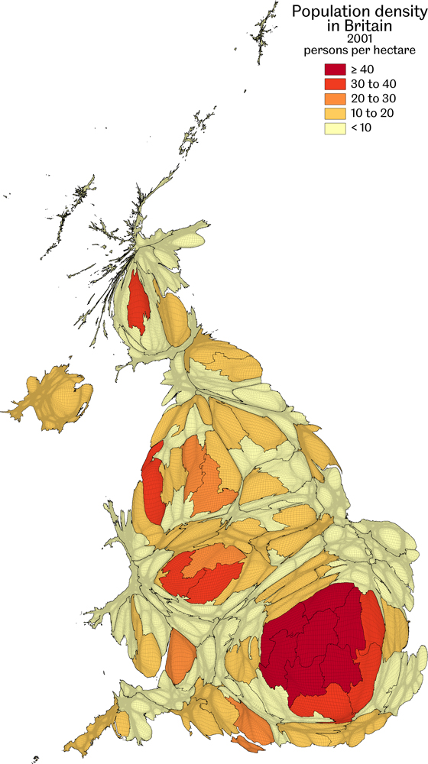
Population density 2001
Data source: UK population Census 2001, calculated for this book as population-weightened density (local authorities are base units)
Home…the settlements of society
Figure 9.1

Slide 3
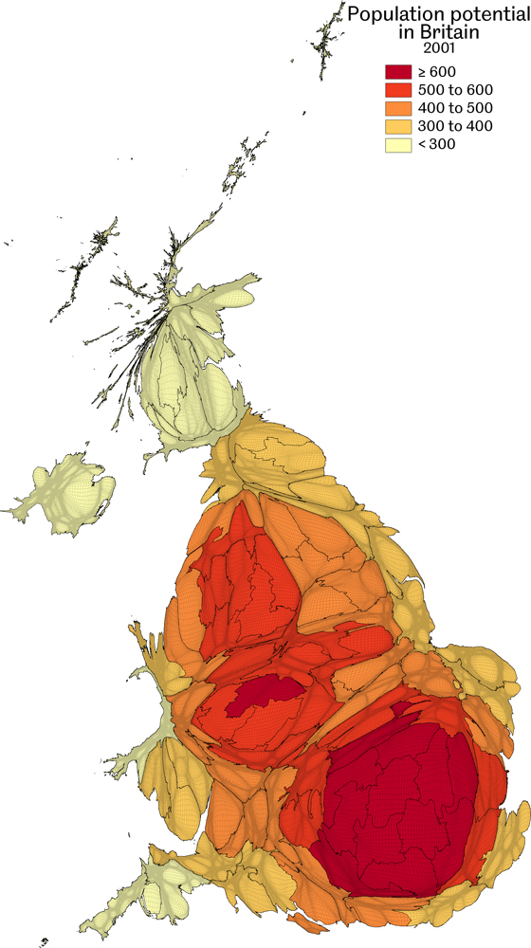
Population potential 2001
Data source: UK population Census 2001, calculated for this book as the population per metre away from each local authority to every other, and a population-weighted mean calculated for each area shown
Home…the settlements of society
Figure 9.2

Slide 4
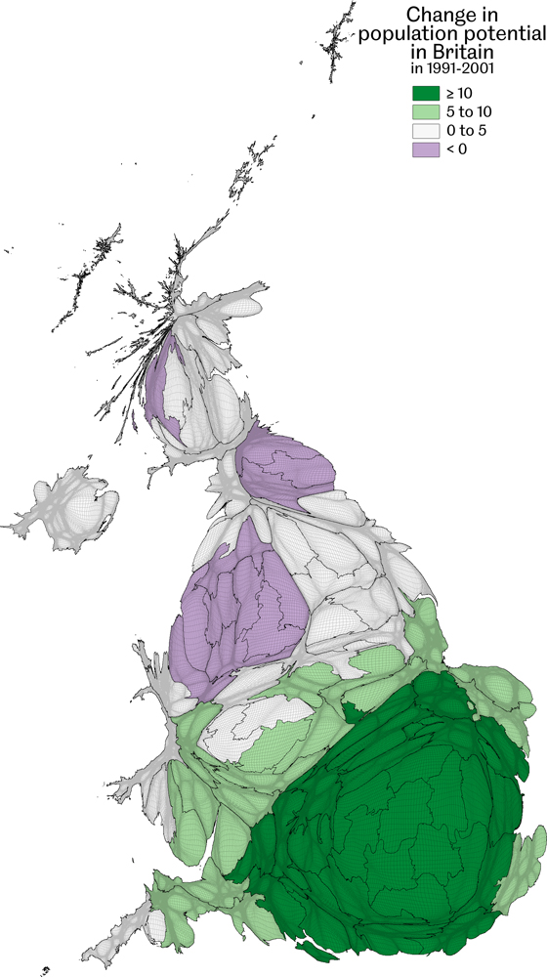
Change in population potential 1991-2001
Data source: UK population Censuses 1991 and 2001, population potential calculated for this book by local authority (see Figure 9.3), 1991 statistics substracted from 2001 and a population-weighted mean shown
Home…the settlements of society
Figure 9.3

Slide 5
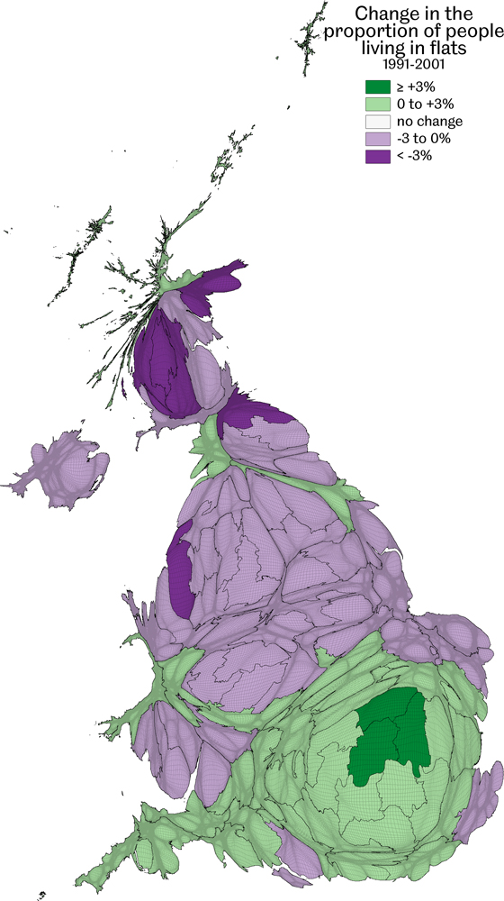
Change in the proportion of people living in flats 1991-2001
Data source: UK population Censuses 1991 and 2001, calculated for this book
Home…the settlements of society
Figure 9.4

Slide 6
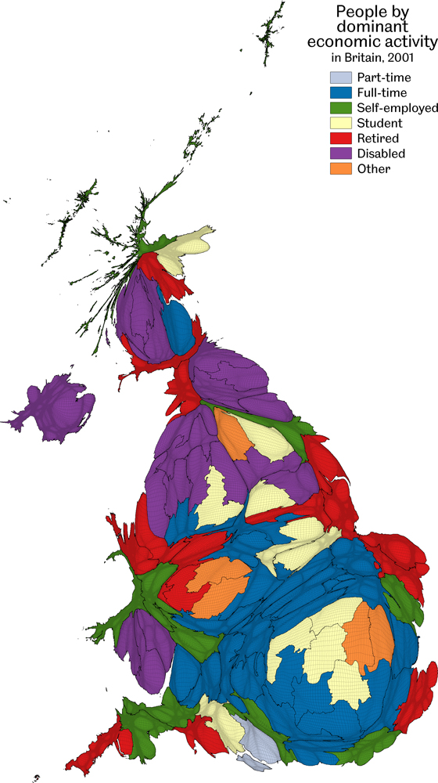
People by dominant economic activity
The most unusually large group displayed here is shown when each area is compared with the UK average
Data source: Analysis of the 2001 Census Key Statistics by local authority
Home…the settlements of society
Figure 9.5

Slide 7
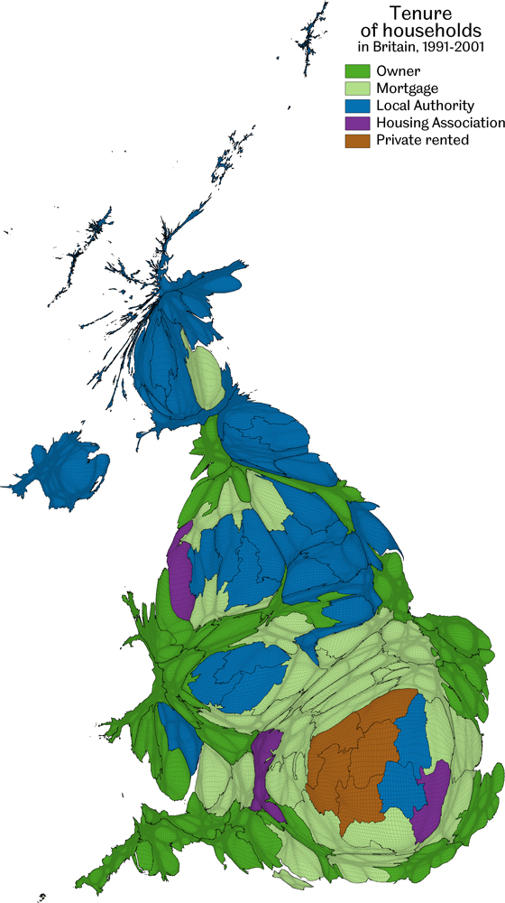
Tenure of households 1991-2001
The most unusually large group displayed here is shown when each area is compared with the UK average
Data source: Analysis of the 2001 Census Key Statistics by local authority
Home…the settlements of society
Figure 9.6

Slide 8
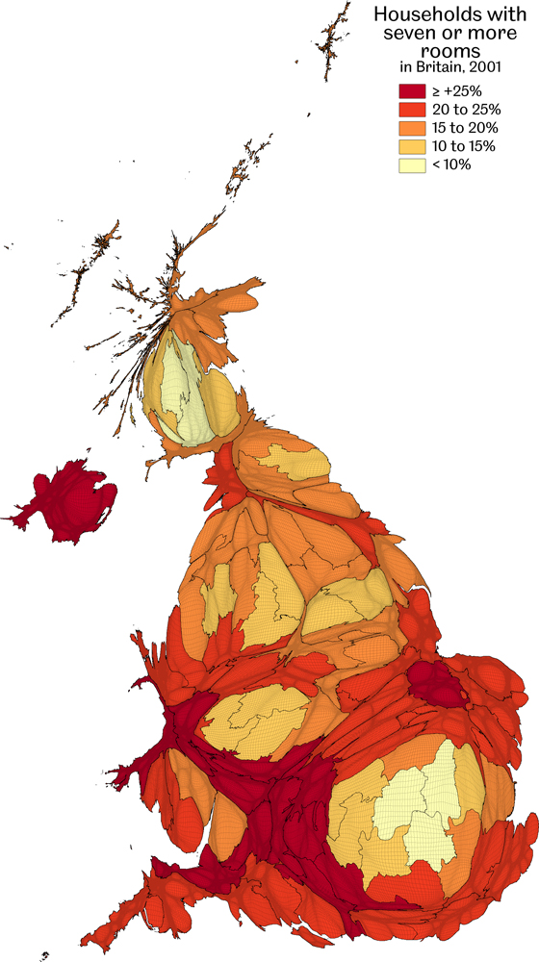
Households with seven or more rooms
Data source: UK population Census 2001, calculated for this book
Home…the settlements of society
Figure 9.7

Slide 9
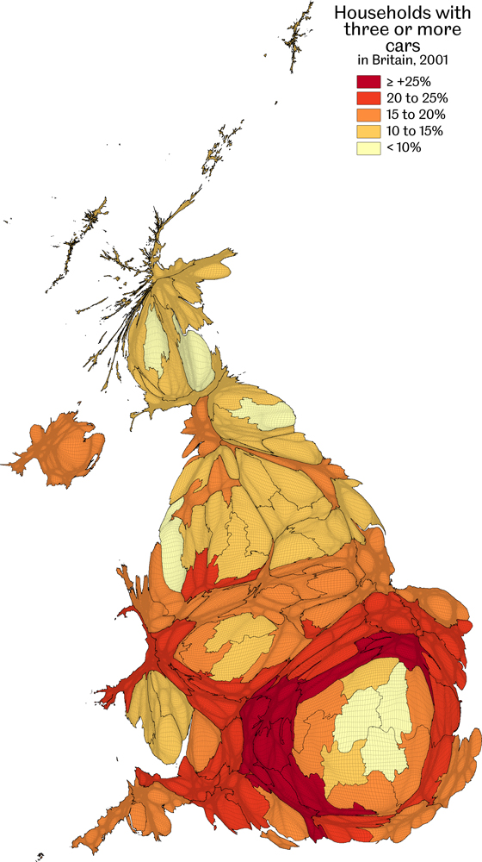
Households with three or more cars
Data source: UK population Census 2001, calculated for this book
Home…the settlements of society
Figure 9.8

Slide 10
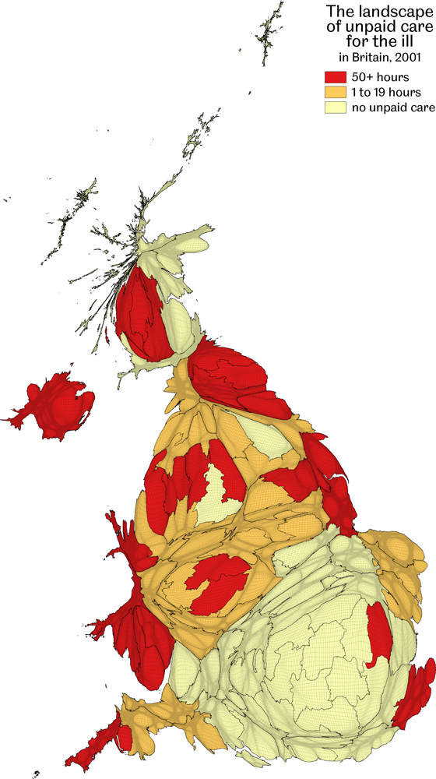
The landscape of unpaid care for the ill
The most unusually large group displayed here is shown when each area is compared with the UK average
Data source: Analysis of the 2001 Census Key Statistics by local authority
Home…the settlements of society
Figure 9.9

Slide 11
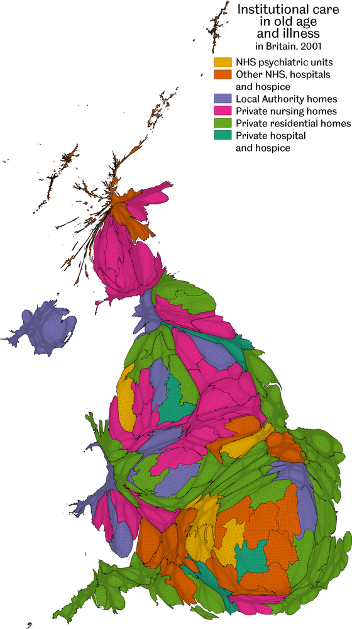
Institutional care in old age and illness
The most unusually large group displayed here is shown when each area is compared with the UK average
Data source: Analysis of the 2001 Census Key Statistics by local authority
Home…the settlements of society
Figure 9.10

Slide 12
Key Point Summary
• Britain is metaphorically tilting, people are leaving the north west, moving into the south
• People in the south and Wales are more likely to be buying their home or to own it outright
• You are more likely to end up in a private nursing home in your final days in the south
Home…the settlements of society

