Slide 1
Work …the segmentation of society
The Population of the UK
A different view of life in the United Kingdom
by Danny Dorling and Benjamin D. Hennig
Chapter 8

Slide 2
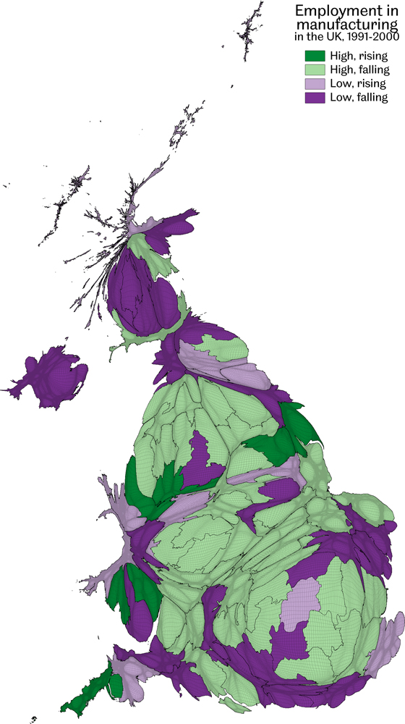
Employment in manufacturing in the UK, 1991-2000
Data source: UK population Censuses 1991 and 2001, calculated for this book
Work…the segmentation of society
Figure 8.1

Slide 3
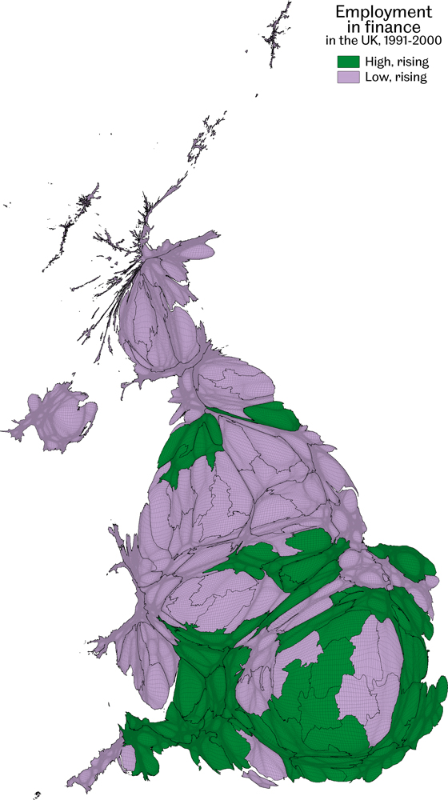
Employment in finance in the UK, 1991-2000
Data source: UK population Censuses 1991 and 2001, calculated for this book
Work…the segmentation of society
Figure 8.2

Slide 4
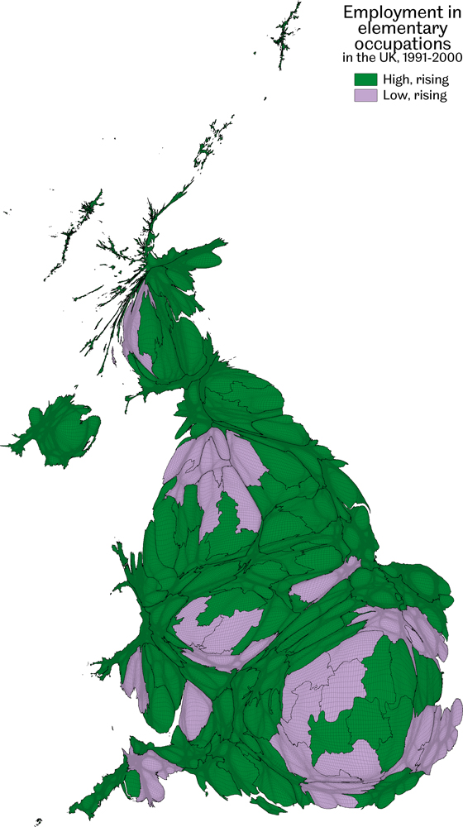
Employment in elementary occupations in the UK, 1991-2000
Low paid jobs often described as unskilled
Data source: UK population Censuses 1991 and 2001, calculated for this book
Work…the segmentation of society
Figure 8.3

Slide 5
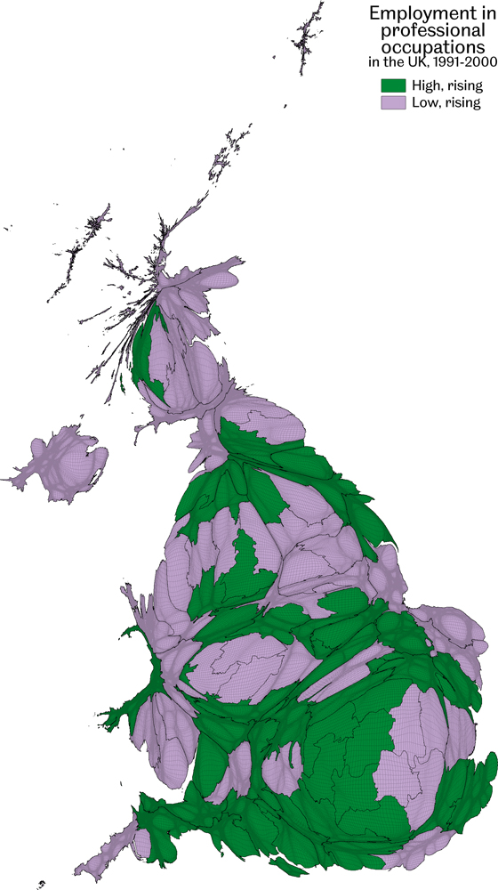
Employment in professional occupations in the UK, 1991-2000
Data source: UK population Censuses 1991 and 2001, calculated for this book
Work…the segmentation of society
Figure 8.4

Slide 6
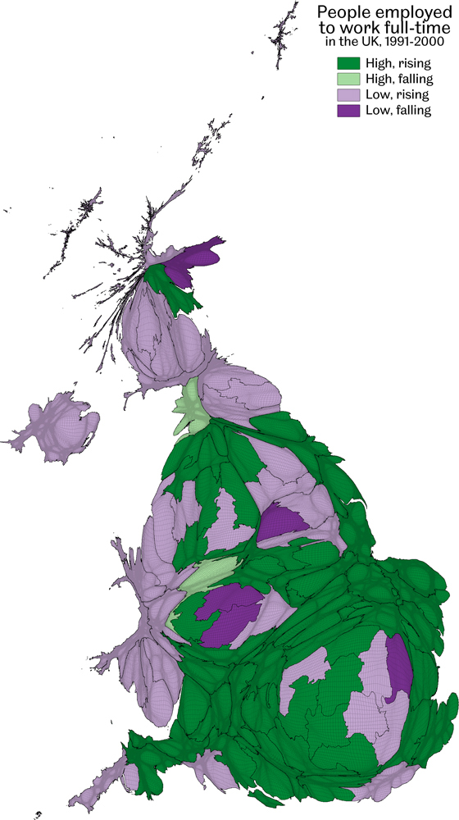
People employed to work full-time in the UK, 1991-2000
Data source: UK population Censuses 1991 and 2001, calculated for this book
Work…the segmentation of society
Figure 8.5

Slide 7
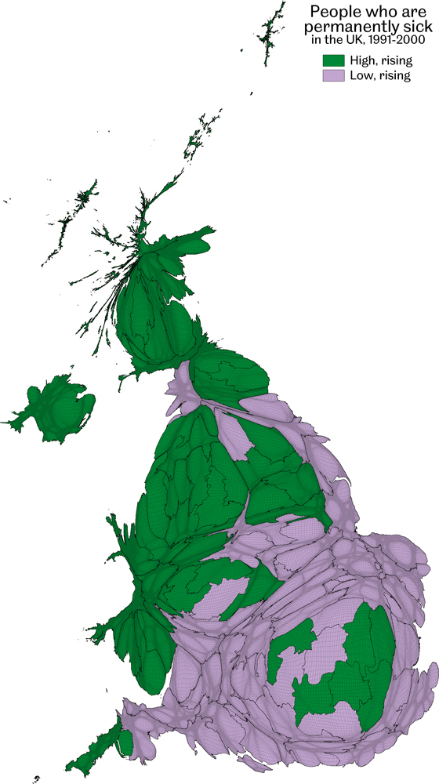
People who are permanently sick in the UK, 1991-2000
Data source: UK population Censuses 1991 and 2001, calculated for this book
Work…the segmentation of society
Figure 8.6

Slide 8
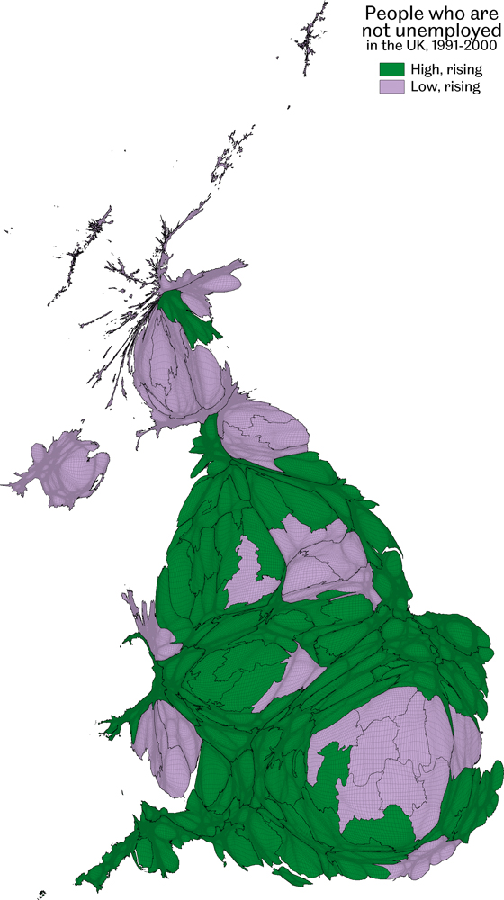
People who are not unemployed in the UK, 1991-2000
Data source: UK population Censuses 1991 and 2001, calculated for this book
Work…the segmentation of society
Figure 8.7

Slide 9
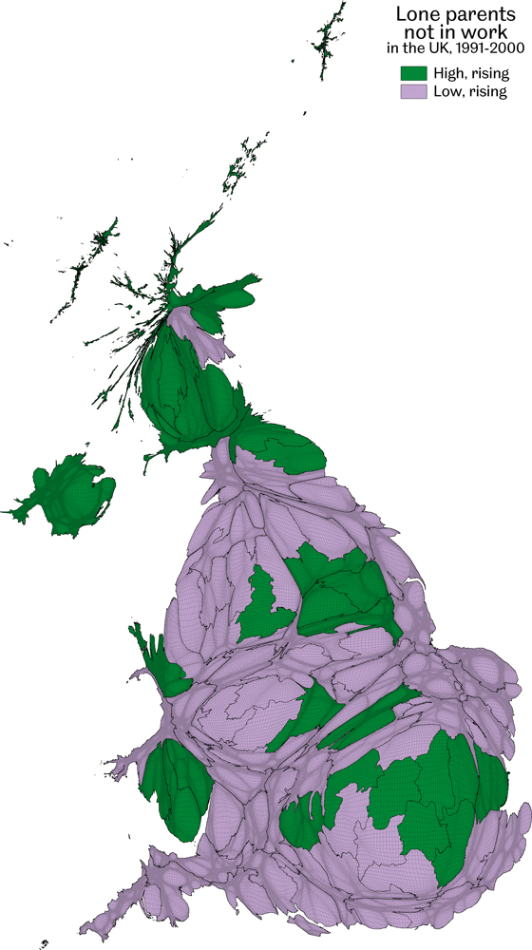
Lone parents not in work in the UK, 1991-2000
Data source: UK population Censuses 1991 and 2001, calculated for this book
Work…the segmentation of society
Figure 8.8

Slide 10
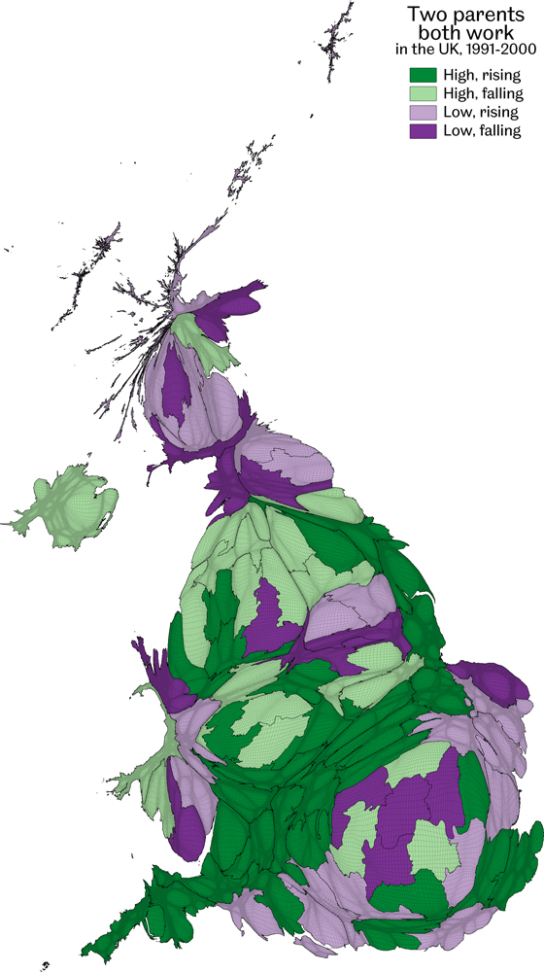
Two parents, both work in the UK, 1991-2000
Data source: UK population Censuses 1991 and 2001, calculated for this book
Work…the segmentation of society
Figure 8.9

Slide 11
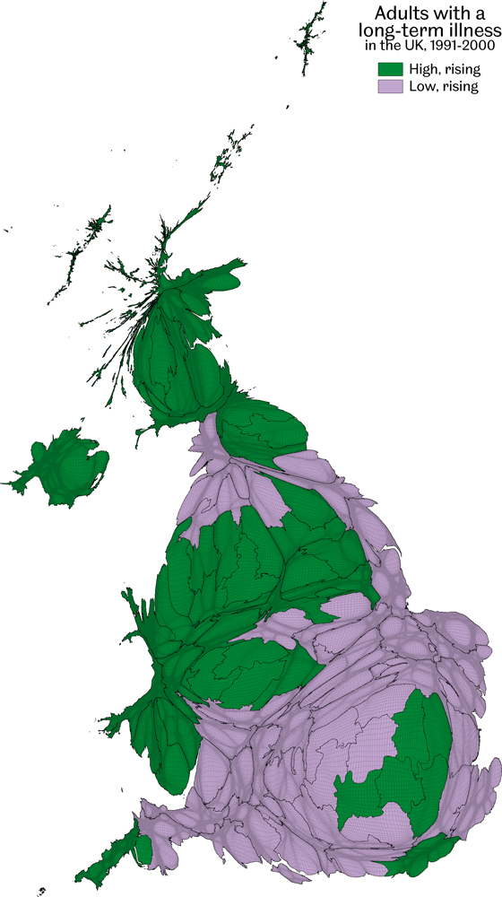
Adults with a long-term illness in the UK, 1991-2000
Data source: UK population Censuses 1991 and 2001, calculated for this book
Work…the segmentation of society
Figure 8.10

Slide 12
Key Point Summary
• There has been a polarisation in UK industry with finance rising and manufacturing falling
• There have also been more better paid jobs, created and more work that is menial in nature
• The most recent economic downturn has tended to reinforce previously established trends
Work…the segmentation of society

