Slide 1
Health …the sedimentation of society
The Population of the UK
A different view of life in the United Kingdom
by Danny Dorling and Benjamin D. Hennig
Chapter 7

Slide 2
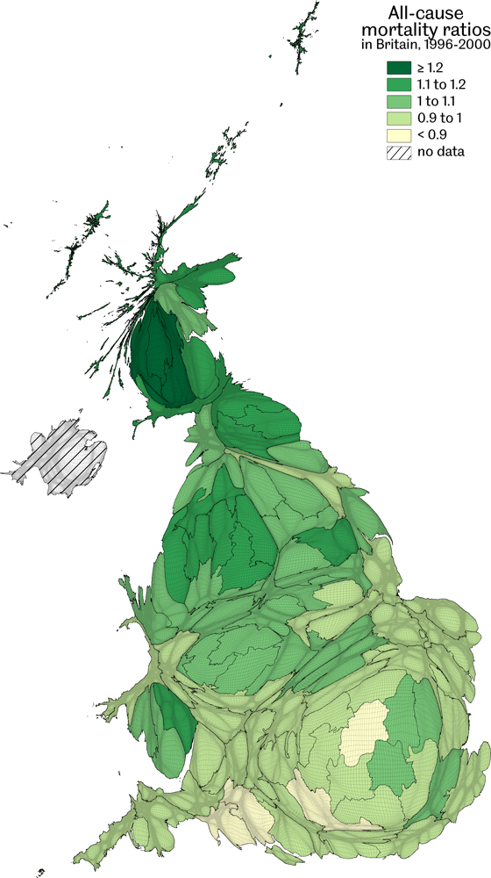
All-cause mortality ratios in Britain, 1996-2000
Age-sex standardized mortality rate, deviation from England and Wales national average of 1.0
Data source: Mortality records and population estimates, calculated for this book
Health…the sedimentation of society
Figure 7.1

Slide 3
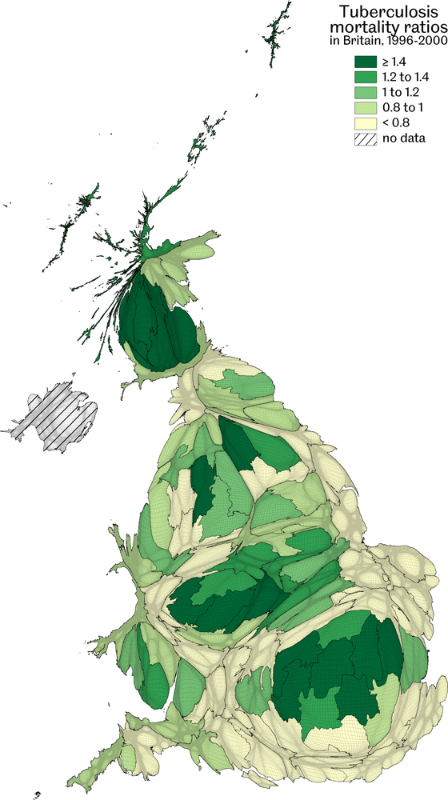
Tuberculosis mortality ratios in Britain, 1996-2000
Age-sex standardized mortality rate, deviation from England and Wales national average of 1.0
Data source: Mortality records and population estimates, calculated for this book
Health…the sedimentation of society
Figure 7.2

Slide 4
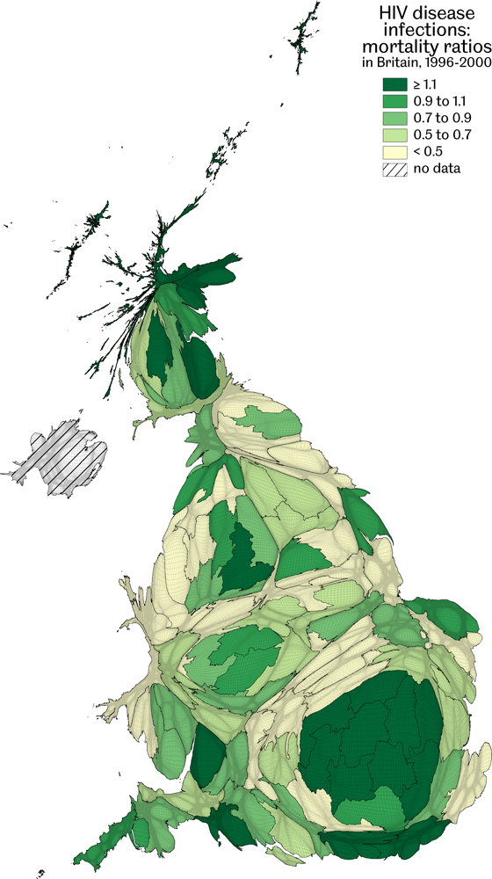
HIV disease infections: mortality ratios in Britain, 1996-2000
Age-sex standardized mortality rate, deviation from England and Wales national average of 1.0
Data source: Mortality records and population estimates, calculated for this book
Health…the sedimentation of society
Figure 7.3

Slide 5
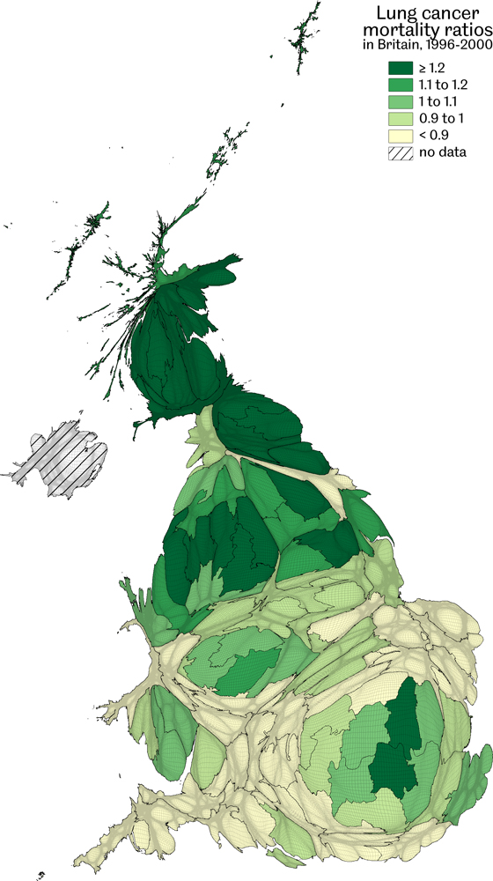
Lung cancer mortality ratios in Britain, 1996-2000
Age-sex standardized mortality rate, deviation from England and Wales national average of 1.0
Data source: Mortality records and population estimates, calculated for this book
Health…the sedimentation of society
Figure 7.4

Slide 6
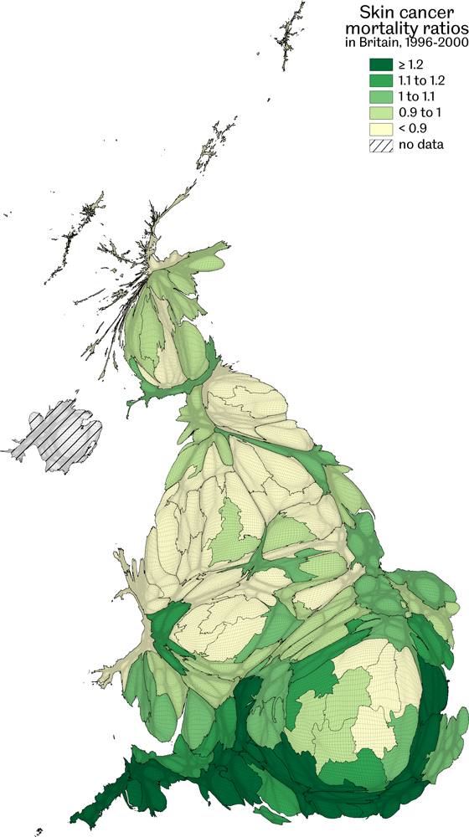
Skin cancer mortality ratios in Britain, 1996-2000
Age-sex standardized mortality rate, deviation from England and Wales national average of 1.0
Data source: Mortality records and population estimates, calculated for this book
Health…the sedimentation of society
Figure 7.5

Slide 7
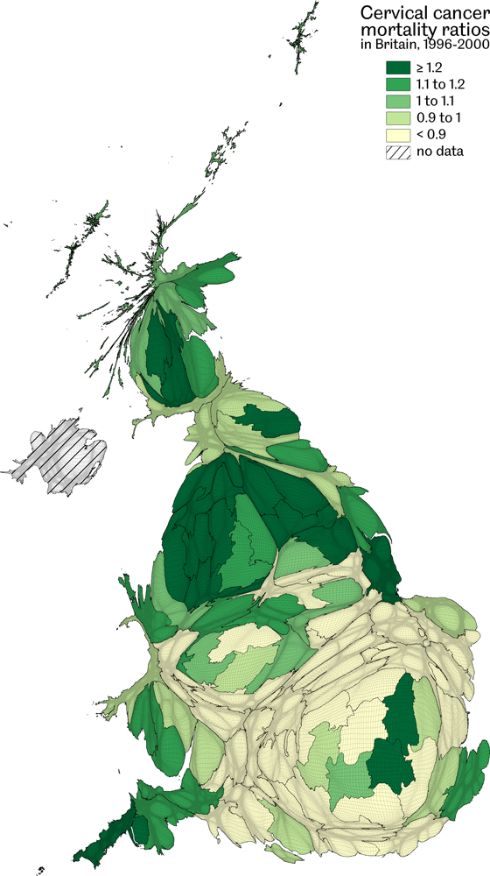
Cervical cancer mortality ratios in Britain, 1996-2000
Age-sex standardized mortality rate, deviation from England and Wales national average of 1.0
Data source: Mortality records and population estimates, calculated for this book
Health…the sedimentation of society
Figure 7.6

Slide 8
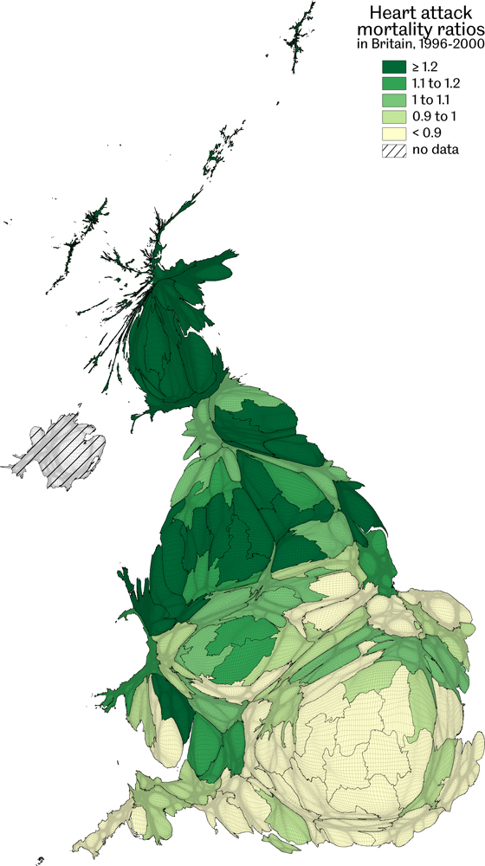
Heart attack mortality ratios in Britain, 1996-2000
Age-sex standardized mortality rate, deviation from England and Wales national average of 1.0
Data source: Mortality records and population estimates, calculated for this book
Health…the sedimentation of society
Figure 7.7

Slide 9
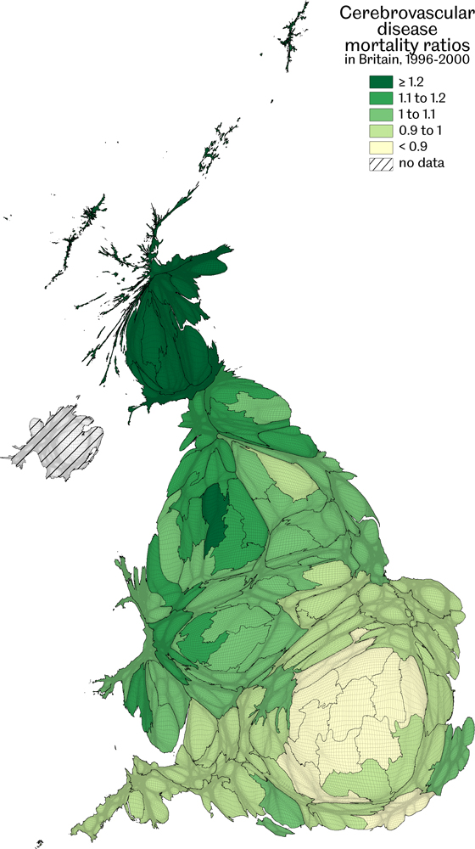
Cerebrovascular disease mortality ratios in Britain, 1996-2000
Age-sex standardized mortality rate, deviation from England and Wales national average of 1.0
Data source: Mortality records and population estimates, calculated for this book
Health…the sedimentation of society
Figure 7.8

Slide 10
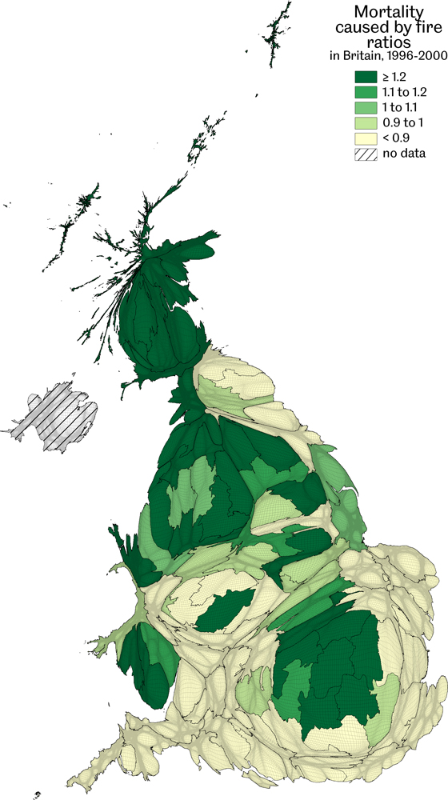
Mortality caused by fire ratios in Britain, 1996-2000
Age-sex standardized mortality rate, deviation from England and Wales national average of 1.0
Data source: Mortality records and population estimates, calculated for this book
Health…the sedimentation of society
Figure 7.9

Slide 11
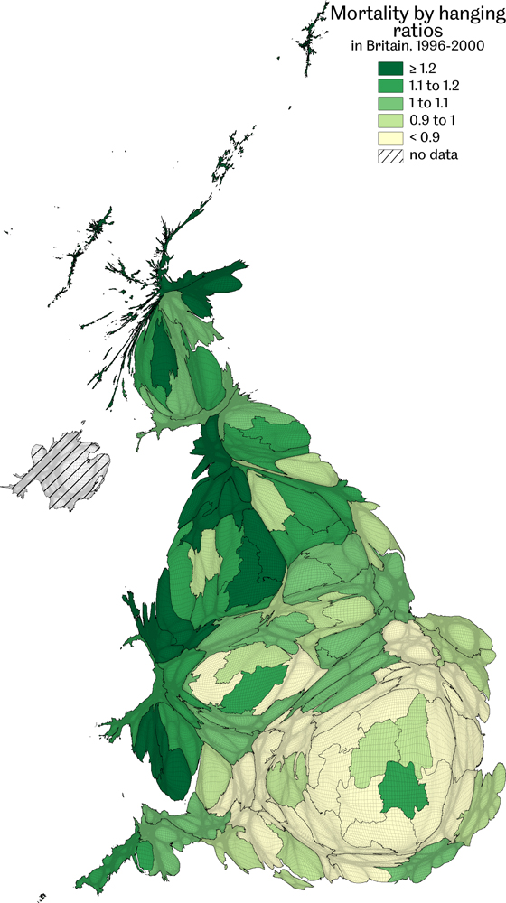
Mortality by hanging ratios in Britain, 1996-2000
Age-sex standardized mortality rate, deviation from England and Wales national average of 1.0
Data source: Mortality records and population estimates, calculated for this book
Health…the sedimentation of society
Figure 7.10

Slide 12
Key Point Summary
• Everybody dies, but some die too early, and there are a wide variety of rare causes of death
• There are distinct geographical patterns to be seen in premature mortality by cause of death
• It is far easier to live a healthy life is you are free, especially free of others’ orders
Health…the sedimentation of society

