Slide 1
Inequality …income, poverty and wealth
The Population of the UK
A different view of life in the United Kingdom
by Danny Dorling and Benjamin D. Hennig
Chapter 6

Slide 2
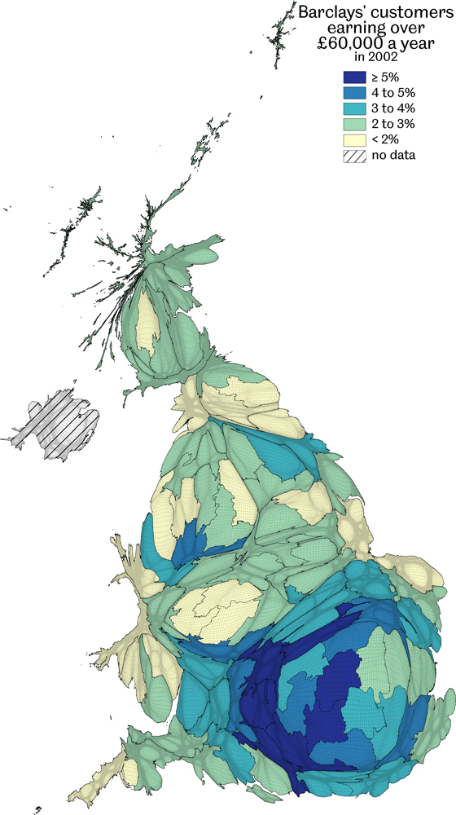
Barclays' customers earning over £60,000 a year in 2002
Data source: Barclays Bank data aggregated to European constituency and estimated for Scotland, available at http://www.newsroom.barclays.co.uk/ (downloaded 14/8/2002)
Inequality…income, poverty and wealth
Figure 6.1

Slide 3
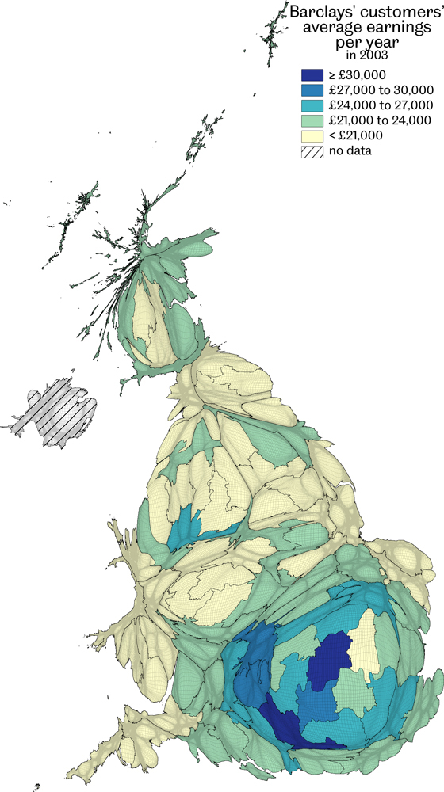
Barclays' customers’ average earnings per year in 2003
Data source: Barclays Bank data aggregated to European constituency and estimated for Scotland, available at http://www.newsroom.barclays.co.uk/ (downloaded 14/8/2003)
Inequality…income, poverty and wealth
Figure 6.2

Slide 4
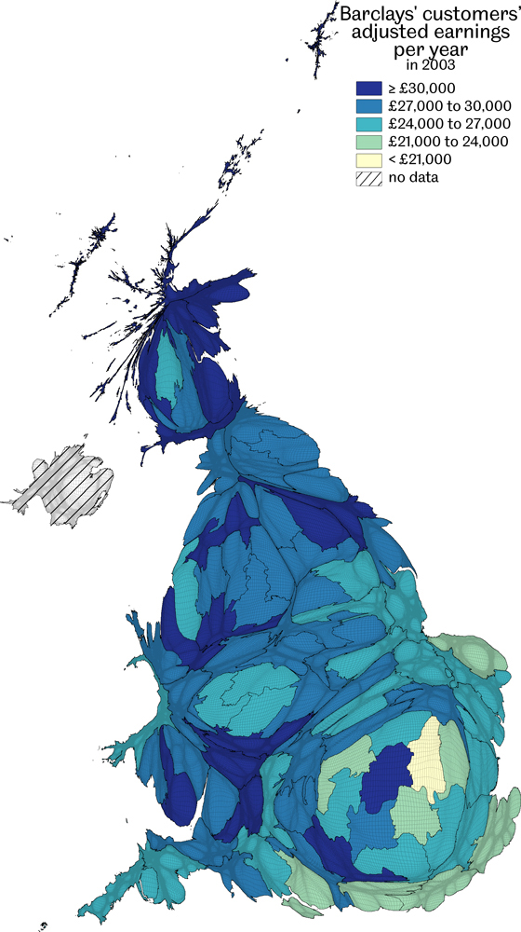
Barclays' customers’ adjusted earnings per year in 2003
Data source: Barclays Bank data aggregated to European constituency and estimated for Scotland, available at http://www.newsroom.barclays.co.uk/ (downloaded 14/8/2003)
Inequality…income, poverty and wealth
Figure 6.3

Slide 5
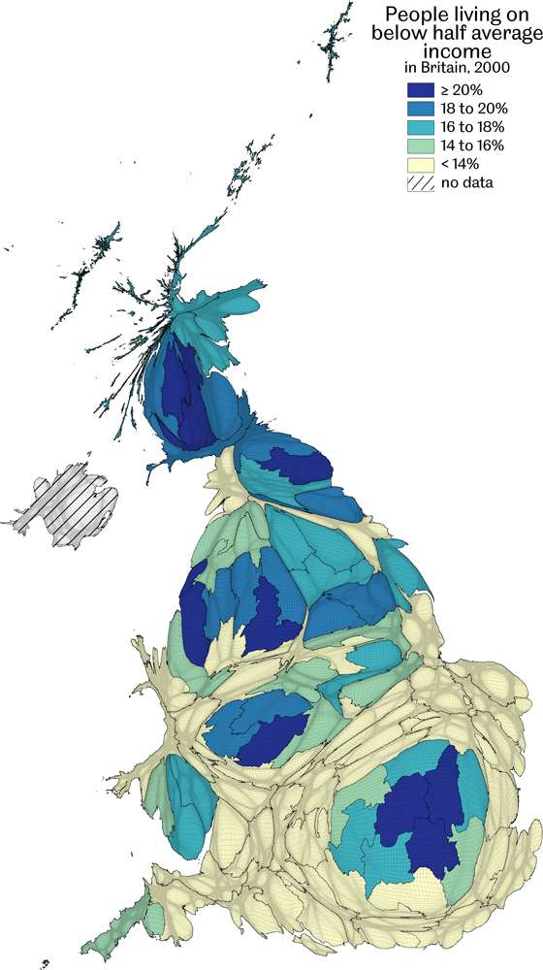
People living on below half average income in Britain, 2000
Data source: A component of the UNDP Human Poverty Index, see Appendix in Seymour, J. (for UNED-UK) (2001) Poverty in Plenty: A Human Development Report for the UK, London: Earthscan Publications Ltd.
Inequality…income, poverty and wealth
Figure 6.4

Slide 6
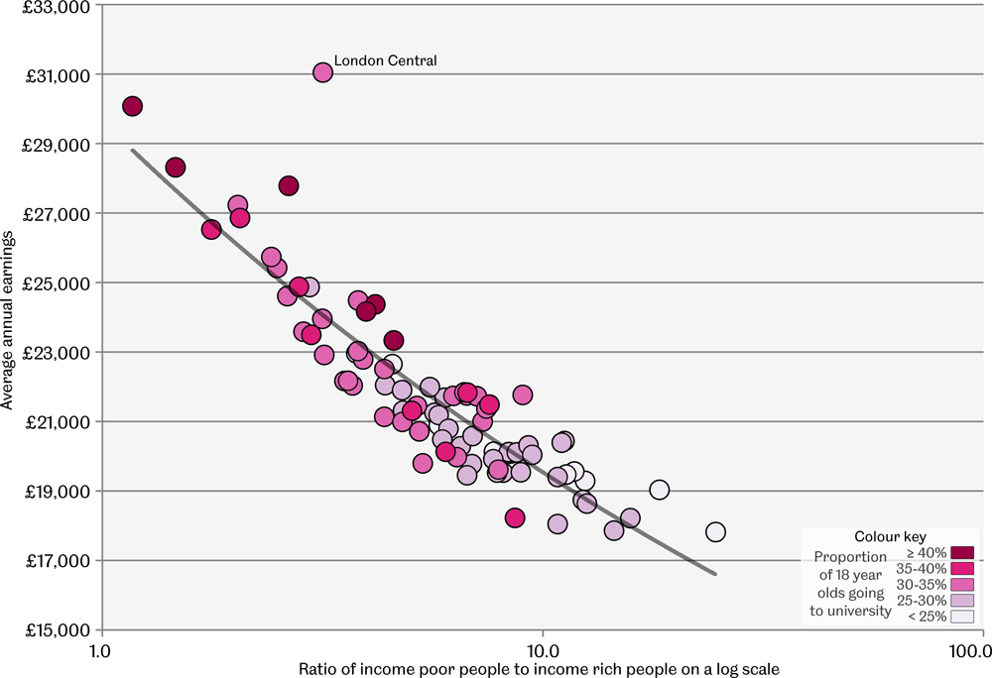
High, low and average earnings in Britain ~2001
Data source: Barclays Bank data aggregated to European constituency and estimated for Scotland, available at http://www.newsroom.barclays.co.uk/ (accessed 14/8/2003); Seymour , J. (for UNED-UK) (2001) Poverty in Plenty:
A Human Development Report for the UK, London: Earthscan Publications Ltd.
Each point is a 1999 European parliamentary constituency in Britain
Inequality…income, poverty and wealth
Figure 6.5

Slide 7
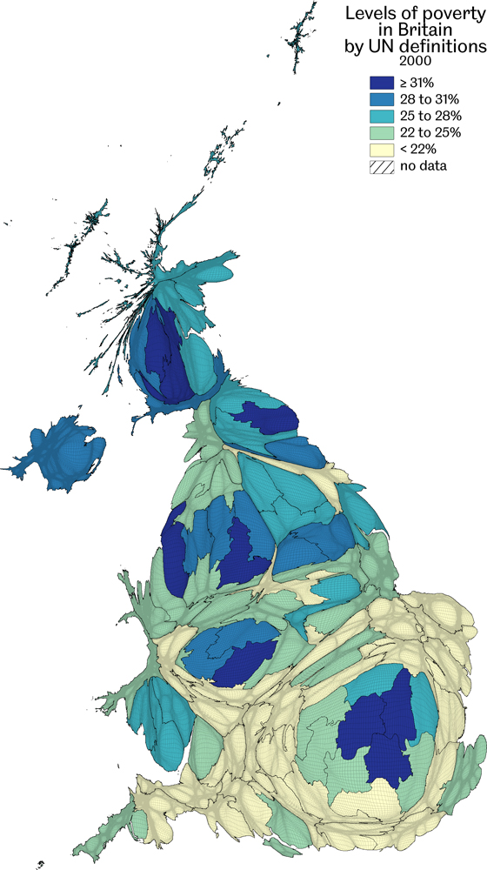
Levels of poverty by UN definitions, 2000
Data source: A component of the UNDP Human Poverty Index, see Appendix in Seymour , J. (for UNED-UK) (2001) Poverty in Plenty: A Human Development Report for the UK, London: Earthscan Publications Ltd., Northern Ireland data from Democratic Dialogue Report 16 (2003)
Inequality…income, poverty and wealth
Figure 6.6

Slide 8
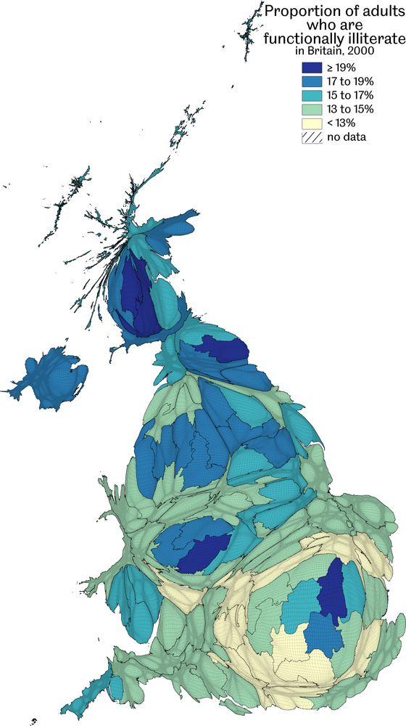
Proportion of adults who are functionally illiterate, 2000
Data source: A component of the UNDP Human Poverty Index, see Appendix in Seymour , J. (for UNED-UK) (2001) Poverty in Plenty: A Human Development Report for the UK. Northern Ireland data from Denny et al (1999) Literacy and Education in Ireland, The Economic and Social Review, 30 (3): 215-226.
Inequality…income, poverty and wealth
Figure 6.7

Slide 9
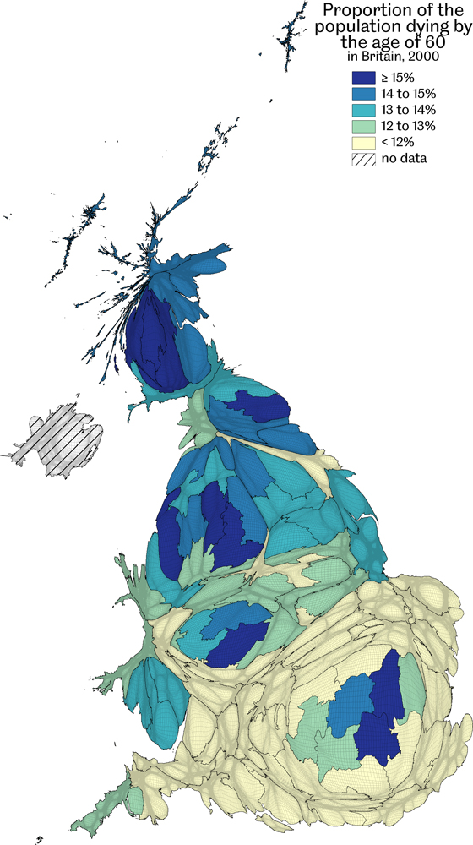
Proportion of the population dying by the age of 60, 2000
Data source: A component of the UNDP Human Poverty Index, see Appendix in Seymour , J. (for UNED-UK) (2001) Poverty in Plenty: A Human Development Report for the UK. Northern Ireland data from Denny et al (1999) Literacy and Education in Ireland, The Economic and Social Review, 30 (3): 215-226.
Inequality…income, poverty and wealth
Figure 6.8

Slide 10
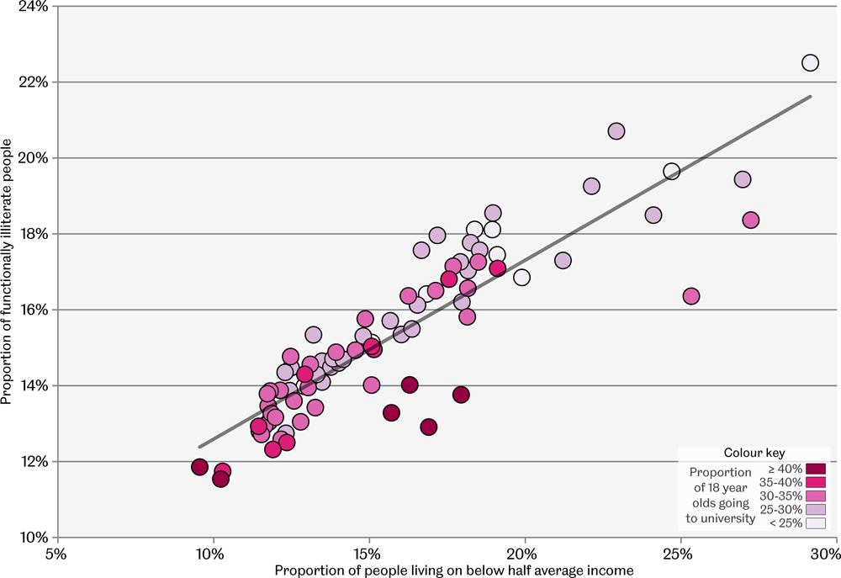
Rates of illiteracy and people living on below half average incomes
Data source: Seymour, J. (for UNED-UK) (2001) Poverty in Plenty: A Human Development Report for the UK London: Earthscan Publications Ltd. (data included in the appendix)
Each point is a 1999 European parliamentary constituency in Britain
Inequality…income, poverty and wealth
Figure 6.9

Slide 11
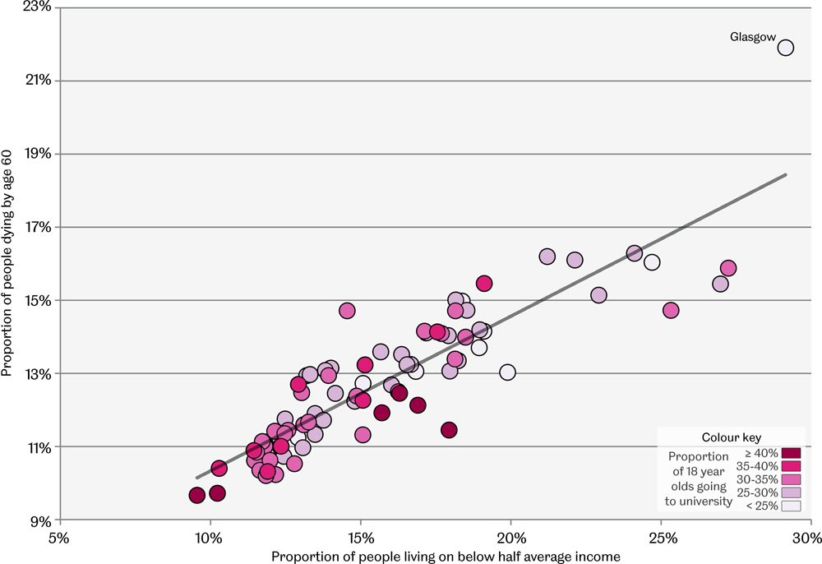
Rates of death and people living on below half average incomes
Data source: Seymour, J. (for UNED-UK) (2001) Poverty in Plenty: A Human Development Report for the UK London: Earthscan Publications Ltd. (data included in the appendix)
Each point is a 1999 European parliamentary constituency in Britain
Inequality…income, poverty and wealth
Figure 6.10

Slide 12
Key Point Summary
• Measured in large areas the share of high earners varies seven-fold, between 8.2% and 1.2%
• The proportion in poverty is as high as 42%, and as low as 18%, between the same areas
• Literacy, numeracy and mortality distributions all closely follow these distributions
Inequality…income, poverty and wealth

