Slide 1
Politics…counting democracy, wasting votes
The Population of the UK
A different view of life in the United Kingdom
by Danny Dorling and Benjamin D. Hennig
Chapter 5

Slide 2
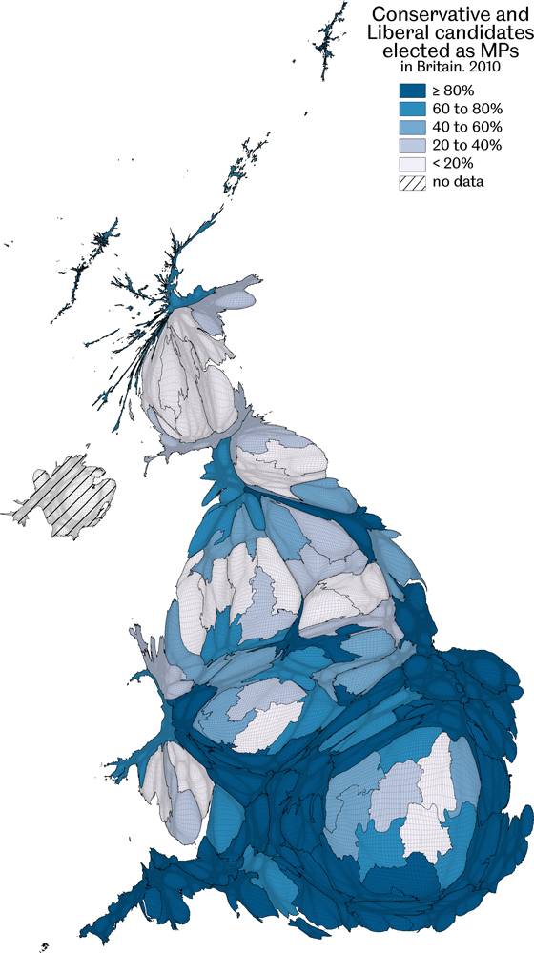
Conservative and Liberal candidates elected as MPs in Britain, 2010
Data source: Analysis of the 2010 general election results, proportion of Conservative and Liberal candidates per European constituency elected to a Westminster constituency
Politics…counting democracy, wasting votes
Figure 5.1

Slide 3
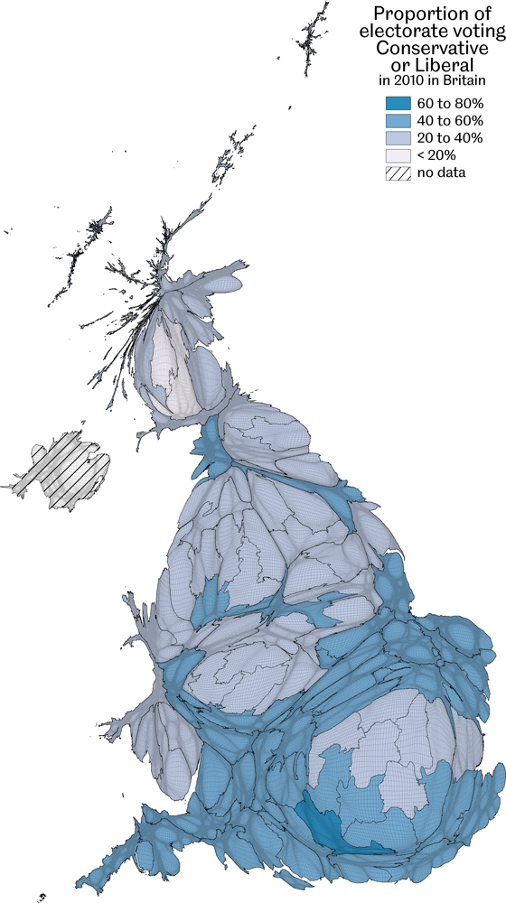
Proportion of electorate voting Conservative or Liberal in Britain, 2010
Data source: Analysis of the 2010 general election results, proportion of Conservative or Liberal votes per European constituency of all people eligible to vote
Politics…counting democracy, wasting votes
Figure 5.2

Slide 4
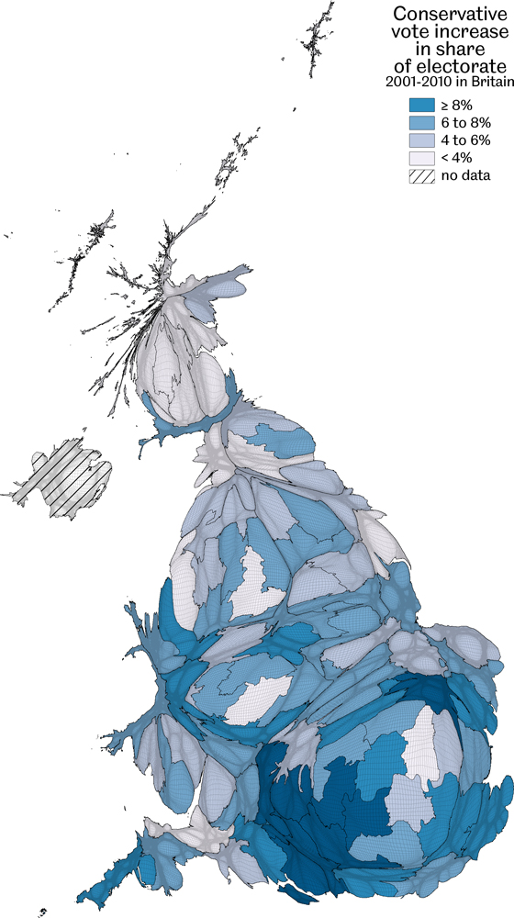
Conservative vote increase in share of electorate in Britain, 2001-2010
Data source: Analysis of the 2001 and 2010 general election results, per European constituency
Politics…counting democracy, wasting votes
Figure 5.3

Slide 5
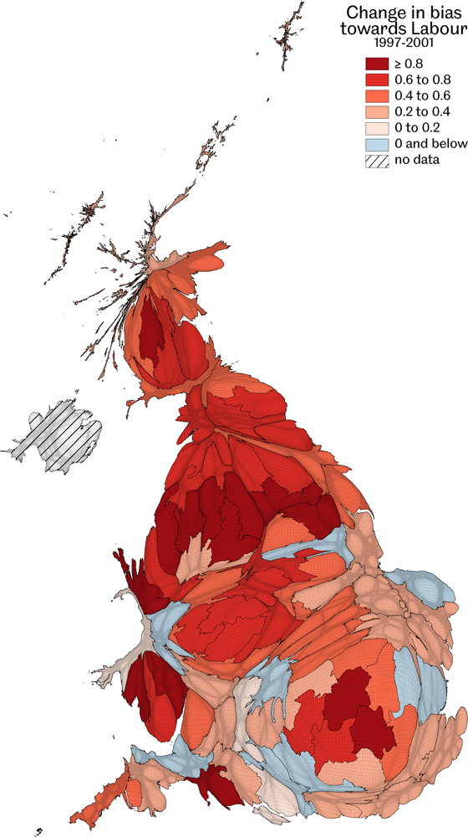
Change in bias towards Labour, 1997-2001
No change is 0 (light blue); a change of 1 implies an extra 1% MPs per 1% vote
Data source: Analysis of the 1997 and 2001 election results
Politics…counting democracy, wasting votes
Figure 5.4

Slide 6
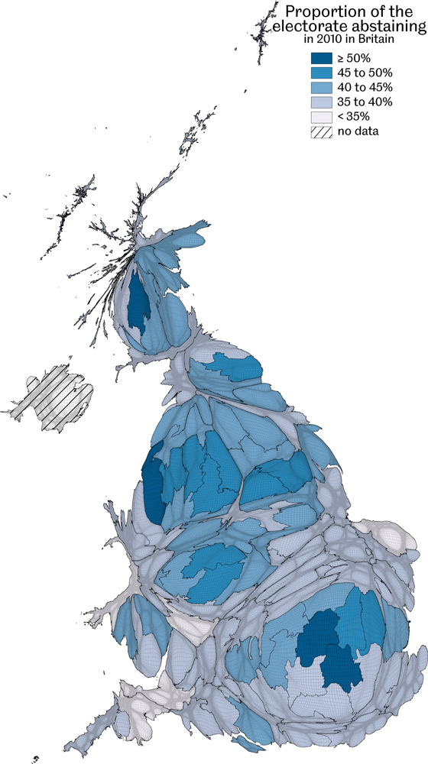
Proportion of the electorate abstaining in Britain, 2010
Data source: Analysis of the 2010 general election results, proportion of Westminster electorate not voting per European constituency
Politics…counting democracy, wasting votes
Figure 5.5

Slide 7
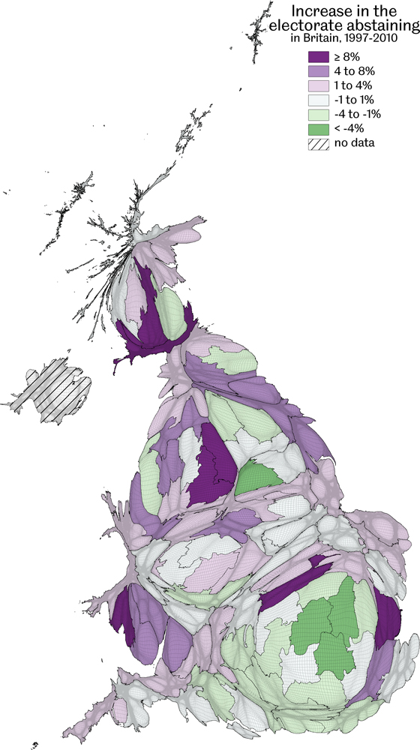
Increase in the electorate abstaining in Britain, 1997-2010
Data source: Analysis of the 1997 and 2010 general election results, rise (and decline) in the proportion of Westminster electorate not voting per European constituency between the elections of 1997 and 2010
Politics…counting democracy, wasting votes
Figure 5.6

Slide 8
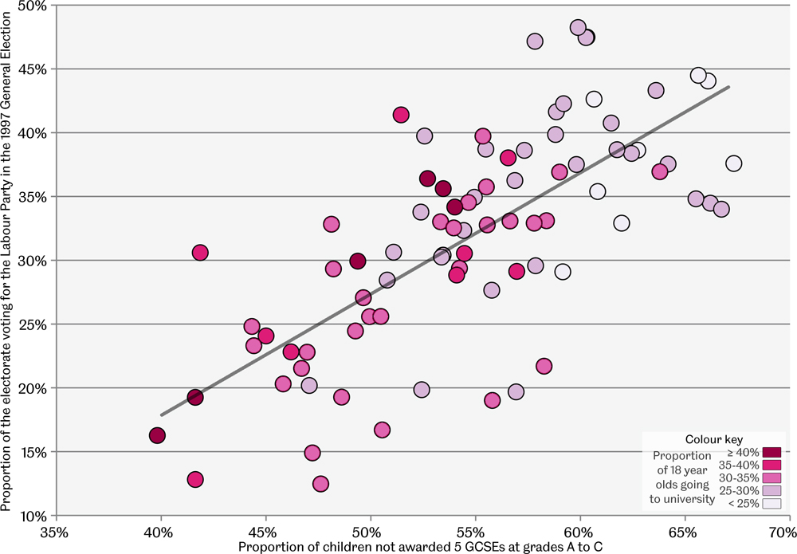
Voting Labour in 1997 versus low qualifications, 1993-99
Each point is a 1999 European parliamentary constituency in Britain
Data source: Analysis of national school league tables for Britain 1993-99; general election data 1997
Politics…counting democracy, wasting votes
Figure 5.7

Slide 9
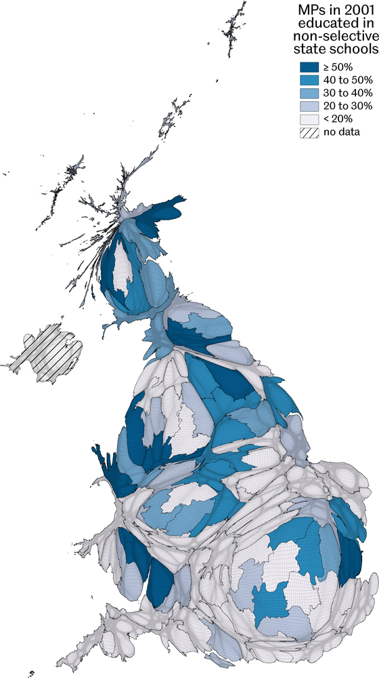
MPs in 2001 educated in non-selective state schools
Figure relies on data of variable quality
Data source: Short bibliographies of MPs and candidates published in various guides to the general election
Politics…counting democracy, wasting votes
Figure 5.8

Slide 10
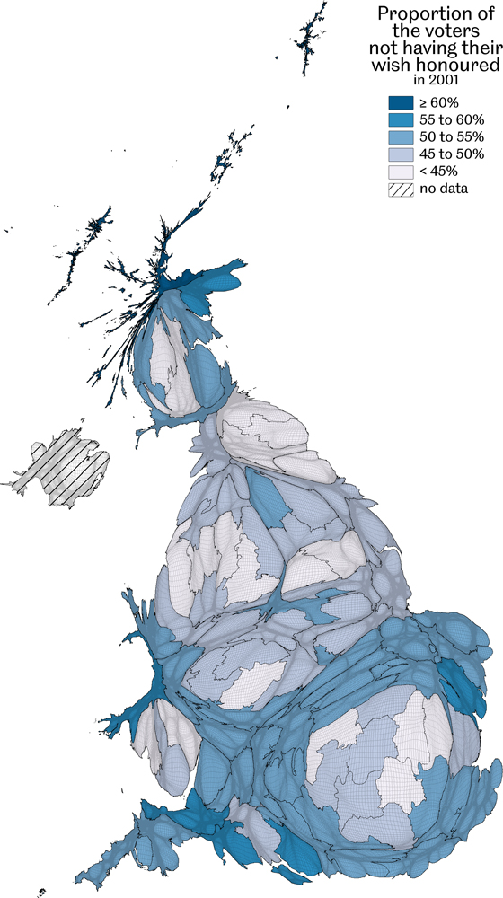
Proportion of the voters not having their wish honoured in 2001
Data source: Analysis of the 2010 general election results, percentage of voters in each area voting for a candidate who did not win a seat in that area
Politics…counting democracy, wasting votes
Figure 5.9

Slide 11
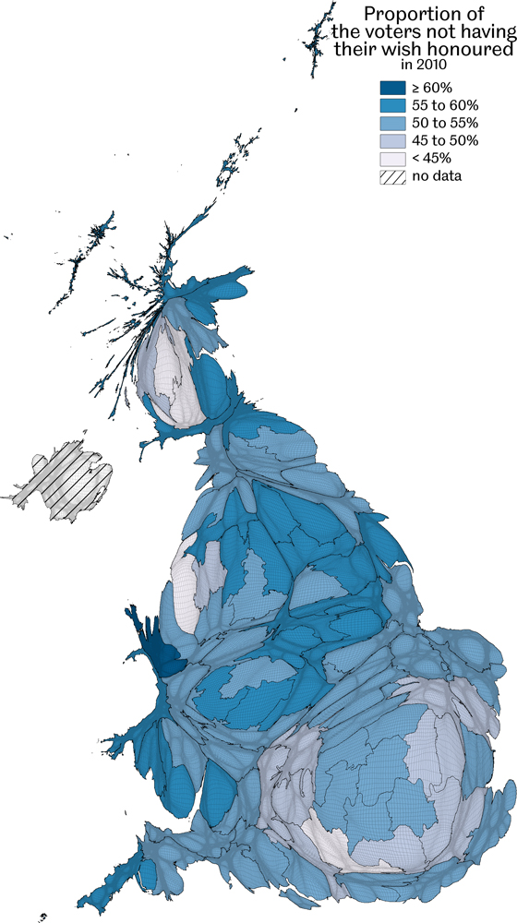
Proportion of the voters not having their wish honoured in 2010
Data source: Analysis of the 2010 general election results by European constituency, percentage of voters in each area voting for a candidate who did not win a seat in that area
Politics…counting democracy, wasting votes
Figure 5.10

Slide 12
Key Point Summary
• There is a very strong geographical pattern to voting in Britain, a clear North-South divide
• The two main political parties secure far more seats than votes due to the voting system
• By 2010 most people who voted in Britain did not get what they voted for
Politics…counting democracy, wasting votes

