Slide 1
Identity …labelling people and places
The Population of the UK
A different view of life in the United Kingdom
by Danny Dorling and Benjamin D. Hennig
Chapter 4

Slide 2
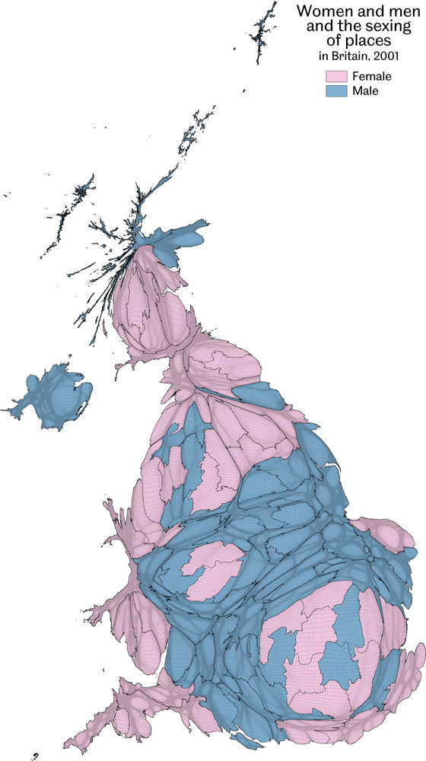
Women & men and the sexing of places
The most unusually large group displayed here is shown when each area is compared with the UK average
Data source: Analysis of the 2001 Census Key Statistics by local authority
Identity…labelling people and places
Figure 4.1

Slide 3
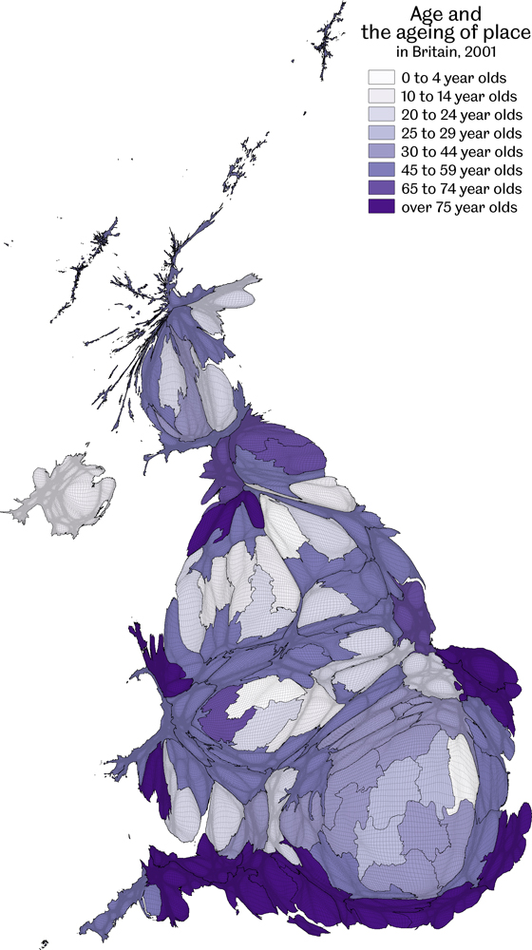
Age and the ageing of place
The most unusually large group displayed here is shown when each area is compared with the UK average
Data source: Analysis of the 2001 Census Key Statistics by local authority
Identity…labelling people and places
Figure 4.2

Slide 4
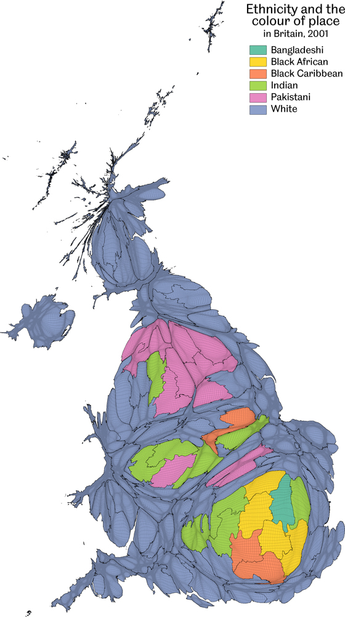
Ethnicity and the colour of place
The most unusually large group displayed here is shown when each area is compared with the UK average
Data source: Analysis of the 2001 Census Key Statistics by local authority
Identity…labelling people and places
Figure 4.3

Slide 5
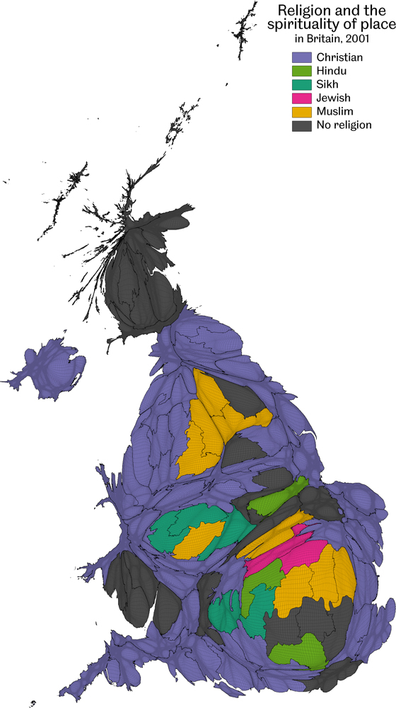
Religion and the spirituality of place
The most unusually large group displayed here is shown when each area is compared with the UK average
Data source: Analysis of the 2001 Census Key Statistics by local authority
Identity…labelling people and places
Figure 4.4

Slide 6
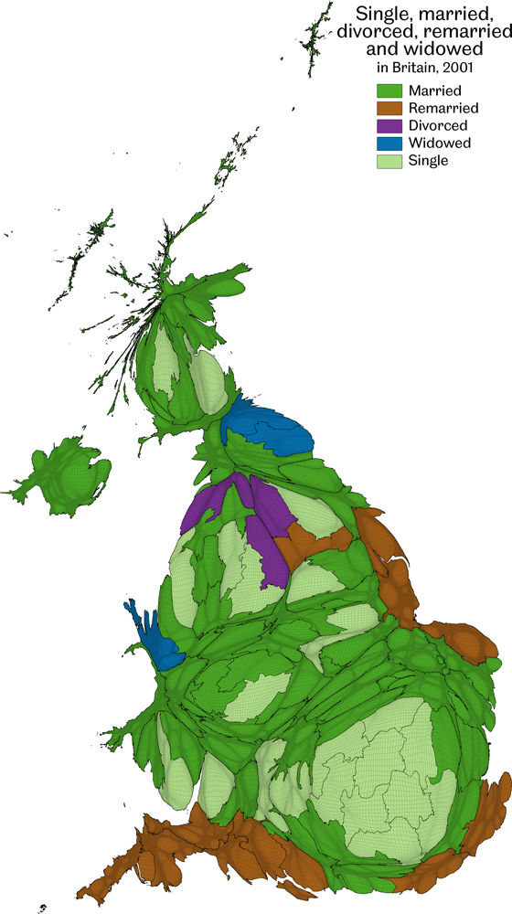
Single, married, divorced, remarried and widowed
The most unusually large group displayed here is shown when each area is compared with the UK average
Data source: Analysis of the 2001 Census Key Statistics by local authority
Identity…labelling people and places
Figure 4.5

Slide 7
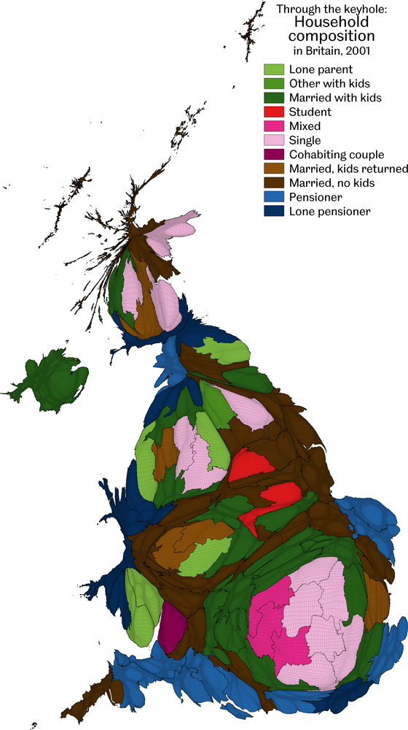
Through the keyhole: Household composition in Britain
The most unusually large group displayed here is shown when each area is compared with the UK average
In the case of conflicts, then the following household types which appear first in this order got priority: Married (with kids), Married (kids returned), Married (no kids), Other (with kids), Lone parent, Cohabiting couple (no kids), Lone pensioner, Lone adult, Student, Pensioner, Mixed
Data source: Analysis of the 2001 Census Key Statistics by local authority
Identity…labelling people and places
Figure 4.6

Slide 8
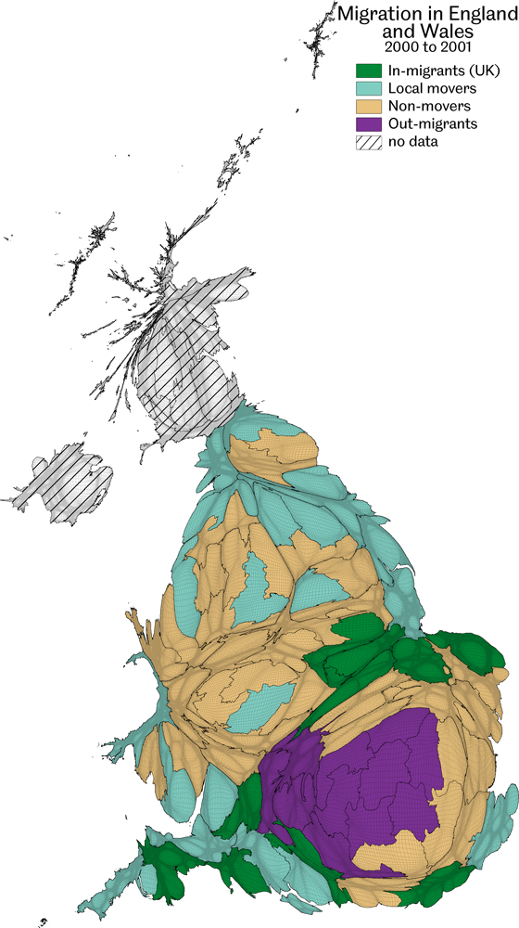
Migration in England and Wales
The most unusually large group displayed here is shown when each area is compared with the England and Wales average
Data source: Analysis of the 2001 Census Key Statistics by local authority
Identity…labelling people and places
Figure 4.7

Slide 9
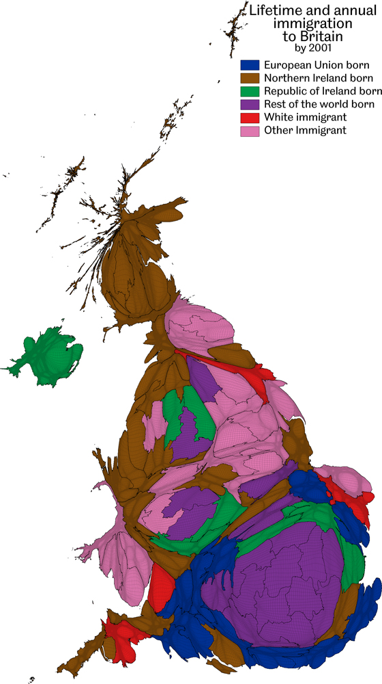
Lifetime and annual immigration
The most unusually large group displayed here is shown when each area is compared with the UK average
Data by 2001; all immigrants since 2000 are labelled either White or Other Immigrant
Data source: Analysis of the 2001 Census Key Statistics by local authority
Identity…labelling people and places
Figure 4.8

Slide 10
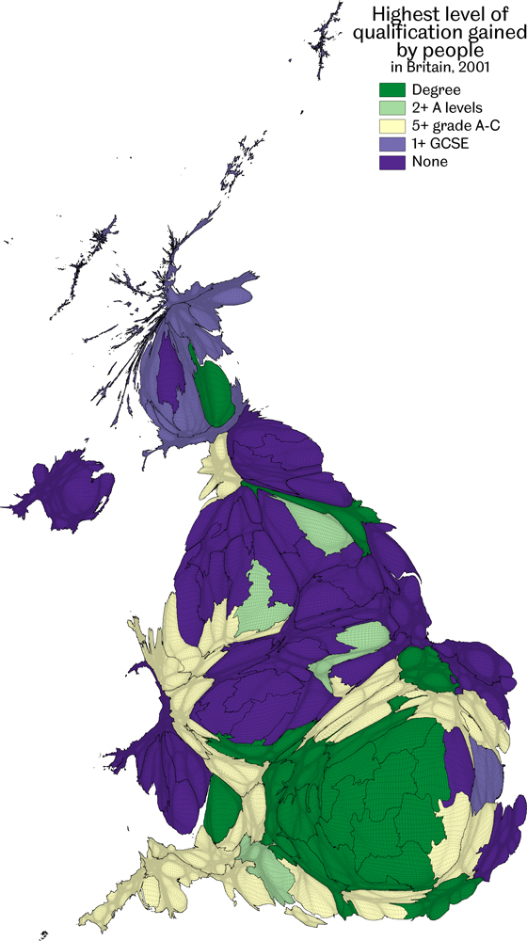
Highest level of qualification gained by people
The most unusually large group displayed here is shown when each area is compared with the UK average
Data source: Analysis of the 2001 Census Key Statistics by local authority
Identity…labelling people and places
Figure 4.9

Slide 11
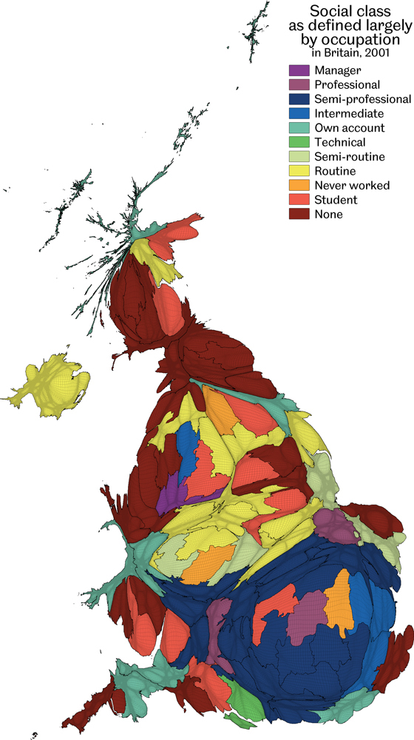
Social class as defined largely by occupation
The most unusually large group displayed here is shown when each area is compared with the UK average
Data source: Analysis of the 2001 Census Key Statistics by local authority
Identity…labelling people and places
Figure 4.10

Slide 12
Key Point Summary
• Different areas of the UK can be typified as having particular groupings of people
• The elderly move towards the edges, people with qualifications tend to drift south
• The labelling of areas can both helpfully illuminate and harmfully stereotype
Identity…labelling people and places

