Slide 1
Maps…a different view of the United Kingdom
The Population of the UK
A different view of life in the United Kingdom
by Danny Dorling and Benjamin D. Hennig
Chapter 1

Slide 2
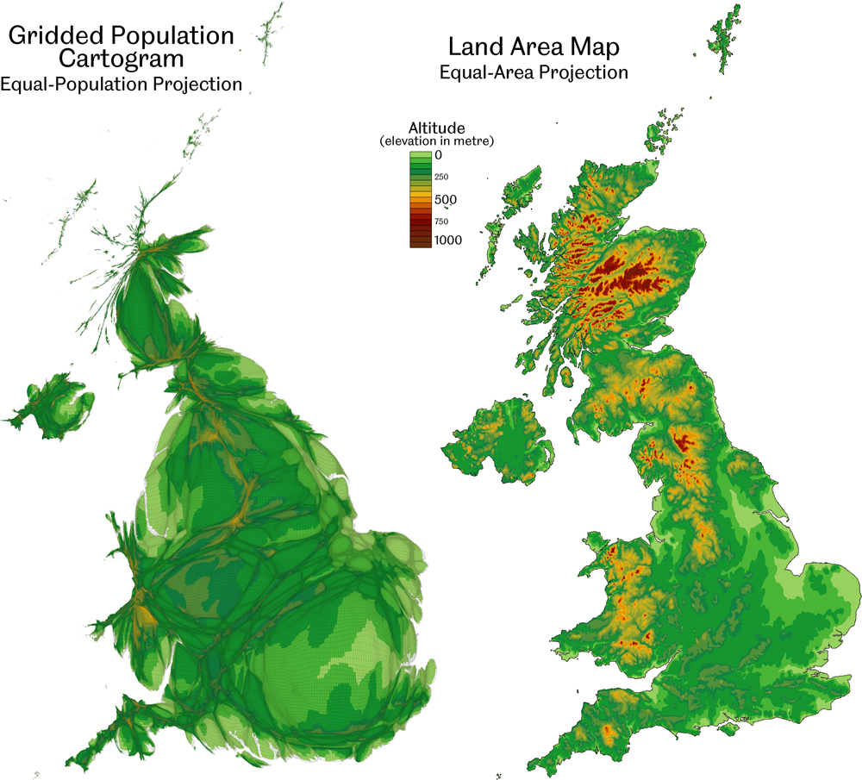
People and Land in the United Kingdom
Data source: Population: SEDAC Columbia University (2010); Topography: U.S. Geological Survey (2011)
The cartogram gives every person the same amount of space. Each grid cell on the cartogram relates to an equal-sized grid cell on the land area map. In the cartogram, each grid cell is resized according to the number of people living in that space.
Maps…a different view of the United Kingdom
Figure 1.1

Slide 3
The Constituencies that never were
Data source: European Constituencies obtained from the House of Commons Research Paper 98/102
Major UK cities and the 1999 UK European Constituencies projected on a gridded population cartogram
Maps…a different view of the United Kingdom
Figure 1.2

Slide 4
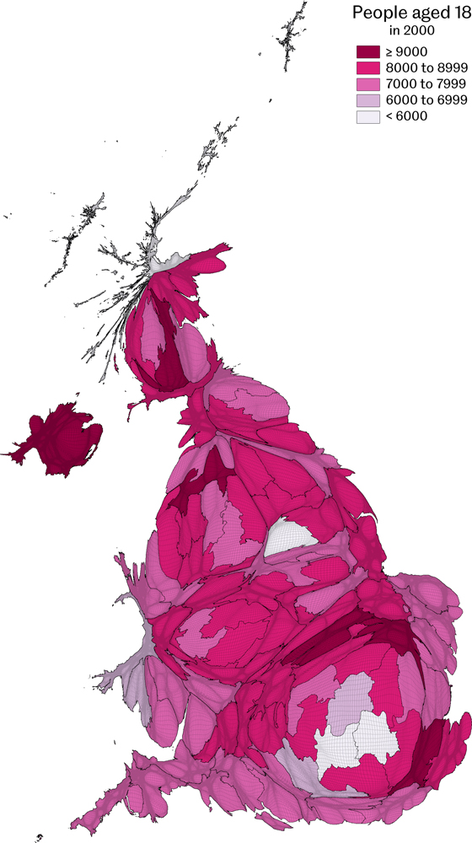
People aged 18
Counts by European Constituency area for the year 2000
Data source: Estimated from school rolls of 15 year olds in 1997 and 2000 mid-year estimate for Northern Ireland
Maps…a different view of the United Kingdom
Figure 1.3

Slide 5
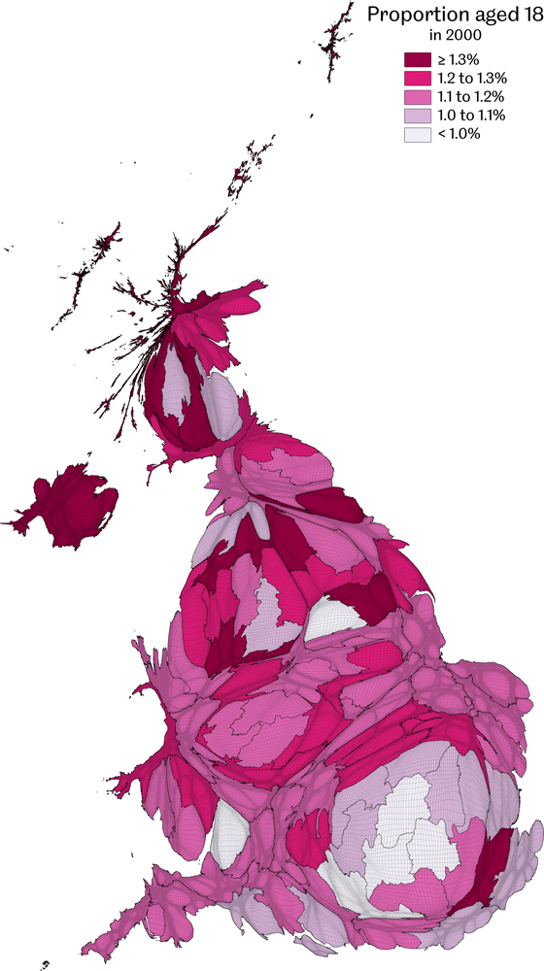
Proportion of people aged 18
Counts by European Constituency area for the year 2000
Data source: Estimated from school rolls of 15 year olds in 1997 and 2000 mid-year estimate for Northern Ireland
Maps…a different view of the United Kingdom
Figure 1.4

Slide 6
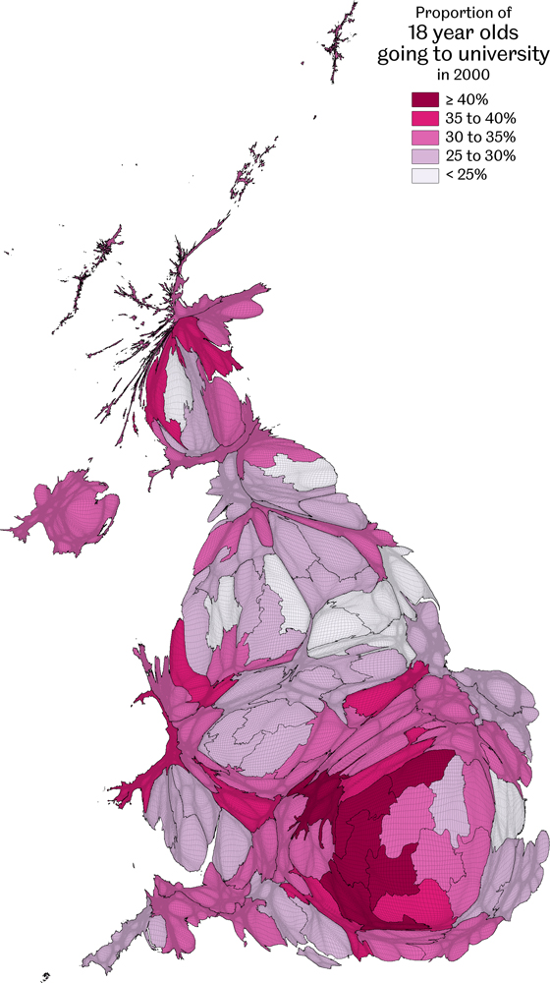
Proportion of 18 year olds going to university
Data for the year 2000
Data source: Successful UCAS under age 21 applicants from National Statistics website and estimated for Scotland and Northern Ireland
Maps…a different view of the United Kingdom
Figure 1.5

Slide 7
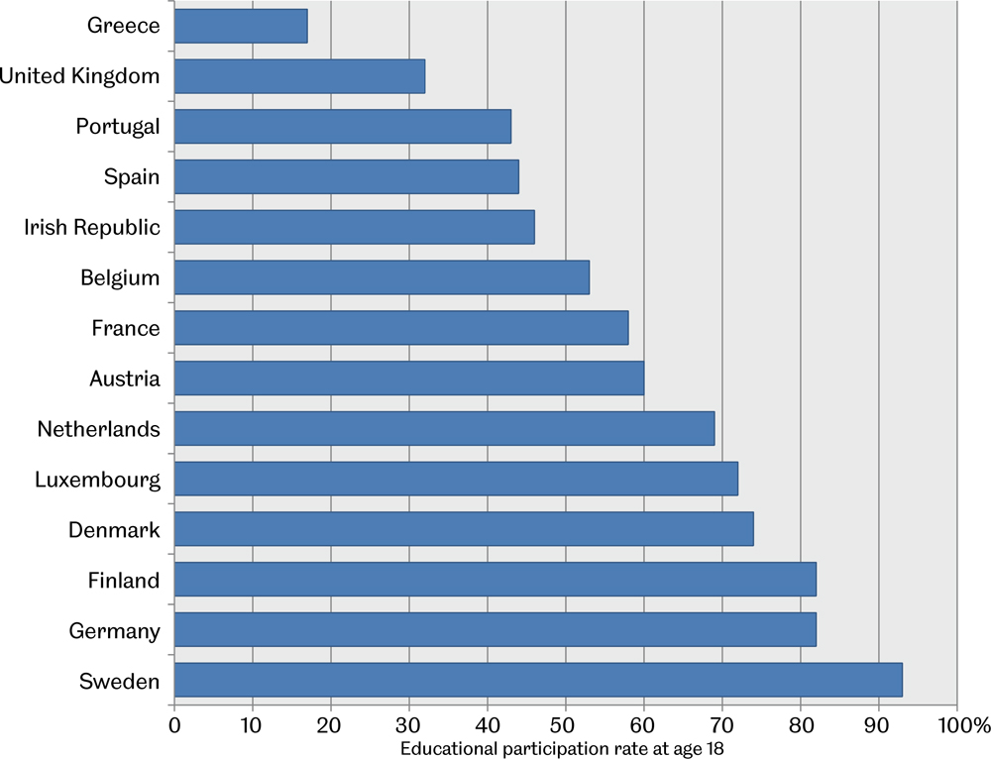
Educational participation rates at age 18
Data given for selected Western European countries
Data source: Full-time participation in secondary education at age 18 in 1996, Social Trends 30
Maps…a different view of the United Kingdom
Figure 1.6

Slide 8
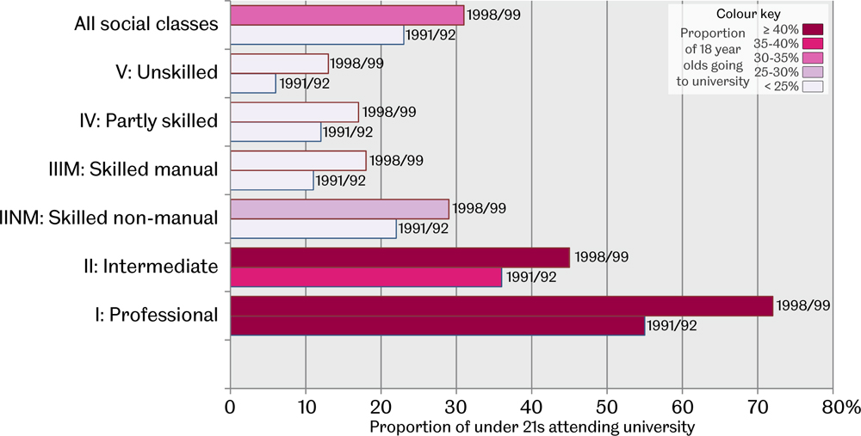
People under 21 attending university by social class
The six social classes shown above are based on the occupations of the parents of those young adults whose chances are being depicted – Data source: Social Trends 30, data from the National Statistics website (for GB)
Maps…a different view of the United Kingdom
Figure 1.7

Slide 9
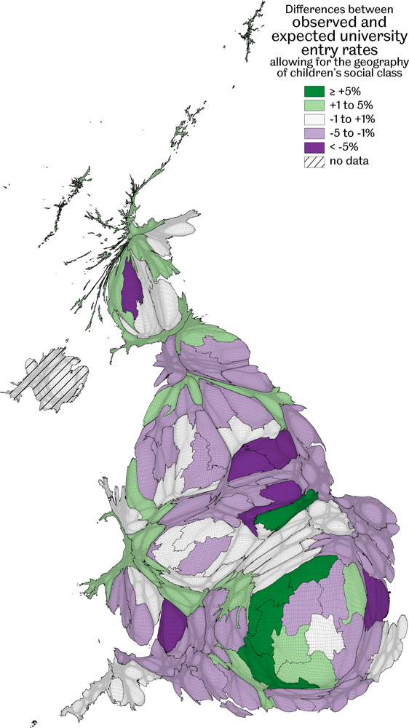
Differences between observed and expected university entry rates
Allowing for the geography of children’s social class; Northern Ireland is excluded as no comparable census data was available
Data source: Successful UCCAs under age 21 applicants from National Statistics website
Maps…a different view of the United Kingdom
Figure 1.8

Slide 10
Key Point Summary
• It is helpful to look at the population of the UK with a map based on that that population
• Life chances can be shown on such a map, such as the chance of going to university
• Such chances alter over time, across space and are often influenced by social class
Maps…a different view of the United Kingdom

