Slide 1
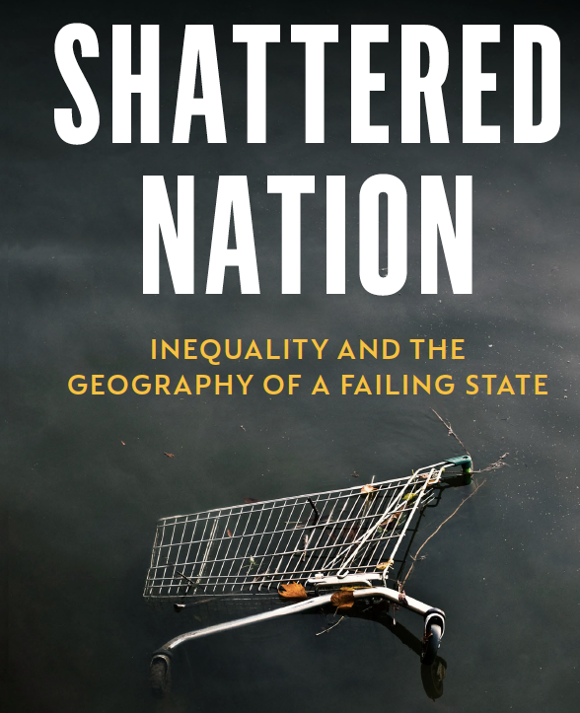

Slide 2
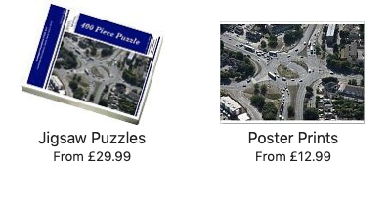
Memories are a marketing opportunity
1.
The Roundabout
Source: https://www.mediastorehouse.com/
historic-england/flight/england-air/headington-roundabout-27840-014-11635856.html

Slide 3
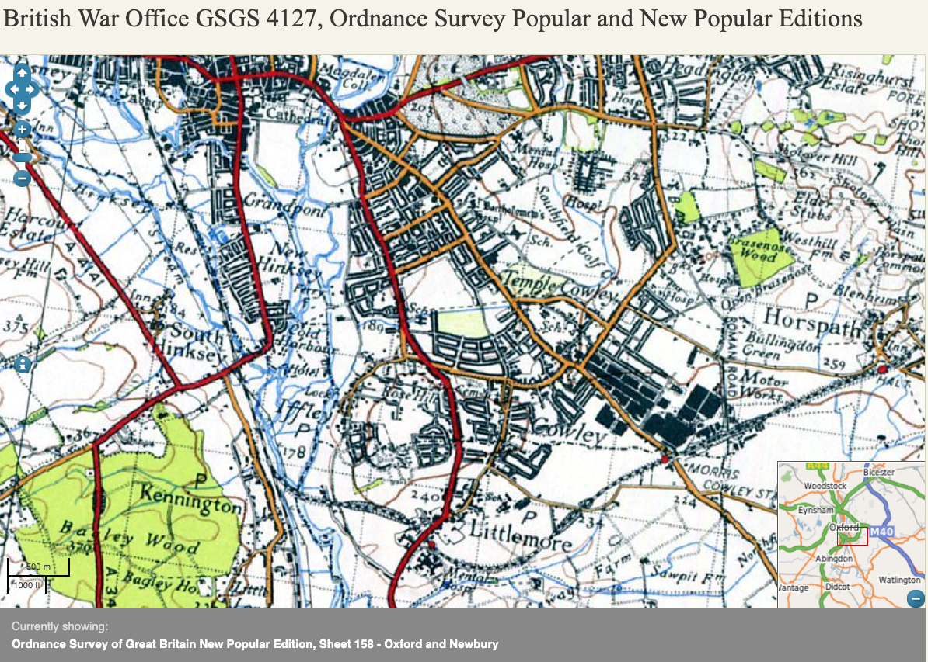
For the first few years of my life, I lived in a house on a road between a cemetery and a shopping centre.
Oxford & Cowley, mapped between 1916 and 1941 Source: www.visionof britain.org.uk/maps/

Slide 4
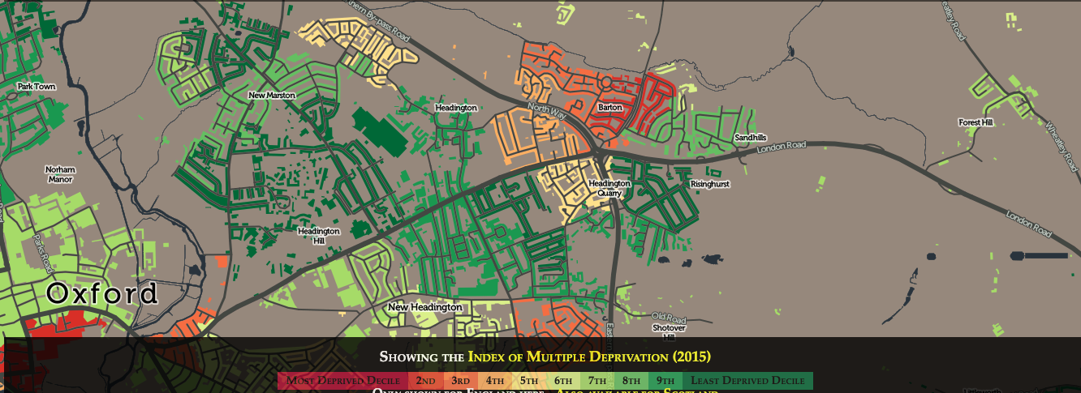
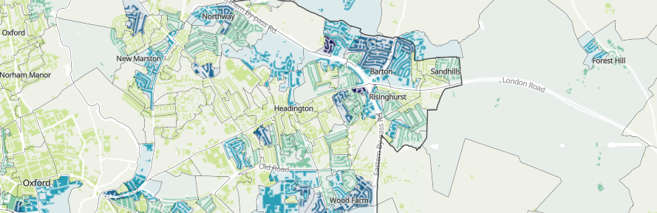

In the 1970s, which neighbourhood a child lived in mattered far less for their life chances, and which local school you went to was less important.
Two deprivation maps, centred on the Green Road Roundabout (Oxford) in 2015 and 2021
Sources https://vis.oobrien.com/booth/
and https://www.ons.gov.uk/census/maps/
choropleth/population/household-deprivation

Slide 5
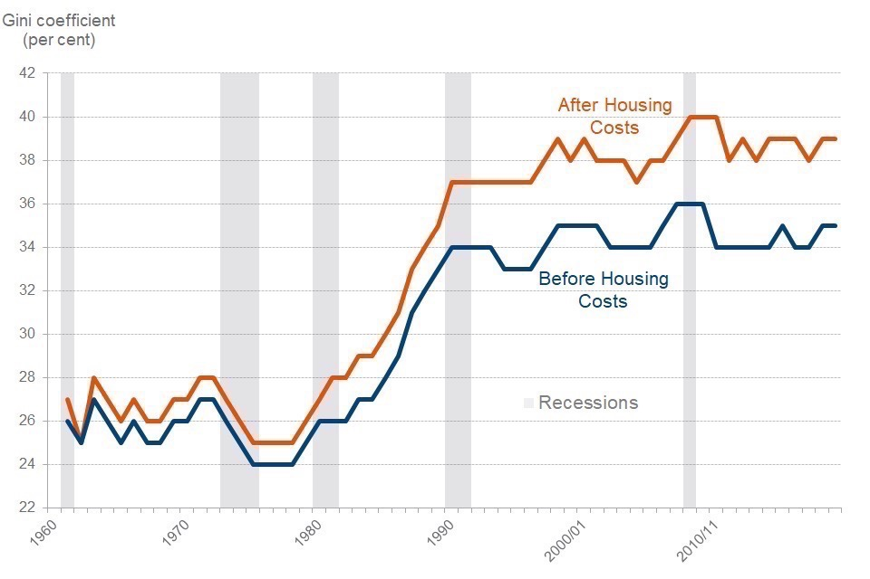
Income Inequality 1961-2020, Great Britain
Source: DWP (government) & IFS (Institute for Fiscal Studies) Households below average income: an analysis of the income distribution FYE 1995 to FYE 2020: Section 11 Long-term Trends (data prior to FYE 1995 are not National Statistics).
Published: 25 March 2021
https://www.gov.uk/government/statistics/households-below-average-income-for-financial-years-ending-1995-to-2020/households-below-average-income-an-analysis-of-the-income-distribution-fye-1995-to-fye-2020

Slide 6
Income Inequality 1961-2020, Great Britain
Source: IFS (2022) Living standards, poverty and inequality in the UK, 14 July
https://ifs.org.uk/living-standards-poverty-and-inequality-uk

Slide 7
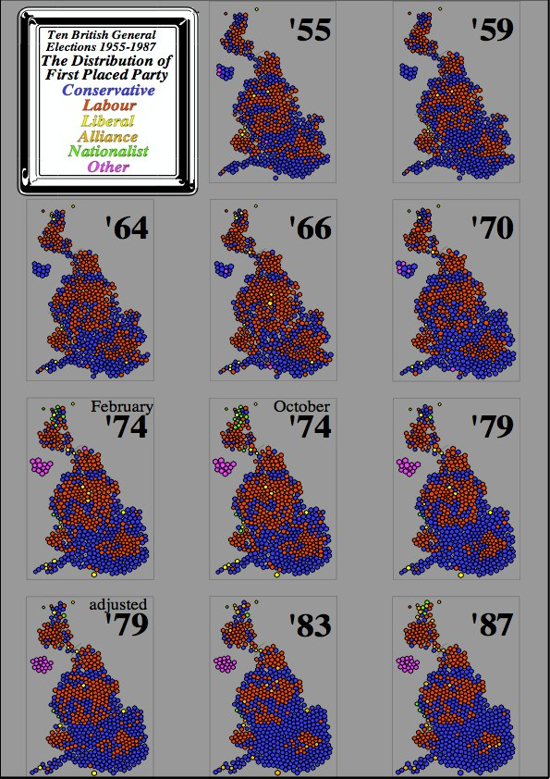
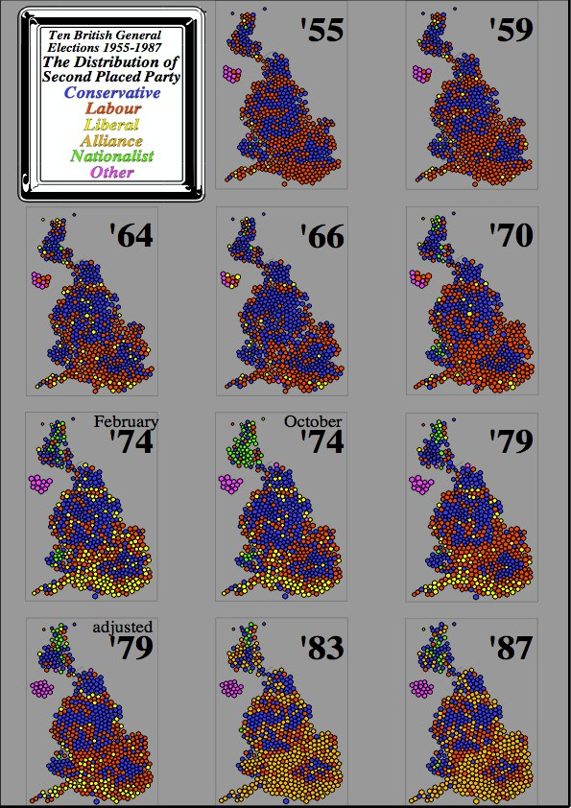
There were two general elections in 1974. These were becoming turbulent times…
Source: https://www.dannydorling.org/books/visualisation/Graphics/Pages/Figures.html#110
Source: https://www.dannydorling.org/books/visualisation/Graphics/Pages/Figures.html#111

Slide 8
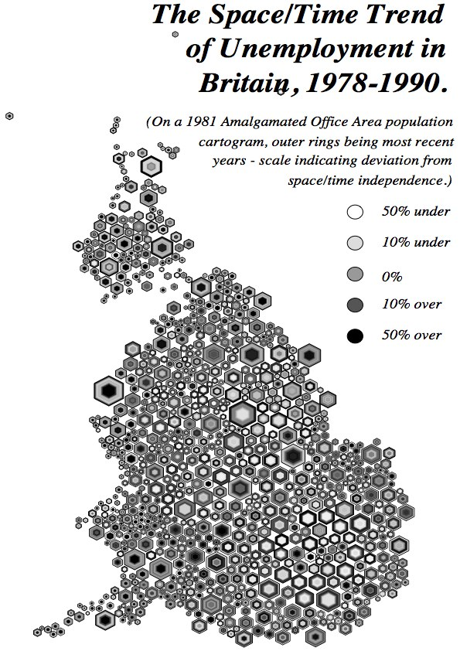
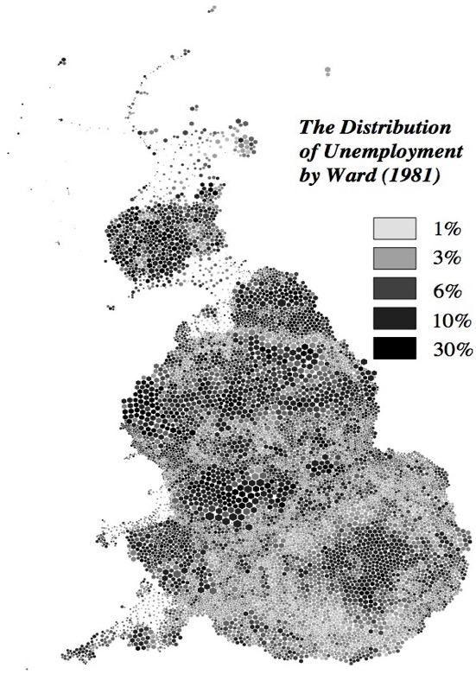
On the Clyde and on the Tyne, people were losing their jobs. But the car factories in the city of Oxford were still employing thousands.
Source: https://www.dannydorling.org/books/visualisation/Graphics/Pages/Figures.html#16

Slide 9
Economic inequality is currently falling in most countries worldwide, including across Europe, where it tends to be lowest already.
Source: OECD estimates of income inequality as of March 2023:
https://data.oecd.org/inequality/income-inequality.htm

Slide 10
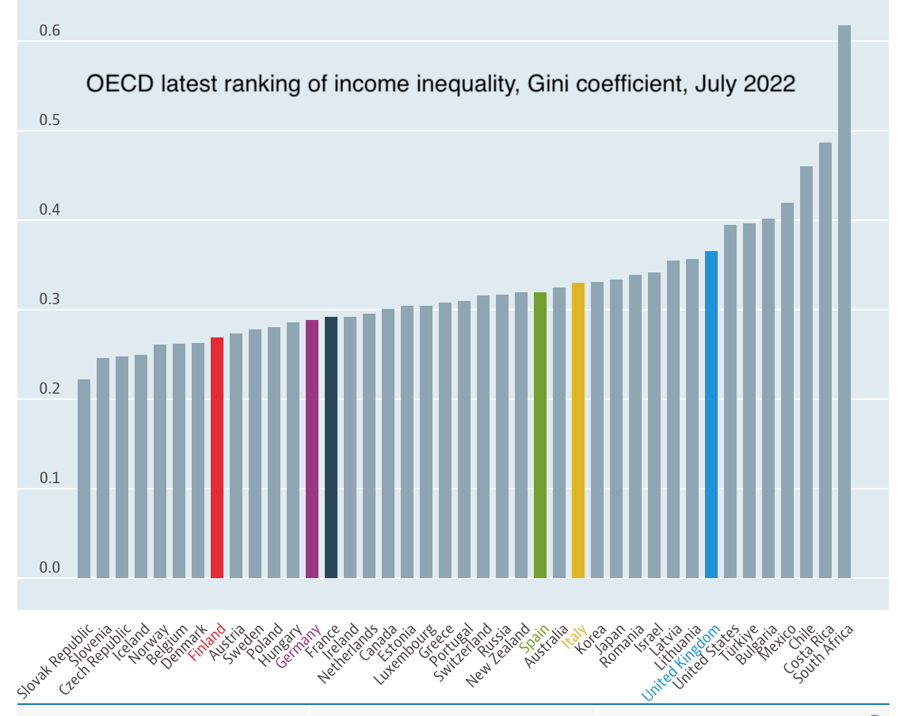
France and Germany became ‘income inequality neighbours’ in July 2022.
Source: Danny Dorling (2022)
A letter from Helsinki, Public Sector Focus, August

Slide 11
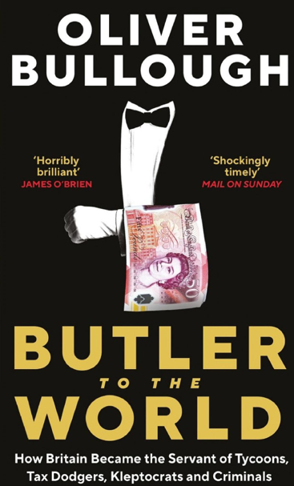
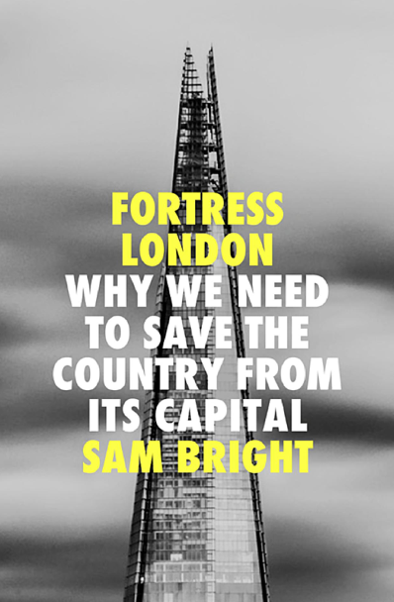

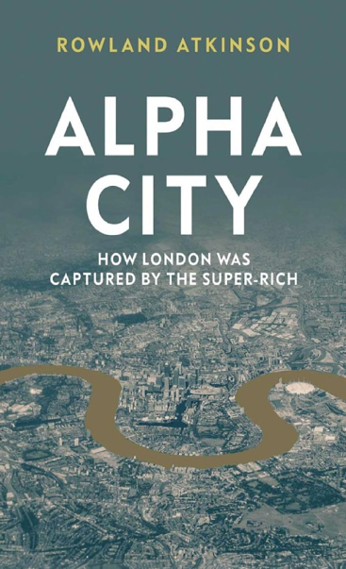
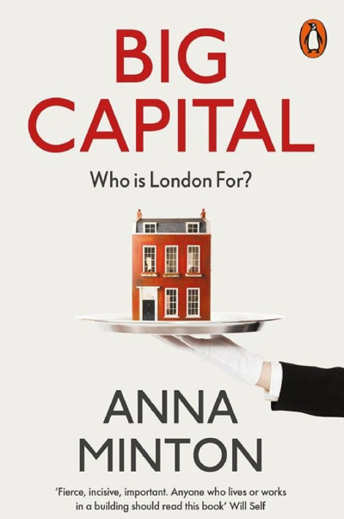
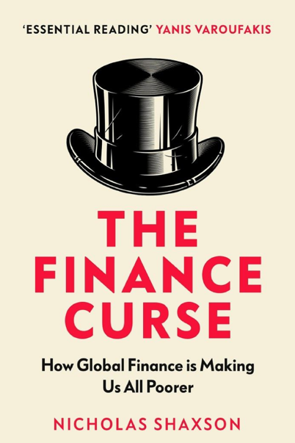
Dozens of recent books examine London and the UK’s financial services industry.

Slide 12
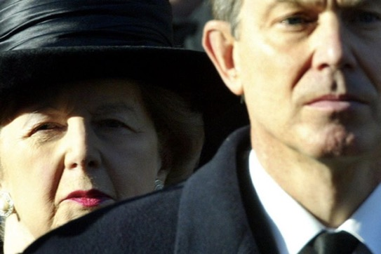
Income Inequality, 1994-2021/22, UK
At a private dinner in Hampshire in 2002, Margaret Thatcher was asked what her greatest achievement had been. She replied:
‘Tony Blair and New Labour. We forced our opponents to change their minds.’
Photo Andrew Parsons/PA wire
Source: https://www.belfasttelegraph.co.uk/news/uk/the-thatcher-years-that-transformed-britain/29181701.html
Source: DWP: Households Below Average Income (HBAI), data release of 23 March 2023

Slide 13
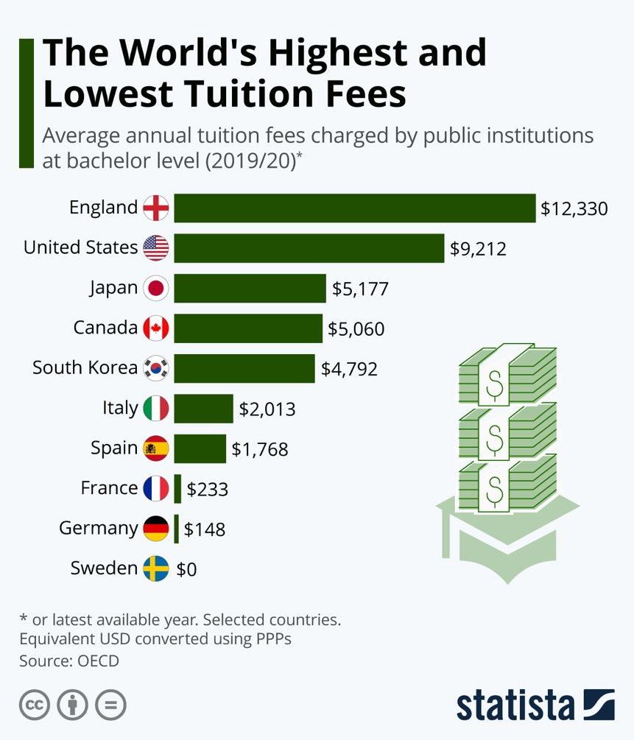
There were no tuition fees for full-time students in the UK from 1962–1998.
New Labour introduced tuition
fees of £1,000 a year
in 1998, increasing them to £3,000 in 2004 (they rose
later in Wales, and
not as high).
In England fees then rose to £9,000
in 2012, and £9,250 in 2017. In January 2023 they were frozen at £9,250 for two years.
In Scotland tuition fees are zero (for Scots).
Sources: Martin Armstrong (2022) The World's Highest and Lowest Tuition Fees, Statista, September 17th, https://www.statista.com/chart/11058/bachelor-tuition-fees-international-comparison/ and https://www.bbc.co.uk/news/education-64236906

Slide 14
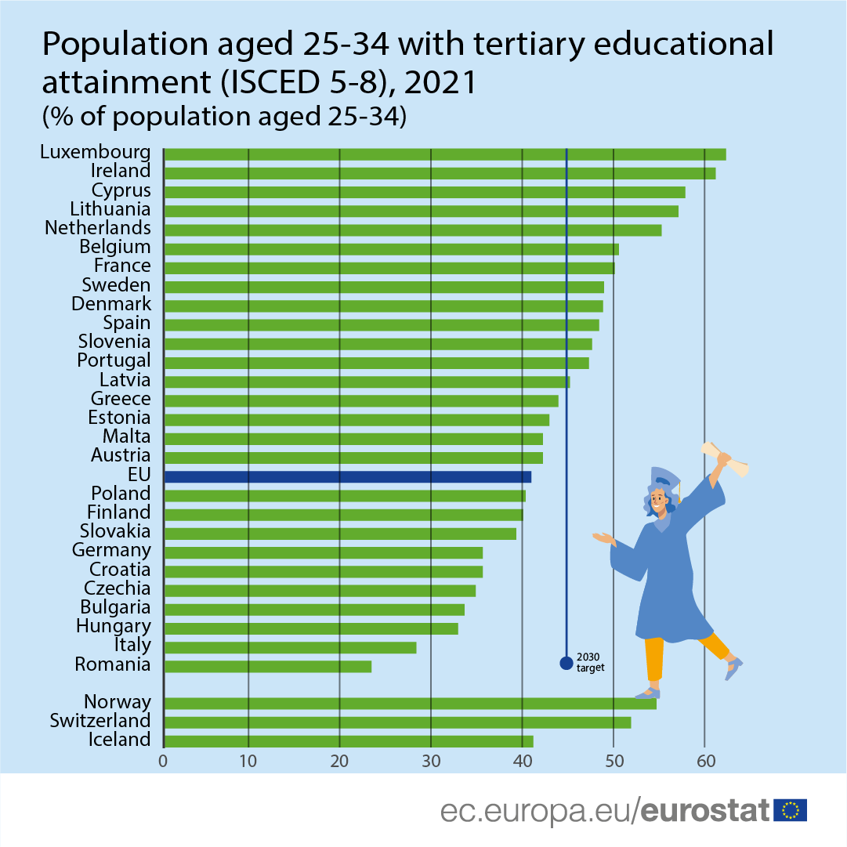
In 2021, 57% of young people in the UK had been to university by the age of 34, but the proportion is rising as births fall everywhere – worldwide.
In some of the world’s wealthiest countries, the majority of young people attend university:
USA: 51% Russia: 62% Ireland: 63% Japan: 65% Canada: 66% Korea: 69%
Sources: https://ec.europa.eu/eurostat/web/products-eurostat-news/-/ddn-20220524-2
and https://data.oecd.org/eduatt/population-with-tertiary-education.htm

Slide 15
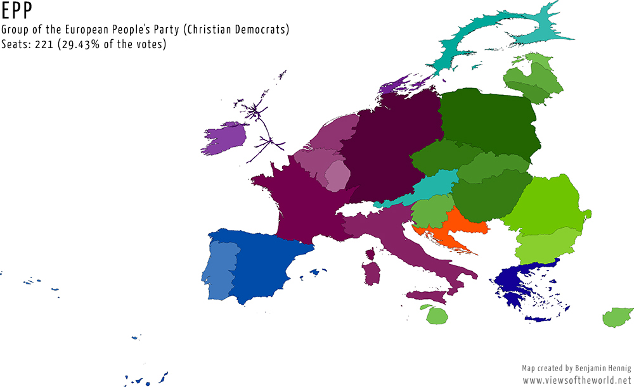
The British Conservative party left the main right-wing group in the European Parliament in 2014, to align with the far-right group instead.
This is a map of Europe with the areas of countries drawn in proportion to how many votes European Conservatives received in 2014.
Hennig, B. D., Ballas, D. and Dorling, D. (2014).
In Focus: European Parliament elections 2014. Political Insight 5 (2): 20-21.
Source: https://www.viewsoftheworld.net/?p=4133

Slide 16
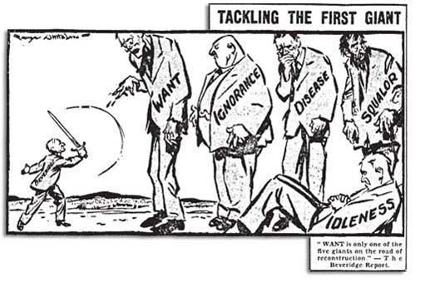
Britain’s ‘giant evils’ have changed shape since the Beveridge Report in 1942. The new evils are related, but different.
Five new social evils in 2023
want → hunger
squalor → precarity
idleness → waste
ignorance → exploitation
disease → fear
Source:
https://social-policy.org.uk/50-for-50/no-43-giant-corporations/

Slide 17
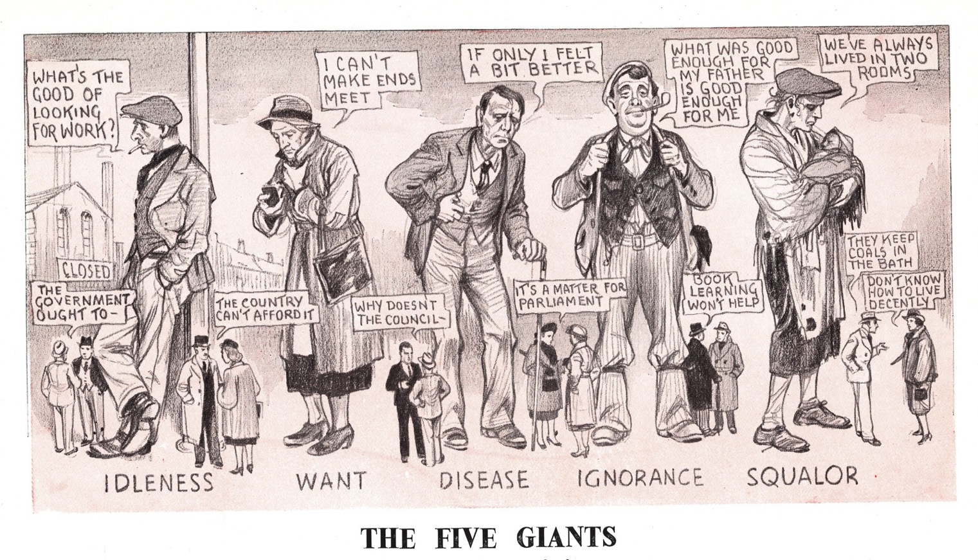
‘Whataboutery’, or reasons for not acting
When a state begins to fail, attempts are often made to suggest that claims of its shattering are exaggerations. Typically, a list of apparent problems faced by other countries will be produced whenever their people are said to be doing better than the British: ‘What about suicide rates in Finland?’, ‘What about Germany’s reliance on Russian gas?’, ‘What about the rise in “populism” in the US, Brazil, Hungary, Turkey and Russia?’ This response is so common that it now has its own label: ‘whataboutery’.
Source: https://mylearning.org/resources/
the-five-giants-cartoon

Slide 18
UK public sector workers
People working for the public good in plummeted from 23% of all those in work in the UK in 1992 to just 17% of the much larger total national workforce today.
Source: https://flickread.com/edition/html/index.php?pdf=60db33a51b897#19

Slide 19
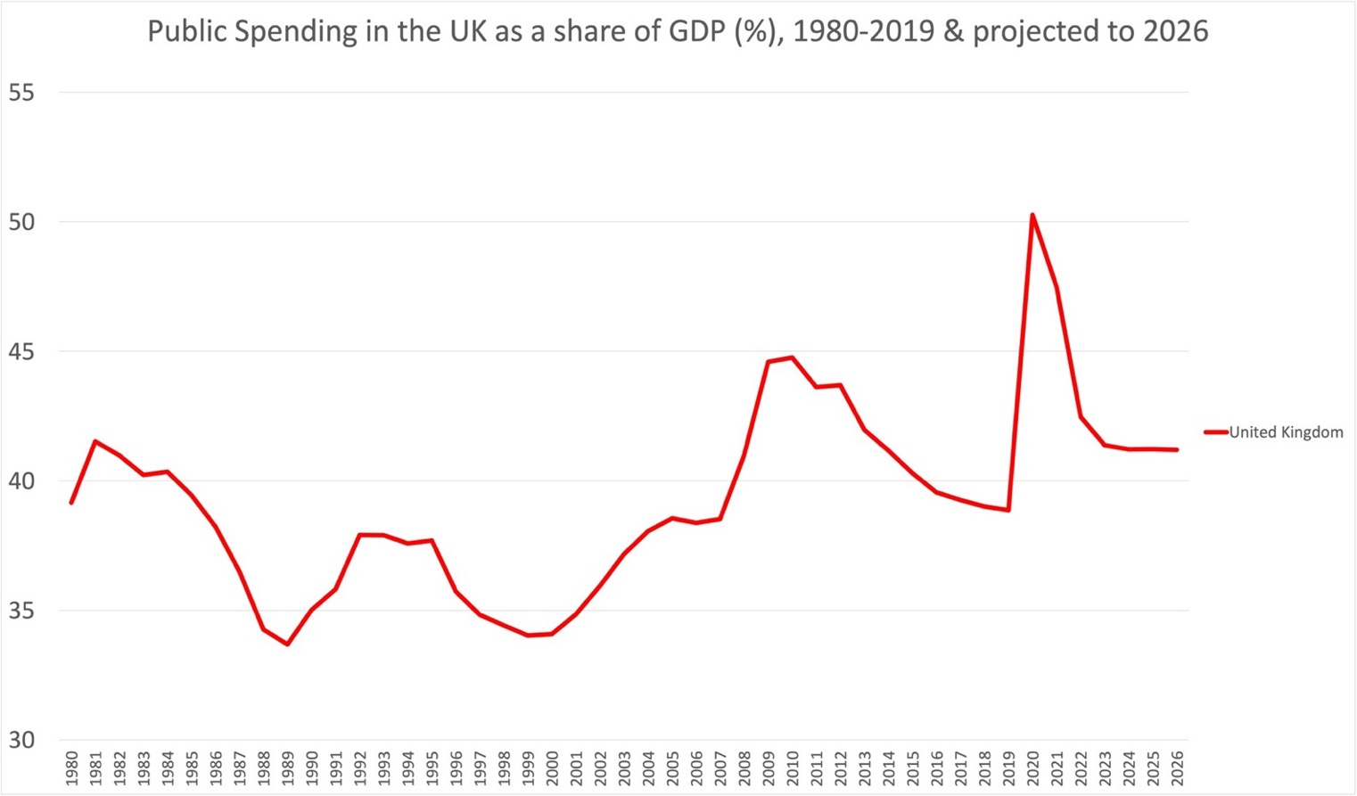
A country’s spending statistics are collated by the International Monetary Fund (IMF), including what countries plan to spend in the future.
Source – IMF statistics. Note this does not include actual 2020 and 2021 spending, which will have been higher (not in the IMF figures of 2021)
http://www.dannydorling.org/?p=8353
The current UK government has said it intends to spend less than almost everywhere else in Europe, even though it will allocate a higher share of its public monies to its military than any other Western European country, and a huge amount to its debt repayments.

Slide 20
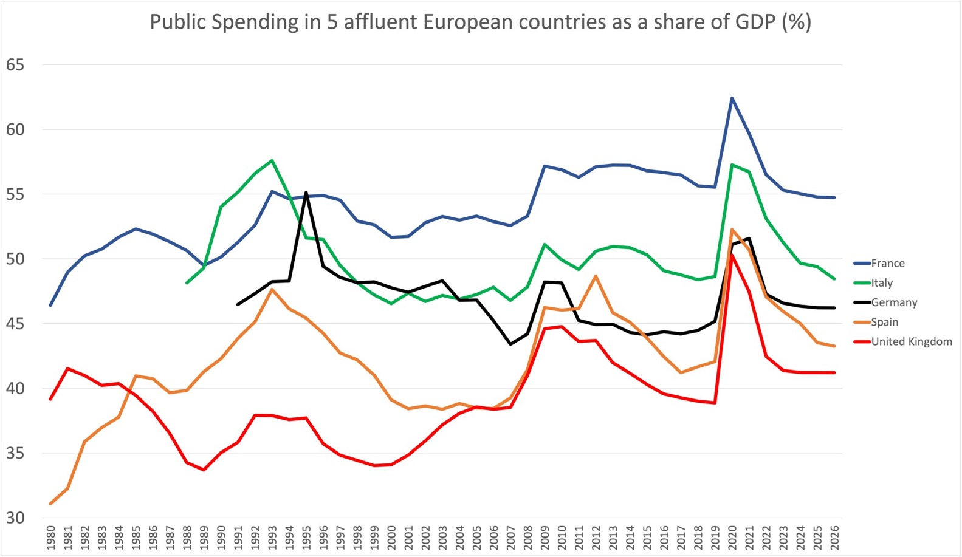
Public spending tends to rise over time as the population ages. But the gap between France and the UK is enormous in size and implications.
Source – IMF statistics. Note this does not include actual 2020 and 2021 spending, which will have been higher (not in the IMF figures of 2021)
http://www.dannydorling.org/?p=8353
UK public spending as a proportion of GDP has now fallen so far it is below that of Spain in the 1980s, and that of Greece in the 1990s. It was already lower than almost every other Western European nation following the cuts that began in the late 1970s.

Slide 21
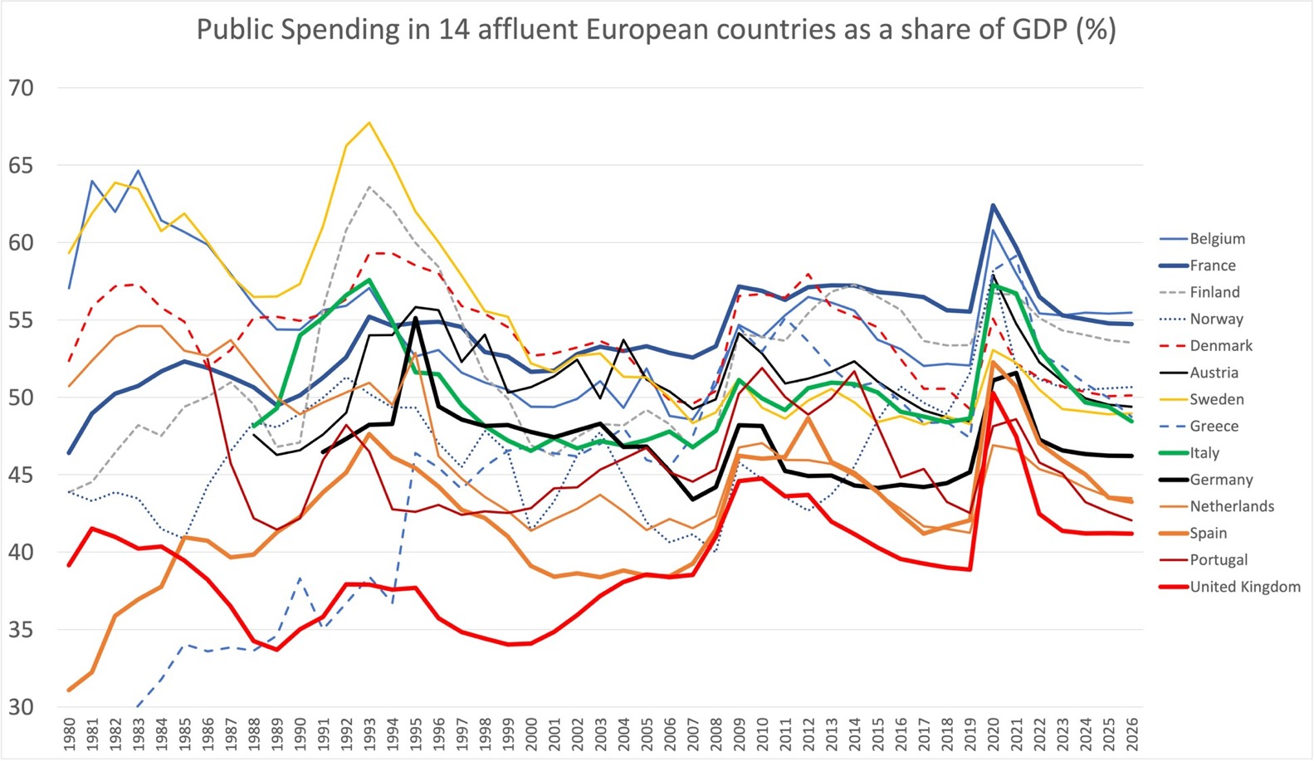
In 2023 France and Belgium will spend 55% of their GDP on public services, followed in descending order by Finland, Greece, Austria…
(Note that Spain and Greece had unusual governments in the distant past, and Ireland is not included here)
Source – IMF statistics. Note this does not include actual 2020 and 2021 spending, which will have been higher (not in the IMF figures of 2021)
http://www.dannydorling.org/?p=8353
…Denmark, Norway, Sweden, Germany and Spain, and finally both Portugal and the Netherlands at 45%, with the UK at only 41%. This is two percentage points higher than the 39% spent in 2019, reflecting the rising costs of debt repayment and a further increase in military spending.

Slide 22
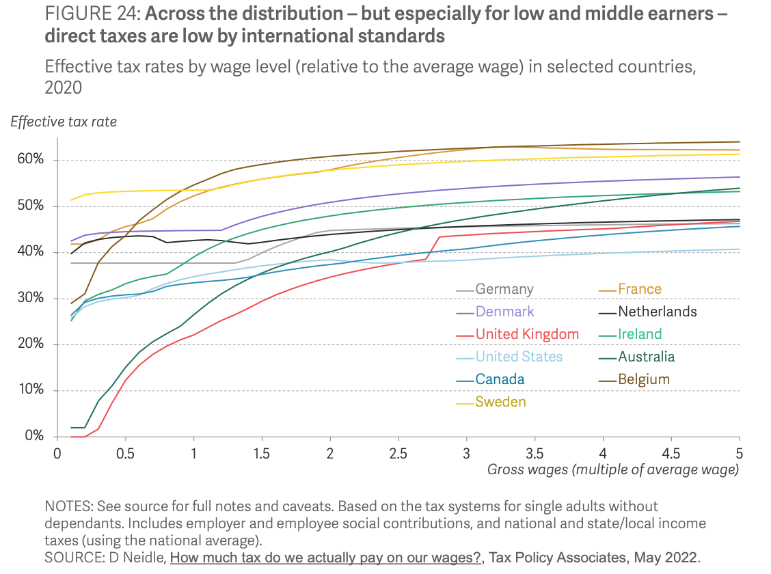
‘Tax policy choices help determine levels of inequality’ – Resolution Foundation, 2022.
Source: https://www.resolutionfoundation.org/publications/the-living-standards-audit-2022/

Slide 23
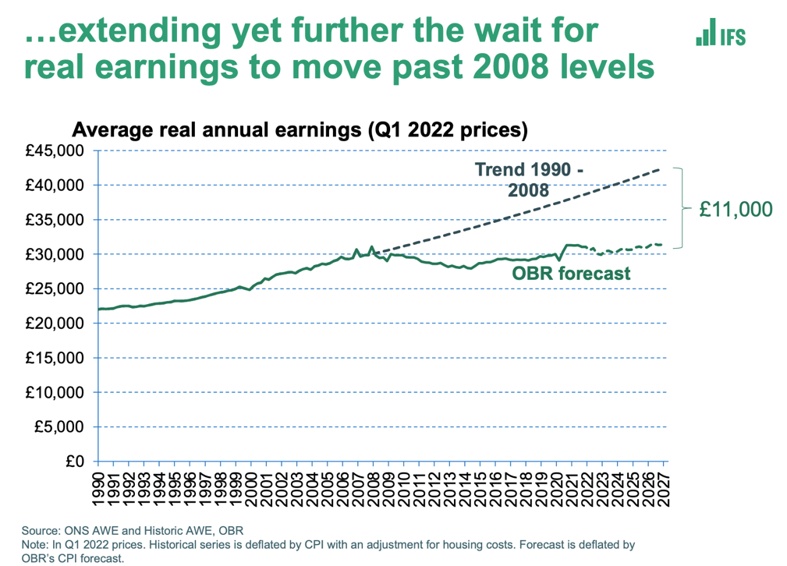
Long before the debacle of autumn 2022, the UK had a special problem. Rising inflation then began.
The UK’s position is even worse than the numbers in this graph suggest, because in recent years its GDP has not risen as much as that of other European countries. Meanwhile the pound has fallen in value.
Source: Dorling, D. (2022) The Trickle Up of Fear, Public Sector Focus, March/April, pp. 12-15, https://flickread.com/edition/html/index.php?pdf=62668d702a8e0#15

Slide 24
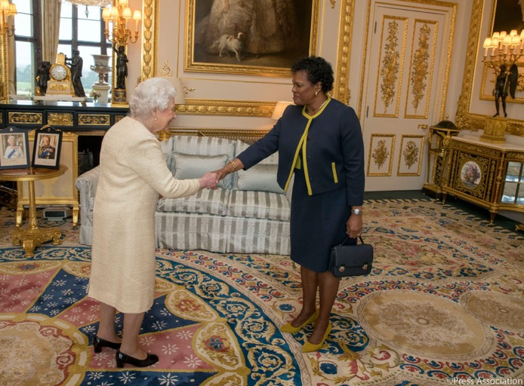
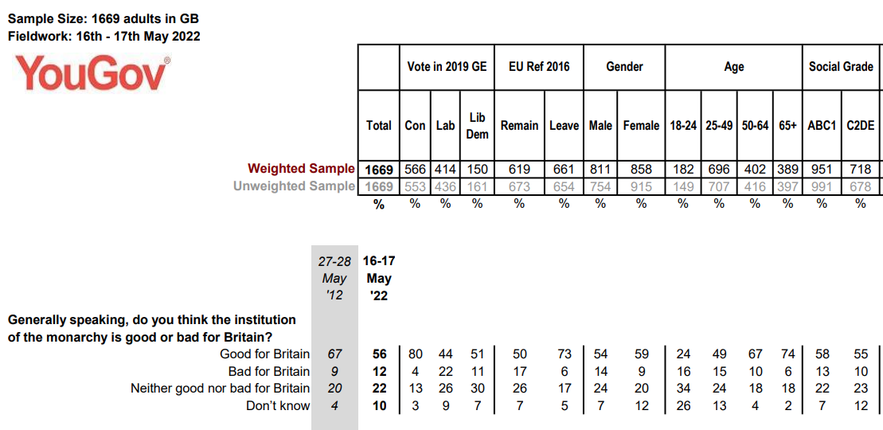
Attitudes are changing most quickly among the young, both internationally and within the UK.
March 2018:
Her Excellency Dame Sandra Mason was received in audience by Her Majesty upon her appointment as Governor-General of Barbados.
October 2021:
Prior to becoming a republic and removing Queen Elizabeth II as
its head of state, Barbados elected
Dame Sandra Mason
as its first president.
Source: https://docs.cdn.yougov.com/tzluoaf4hh/YouGov%20-%20Jubilee%20-%20Views%20of%20the%20Monarchy%20Survey%20Results.pdf
Photo source: https://twitter.com/RoyalFamily/status/978993565501140992?s=20

Slide 25
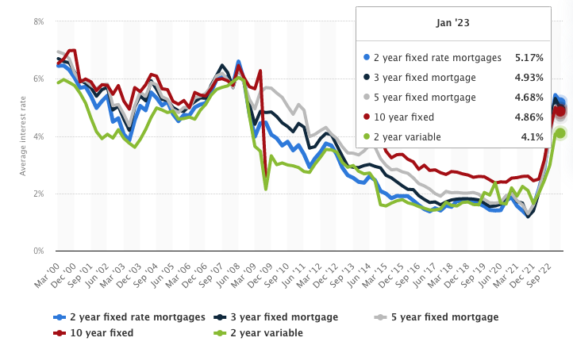
The crisis of 2022/23, as mortgage rates rose, was very much a middle-class affair, affecting almost everyone who had got on the housing ladder in the current century. It was no longer among the poorest where the (new) pain was most concentrated.
Source: https://www.statista.com/statistics/386301/uk-average-mortgage-interest-rates/

Slide 26
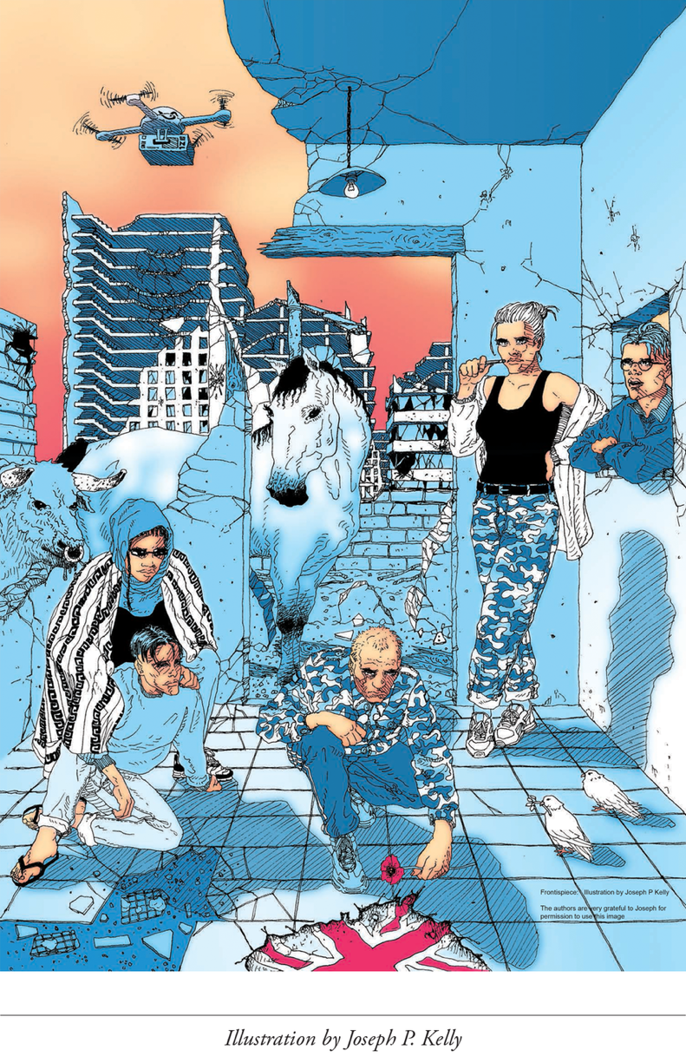
2.
Growing Divides
Source: https://www.dannydorling.org/books/rulebritannia/figures/start.html

Slide 27
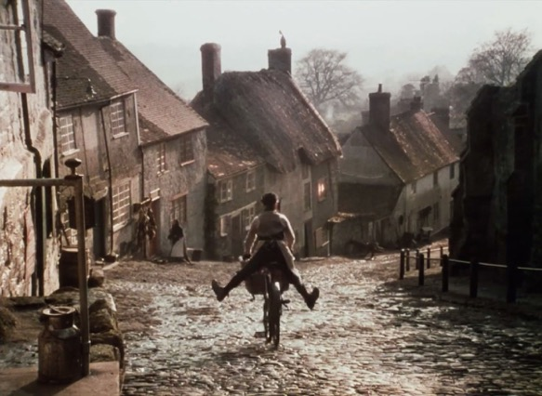
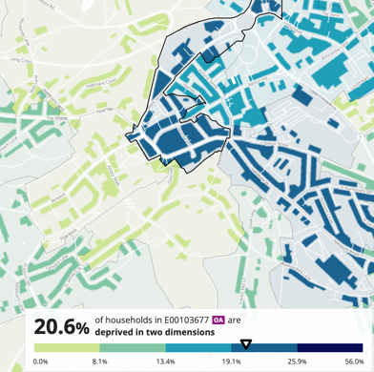
The Boy on the bike advert,
filmed on Gold Hill in 1973.
“Last upon round will be old ma Bigoty’s place; ‘twas like taking bread to the top of the world; ‘twas a grand ride back though. I knew baker would have kettle on and doorsteps of Hovis ready. There’s wheatgerm in that loaf he’d say. Get it inside you boy, and you’ll be going up that hill as fast as you come down.”
Voiceover: “Hovis still has many times more wheatgerm than ordinary bread. It’s as good for you today as it’s always been.”
A fifth of households at the top of Gold Hill were deprived in at least two ways in 2021.
Two out of four possible ways:
No GCSEs, CSEs or O levels
Unemployed or long-term sick
Health is bad, very bad or disabled
Overcrowded, in a shared dwelling or
has no central heating in the home
Source: 2021 census deprivation maps & https://musebycl.io/advertising/ridley-scotts-classic-1973-hovis-ad-boy-bike-has-been-beautifully-remastered

Slide 28
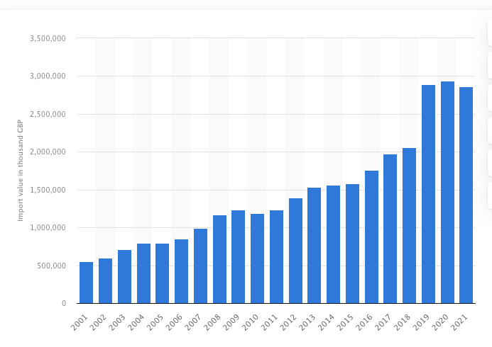
The Hovis advert was about bread. We now make less bread in the UK, and import more of it.
Imports of bread products into the UK increased more than fivefold by cost between 2001 and 2021. We made and exported less. There was a rapid rise in imports even before the pandemic began.
This graph shows the value of bread, biscuits,
wafers, cake and pastries imported to the UK
from 2001 to 2021 (in thousands of
pounds/year).
Source: https://www.statista.com/statistics/520147/bread-biscuits-wafers-cakes-and-pastries-import-value-united-kingdom-uk/
Contrasts badly with the export figures: https://www.statista.com/statistics/859202/volume-of-exports-of-bread-pastry-and-cake-uk-by-country/

Slide 29
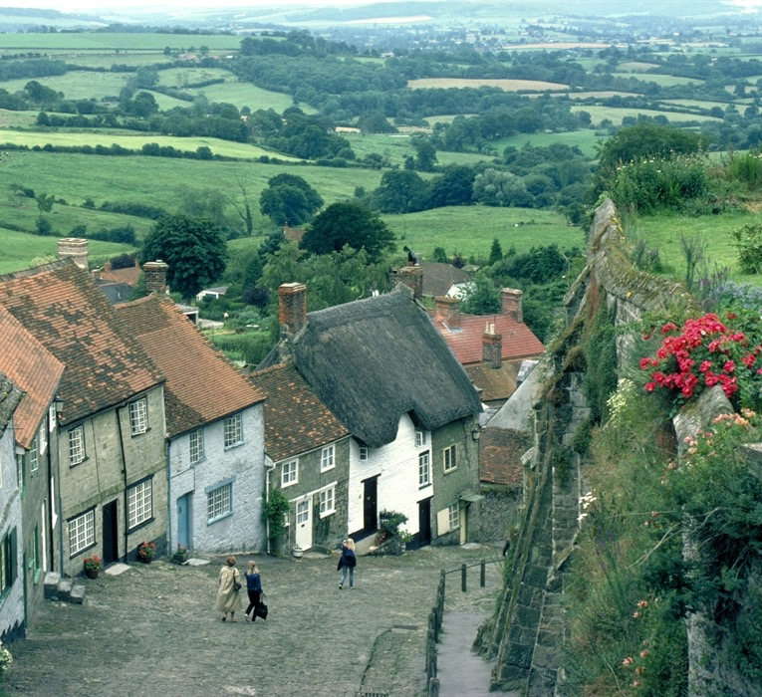
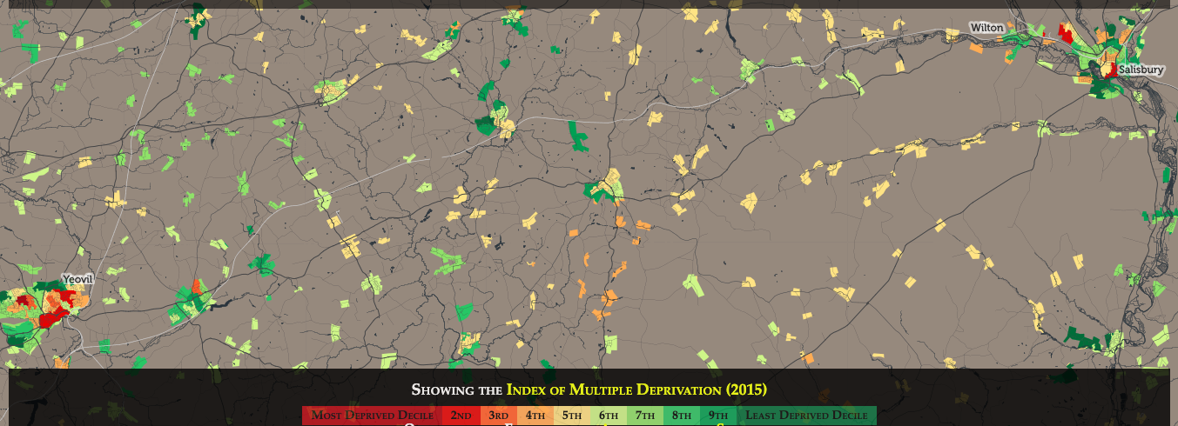
Gold Hill in Shaftesbury, Dorset, England
Today, Shaftesbury sits amid a more recently socially fractured patchwork of middle-England villages lying between Salisbury and Yeovil; places where the cost of petrol and the energy needed to heat homes have become key issues for most people, although not all, living in these enclaves.
Shaftesbury
Source: https://musebycl.io/advertising/
ridley-scotts-classic-1973-hovis-ad-boy-
bike-has-been-beautifully-remastered
Photo Source:
https://www.visit-dorset.com/listing/gold-hill/124444301/

Slide 30
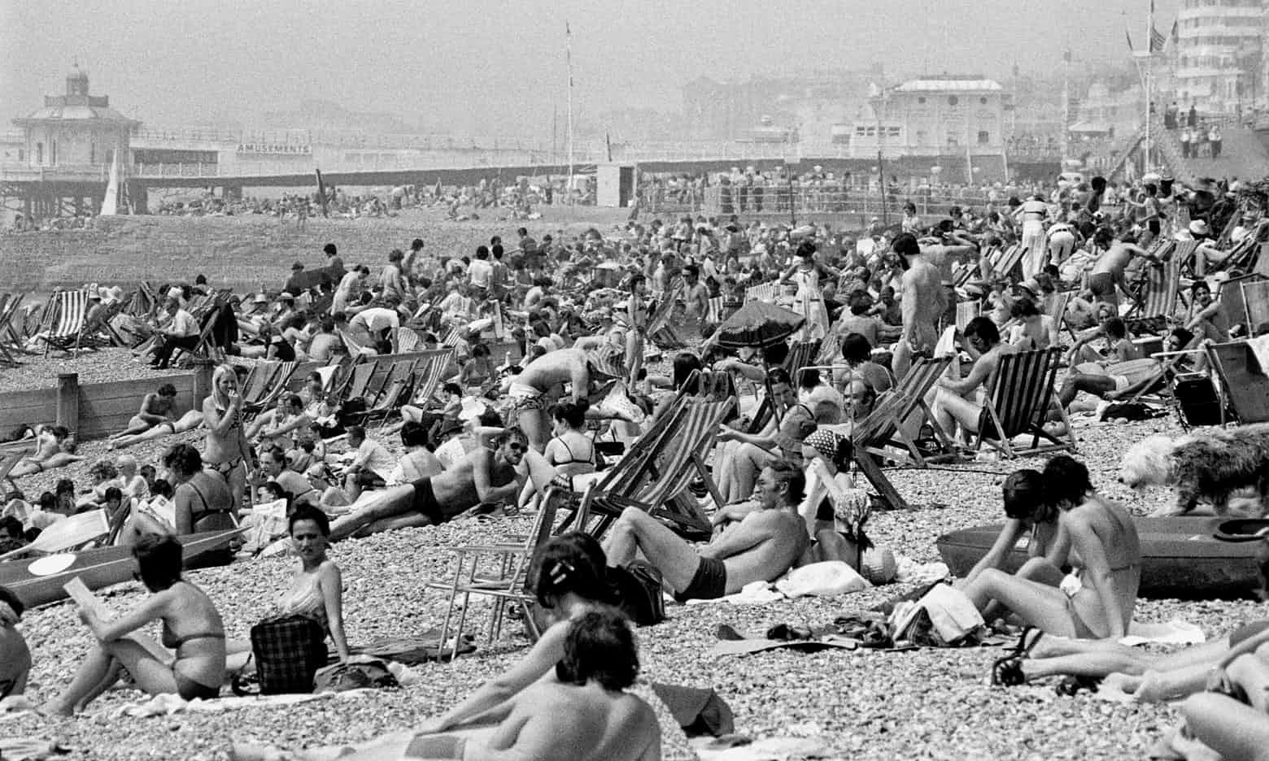
Some things were better in the 1970s.
‘In this photo, from 1976, almost everyone is what we would now call slim. So, what has happened? A sudden loss of willpower, as some rightwing journos claim? No. An obesogenic environment created by junk food manufacturers and their advertisers.’
George Monbiot, 26 July 2018
Source: https://twitter.com/GeorgeMonbiot/status/1022438330611499009

Slide 31
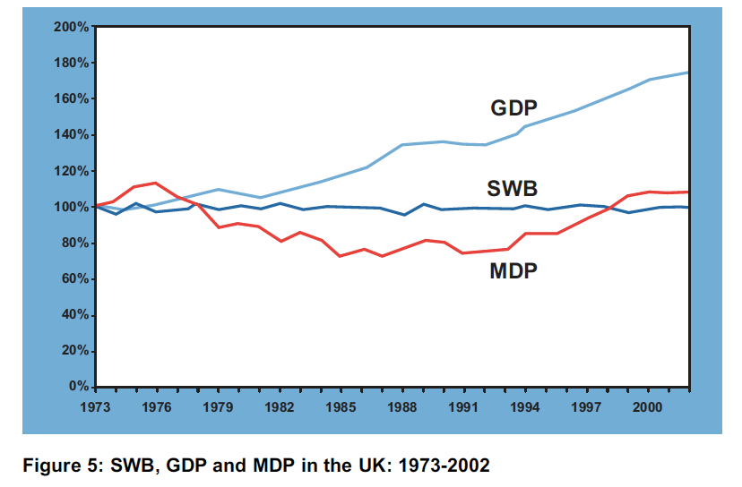
Measures of domestic progress (MDB peak 1976)
‘Measure of Domestic Progress’ (MDP) is an index designed by the
New Economics Foundation to reflect our progress towards sustainable development by including economic progress, environmental costs, resource depletion and social factors in a single composite measure.
Source: NEF (2004) Chasing Progress: Beyond measuring economic growth, the New Economics Foundation, https://neweconomics.org/uploads/files/70e2c4fbed5826b19e_dvm6ib0x9.pdf

Slide 32
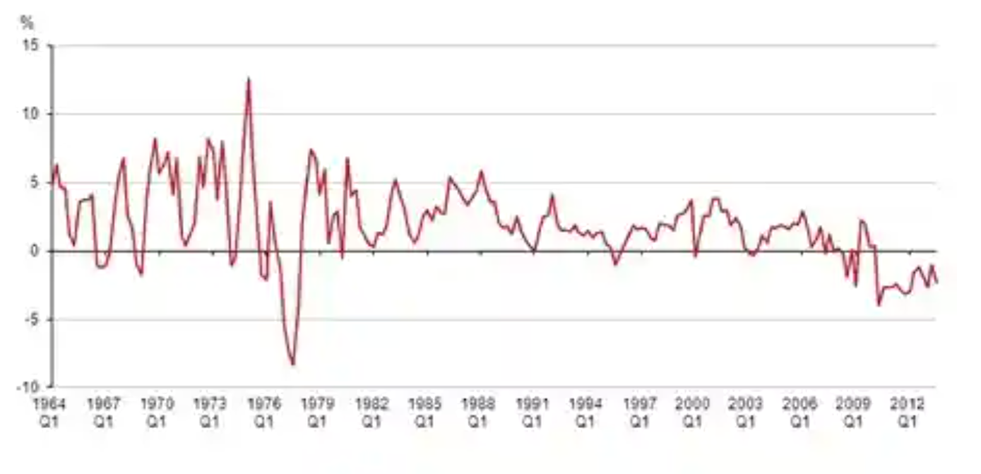
Average earnings growth 1964–2021, with RPI inflation stripped out
Real wages rose fastest in the early 1970s. By 2014 they had been falling consistently. The fall had started after the 2008 economic crash, and it was already the case in 2014, almost a decade ago, that this was the longest fall for 50 years.
Source: Office for National Statistics.
Real wages have been falling for longest period for at least 50 years, ONS says, The Guardian, 31 January 2014. https://www.theguardian.com/business/2014/jan/31/real-wages-falling-longest-period-ons-record

Slide 33
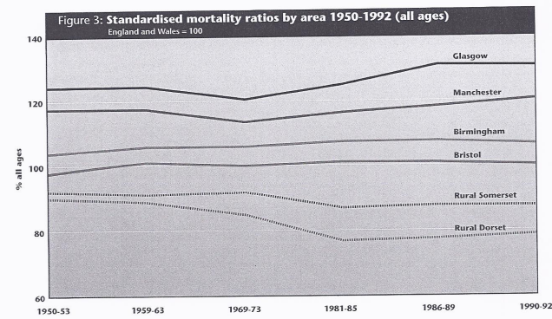
The most important chances in life became the most equitable they had ever been in the years 1969–1973.
Source: Dorling, D. (1997) Death in Britain: how local mortality rates have changed: 1950s-1990s, Report published by the Joseph Rowntree Foundation.

Slide 34
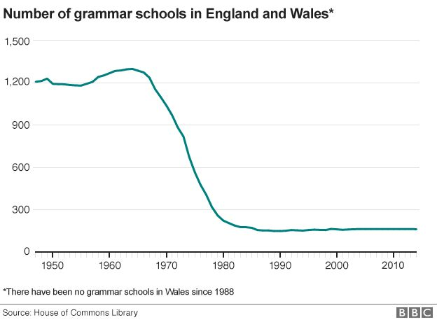
The greatest reduction in the segregation of children by schools began in the late 1960s.
Source: https://www.bbc.co.uk/news/
education-34538222

Slide 35
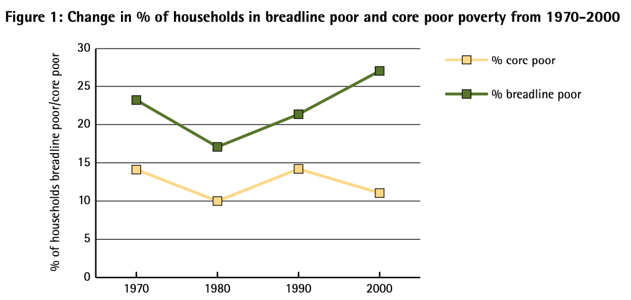
Poverty was falling in the 1970s across Britain.
‘Core poor’ is used here to describe those households that are simultaneously income poor, deprivation poor (cannot afford the essentials in life) and subjectively poor (people who will say they are poor when asked if they are).
‘Breadline poor’ is not being able to afford the essentials in life, as defined what a majority believe at that point in time. It is what it means to be excluded from participating in the norms of society due to low income.
Breadline poor in the year 2000 if:
• in arrears on rent/mortgage
• or buy secondhand not new clothes not out of choice
• or cannot afford protein every second day in their food
• or cannot afford to keep their home adequately warm
• or cannot afford a week’s annual holiday away from home (other than staying at relatives)
• or cannot afford to have friends or family for a meal once a month due to low income.
Source: https://www.jrf.org.uk/report/poverty-and-wealth-across-britain-1968-2005

Slide 36
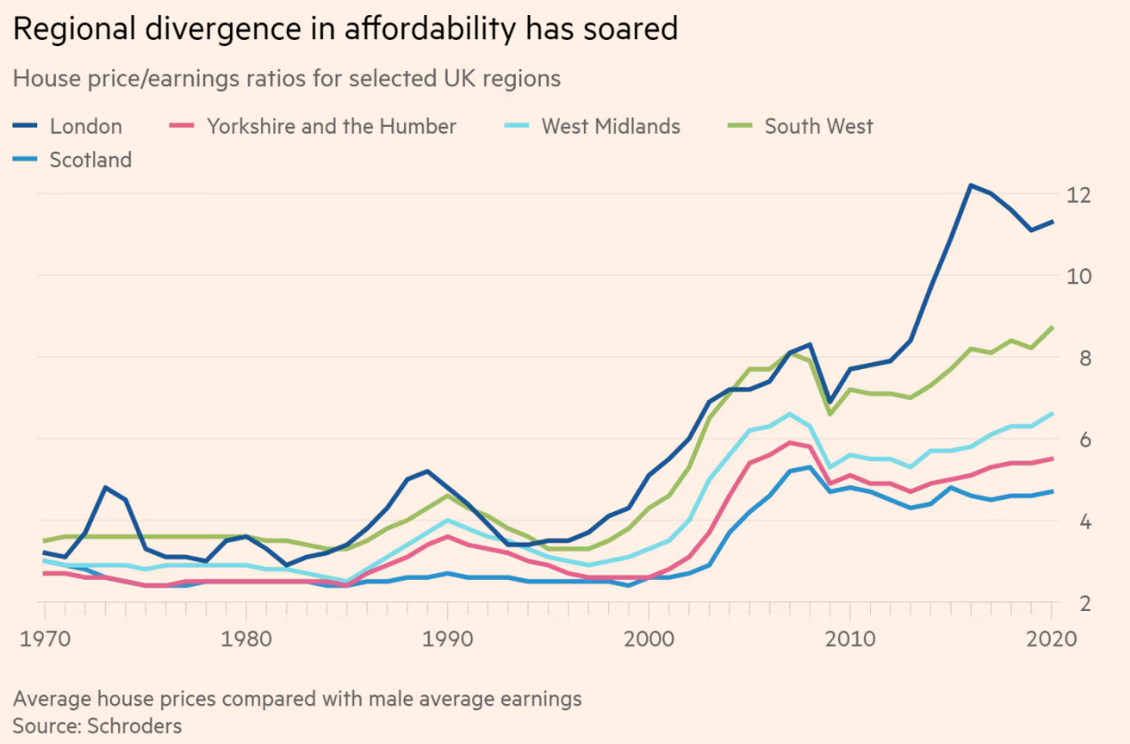
In the 1970s it was becoming cheaper to purchase a house and regional divides were falling.
Source: Martin Wolf, British housing is expensive and its supply must increase, 21 March 2021, https://www.ft.com/content/75942d5f-6bdf-40fb-b7ce-a48429ab84fc

Slide 37
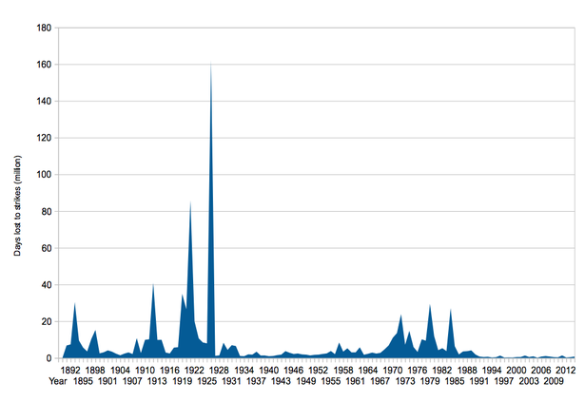

The strikes of the 1920s were successful in contributing to rising equality, both at the time and afterwards. The wave of strikes that began in the 1970s dwindled after defeat of the miners in 1984/85. The wave that began in 2022 is small.
2022
https://www.mirror.co.uk/news/uk-news/strike-days-rise-77-year-6082845
https://news.sky.com/story/number-of-days-lost-to-strike-action-in-2022-highest-since-1989-12810216

Slide 38
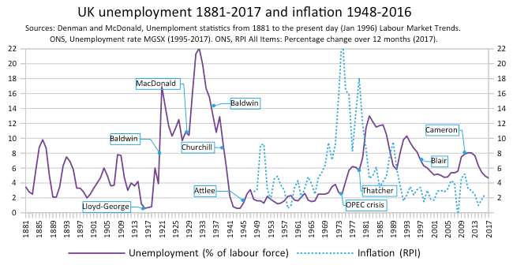
Unemployment
1881–2017, and under-employment 2000–2022. Very rare still in most of the 1970s, but rising in those years.
Source: https://www.statista.com/statistics/414896/employees-with-zero-hours-contracts-number/
Source: https://en.wikipedia.org/wiki/
Unemployment_in_the_United_Kingdom

Slide 39
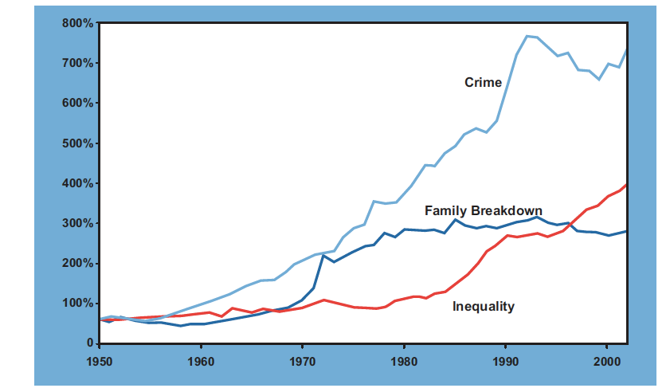
Crime was rising before the 1970s. Divorce was more possible when abortion was legalised, and inequality was falling throughout the 1970s.
Detail from Measure of Domestic Progress (MDP), designed to reflect our progress towards sustainable development by including economic progress, environmental costs, resource depletion and social factors in a single composite measure.
Source: NEF (2004) Chasing Progress: Beyond measuring economic growth, the New Economics Foundation, https://neweconomics.org/uploads/files/70e2c4fbed5826b19e_dvm6ib0x9.pdf

Slide 40
The current UK pay squeeze is unlike any in the past century. It will now probably last longer than 2029, as inflation has risen higher than it predicted in 2022 when this data was released by the TUC.

Slide 41
People in the UK are now suffering the worst pay squeeze since the Napoleonic wars.
Source: Dorling, D. (2022) The Trickle Up of Fear, Public Sector Focus, March/April, pp. 12-15, https://flickread.com/edition/html/index.php?pdf=62668d702a8e0#15

Slide 42
The UK’s current wage crisis is unlike any other in living memory.

Slide 43
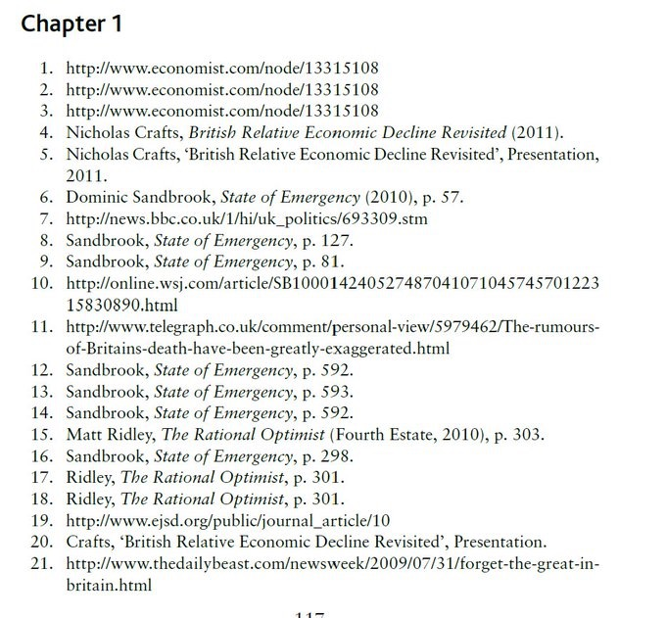
Liz Truss was derided for many things during her Conservative Party leadership campaign, including how few sources she relied on when she wrote about the 1970s
‘Cracked open Britannia Unchained in light of the looming prospect of
PM Liz Truss, and boy is this book densely researched’
Source: Chris Haynes, tweeting ironically on 20 July 2022 https://twitter.com/chrismwhayes/status/1549785631227772933
The first three references are to: Nicholas Henderson (1979) Britain’s decline; its causes and consequences, published in the Economist.

Slide 44
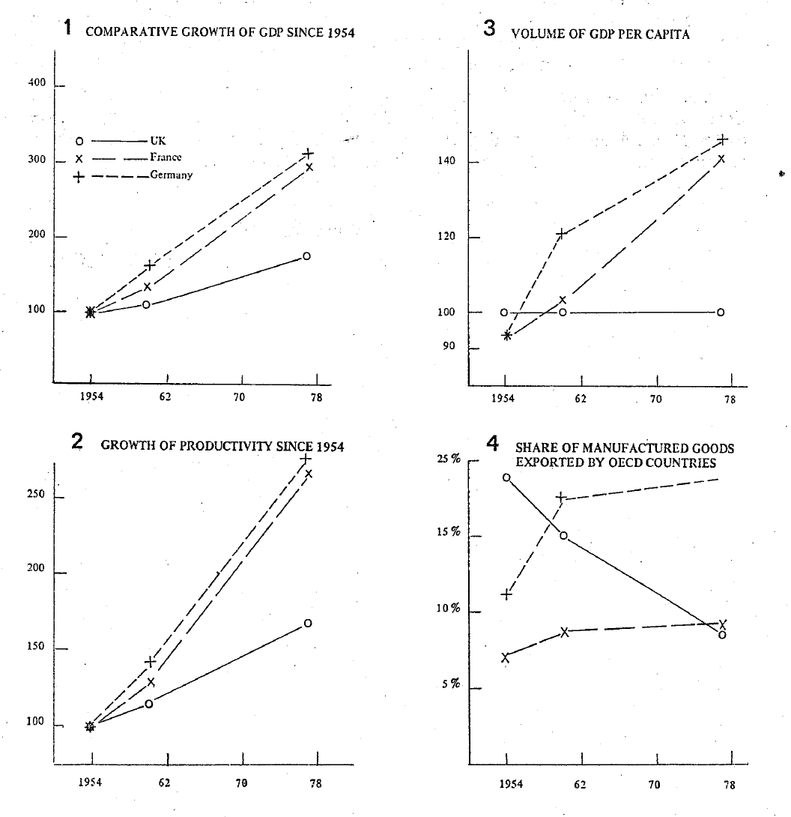
Valedictory despatch by Nicholas Henderson Britain’s ambassador in Bonn and Paris, graphs:
Source: Nicholas Henderson (1979) Britain's decline; its causes and consequences (leaked document published in full), The Economist, 2 June, https://www.economist.com/news/1979/06/02/britains-decline-its-causes-and-consequences https://www.margaretthatcher.org/document/110961

Slide 45
1840s England was the richest place on Earth, but life for most people in England was short.
Average age of death for occupational group by location (after Chadwick, 1842).
Location | Professional Trades | Tradesmen | Labourers
Rutland | 52 | 41 | 38
Leeds | 44 | 27 | 19
Liverpool | 35 | 22 | 15
Manchester | 38 | 20 | 17
Bolton | 34 | 23 | 18
Source: https://www.sciencedirect.com/science/article/pii/S0277953617307281

Slide 46
Some 170 years after Victorian misery, UK multiples of mortality risk was widening.
By the start of the twenty-first century, Rutland, which in the nineteenth century was in good health because it was a remote
rural area, had become a safe, affluent enclave for the better-off.
By 2011, of every 2,174 women aged sixteen to seventy-four in
the highest social class in Rutland, one died each year on average.
In contrast, in Manchester, men in the same age band but from the lowest social class were twenty-two times more likely to die.
Multiples of annual mortality risk all being compared to a
women of high status in Rutland 2010-2012:
Note: The rates are multiples of the rate for women of high social class in Rutland, who had a mortality rate of 46.1 per 100,000 between aged 16 and 74 in the years 2010 to 2012 (or 0.046%); 22 times that is 1.10%.
Source: https://www.sciencedirect.com/science/article/pii/S0277953617307281

Slide 47
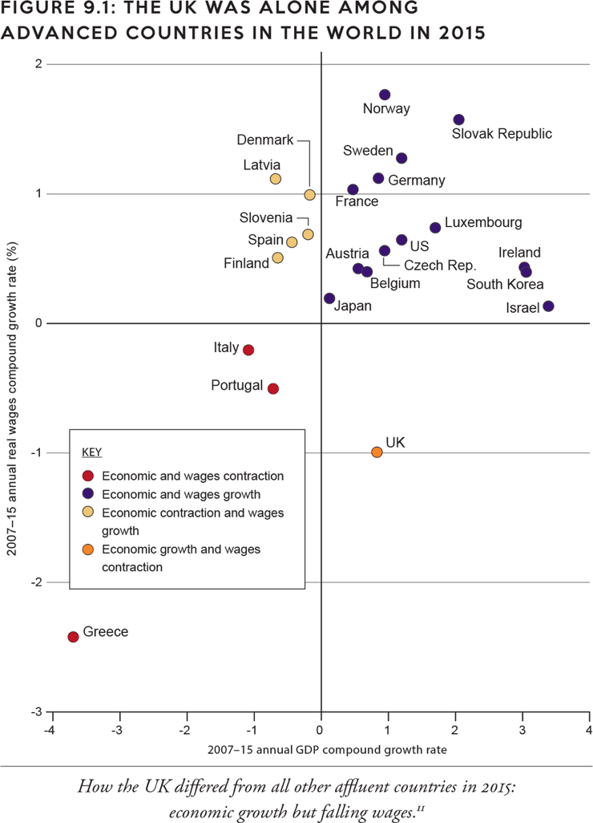
Shattering has occurred in many ways in the UK, but it was mostly silent shattering in the social statistics.
By 2015 the UK had become unique in Europe. The wages of people across the UK were 1% lower in 2015 than in 2007. This put the UK in the company of Italy, Portugal and Greece, which had also seen wages fall in real terms. But these countries had had no choice, as their GDP had fallen. In Britain, what recovery there was, was taken by the bosses and wealthy taking a little more for themselves.
Source: https://www.dannydorling.org/books/rulebritannia/figures/figure-91.html

Slide 48
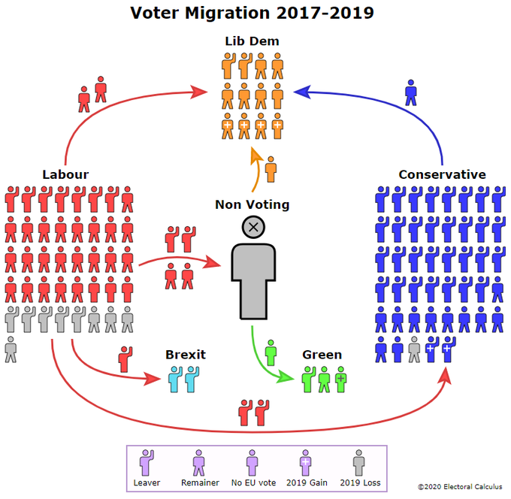
Labour lost the 2019 election so badly because
1.2 million people who had voted for the party in 2017 chose not to vote in 2019. It was as simple as that.

Slide 49

2017 was the sea-change election.
At first it was at the local level that a change in the geographical segregation of voting in Britain was seen, a segregation that had reached its postwar peak in 2015. The segregation that had risen continuously since the 1970s has now begun to fall. The 2017 election was the first to mark the change in direction nationally. There is so much more to see in careful analysis of the data beyond the crude results. The 2017 election was the real sea-change election – the one
in which the direction of travel we had been on for decades first measurably altered – when a nation that had become increasingly politically divided by geographical area first became less divided.
That was continued in 2019.
Source: https://www.dannydorling.org/books/peakinequality/figures/figure-2122.html

Slide 50

In 2019 the Conservative share of the vote actually shrank in London and the south-east. These were the two regions, along with the south-west, where Labour losses were lowest. However, a rise in popularity for the Liberal Democrats in every region also helped to split the opposition vote and secure the very large Conservative majority.
2019 was no great mandate for Johnson.

Slide 51
What happened between May 2019 and December 2019?
Source: Dorling, D. (2019) Counting words in the manifestos, Public Sector Focus, November/December, p. 14-15, https://flickread.com/edition/html/
index.php?pdf=5dfa4dba6d89e#17

Slide 52

Lethargy rose, but enough of the old voted.

Slide 53

3.
Hunger
Farmers travelling from old farm to new on Lady Day (25 March), the other three ‘quarter days’ being Midsummer Day (24 June), Michaelmas (29 September) and Christmas Day (25 December).
Source: https://twitter.com/DominicFrisby/status/1643889714959724545

Slide 54


In 2022 the International Monetary Fund pointed out that Estonia and the UK were the two countries in Europe where living costs for the poorest 20% of households were set to rise by about twice as much as those for the wealthiest.
In 2023 Stephanie Flanders, head of Bloomberg Economics, explained that in the UK, “The poorest fifth of the population are now much poorer than [in] most of the poorest countries in central and eastern Europe.”
“On present trends, the average Slovenian household will be better off than its British counterpart by 2024.”
(John Burn-Murdoch, 2022).
Source: https://twitter.com/amanpour/status/
1621219401713287174?s=20

Slide 55

Foodbank form and tulips
‘We are social beings and our survival depends on feeling connected, understood, and cared for. We have to find ways of living together and sharing in order to prosper, and we tell stories to make meaning and sense of our lives.’
Sarah Holyfield
May 2023
Source: https://sarahholyfield.com/social-being/

Slide 56

In the last 30 days, were you ever hungry but didn’t eat because there wasn’t enough money for food?
Source: https://www.resolutionfoundation.org/
publications/the-living-standards-outlook-2023/

Slide 57

Briefly, the UK was ahead of the pack.
But only if the cost of housing was ignored.
Source: https://www.resolutionfoundation.org/
publications/the-living-standards-audit-2022/

Slide 58

But the middle UK household was already worse-off than the median individual in comparison to other European countries.
“Britain and the US are poor societies with some very rich people.” John Burn-Murdoch, 16/9/2022
Source: https://www.ft.com/
content/ef265420-45e8-497b
-b308-c951baa68945

Slide 59

‘The only part of the income distribution where incomes grow is in the top 5%, where households benefit from higher interest rates.’ (Resolution Foundation 2023)
Source: https://www.resolutionfoundation.org/
publications/the-living-standards-outlook-2023/

Slide 60


Controlling food prices in mainland Europe
In 2014, a cap was introduced on Greece’s beaches to stop greedy proprietors trying
to charge more than €1.15 for a cheese toastie. By 2022 price controls on basic foodstuffs had been extended to the food and drinks sold in airports, cinemas, theatres, bus stations, hospitals, clinics, archaeological sites and museums, passenger ships, trains, sports grounds, courts, nursing homes, universities and schools. The items affected included bottled water of any kind, which was capped at half a euro for half a litre. A single Greek coffee was capped at €1.20, French filter coffee
at €1.30, an espresso coffee at €1.45, a frappé at €1.30 and English tea at €1.30. Passengers in first class could be charged more. The point of these regulations was
to stop exploitation. By 2022 the price
of a toastie had risen by 10 cents to
€1.25, or €1.45 if it also contained ham.

Slide 61
Three or four out of every seven UK children live in poverty (£10 a day to live on).
If you divide UK families with children into seven equal-sized groups by income (each containing about 2 million children), then each group has at least 18% more income than the one below it. However, the seventh (the best-off group) has 35% more than the sixth group. The many people across the UK who found a real income fall of 3% in 2022 shocking can probably barely imagine living on an income 18% or 35% below what they live on now.
 | £ ‘disposable’ | /Week | Per Year | per child/day
1 | 1st seventh | 118 | 6100 | 3.37
2 | 2nd seventh | 237 | 12300 | 6.77
3 | 3rd seventh | 305 | 15900 | 8.71
4 | Middle Child | 371 | 19300 | 10.60
5 | 42nd-29th %tile | 476 | 24800 | 13.60
6 | 28th-14th %tile | 633 | 32900 | 18.09
7 | 14th-1st %tile | 984 | 51200 | 28.11
i | 7th percentile | 1281 | 66600 | 36.49
ii | 6th percentile | 1381 | 71800 | 39.34
iii | 5th percentile | 1687 | 87700 | 48.05
iv | 4th percentile | 1915 | 99600 | 54.58
v | 3rd percentile | 2327 | 121000 | 66.30
vi | 2nd percentile | 3365 | 175000 | 95.89
vii | in top 1% | 11956 | 621700 | 340.66
Source – analysis of HBAI data and (for the top 7%, tax records) for children born in 2018. Equivalized incomes after housing costs, taxes & benefits.

Slide 62


Universal Credit claim instructions
‘I printed these instructions in Welsh and English on fabric and they became strips which were 17 feet long.’
Sarah Holyfield May 2023
Source: https://sarahholyfield.com/moral-compass/

Slide 63

Top Rank:
The UK has continued to have the most miserly out-of-work benefits for single adults for many decades.
Sources: Olaf van Vliet and Koen Caminada (2012) Unemployment Replacement Rates Dataset Among 34 Welfare States, 1971-2009:
An Update, Extension and Modification of the Scruggs' Welfare State Entitlements Data Set
Leiden Law School - Department of Economics, NEUJOBS Special Report No. 2, Table 2, page 7, https://papers.ssrn.com/sol3/papers.cfm?abstract_id=1991214 and https://www.researchgate.net/publication/228311401

Slide 64

The UK had the widest geographical inequalities of all European Union countries when it was a member.
Source: https://ec.europa.eu/eurostat/web/
products-euro-indicators/-/1-26022019-ap

Slide 65






In 2017, the GDP/capita of Inner West London was €209,900. Those boroughs contained 10.5% of the GDP of the UK and just 1.8% of the population.
GDP/capita inequality in London in 2017, EU data
PPS = purchasing power standard
Inner West London:
City of London, Camden,
Kensington & Chelsea,
Hammersmith & Fulham, and Westminster.
Outer London E and NE:
Barking & Dagenham, Enfield,
Redbridge & Waltham Forest,
and Havering.
Source: https://ec.europa.eu/eurostat/web/
products-euro-indicators/-/1-26022019-ap

Slide 66

Hunger rises, 2019/2020 to November 2022
Source: https://www.resolutionfoundation.org/
publications/the-living-standards-outlook-2023/

Slide 67

Trouble ahead
‘Inequality is set to rise every year from 2021-22 onwards. …. This rise in inequality is primarily driven by gains at the top of the distribution from growth in unearned income. After 2023-24, the pattern of income growth … is unambiguously inequality-increasing. Our forecast is that, by 2027-28, inequality could reach a record high of 40.8%, higher than the previous peak just before the financial crisis.’ Resolution Foundation
Source: https://www.resolutionfoundation.org/
publications/the-living-standards-outlook-2023/
Source: https://www.cbpp.org/research/social-security/social-security-benefits-are-modest

Slide 68

4.
Precarity
‘The unstoppable fire of freedom’:
AI painting inspired by Vincent van Gogh
Source: https://twitter.com/literatura_rte/status/
1646517825446752257 Available as a canvas print bit.ly/3GyidzQ

Slide 69

Rapid increase in housing precarity from 2022.
In September 2022, over 1,000 mortgage products were withdrawn from offer in the UK as interest rates surged. In February 2023, ONS reported the largest rise in UK average rents since their time series began (heading to 5%). The cost of new housing per square metre in the UK is highest of any country in Europe. Rates of homelessness and precarity in housing are rising. More homes are revealed to be unfit for human habitation.
Source: https://www.ons.gov.uk/economy/
inflationandpriceindices/bulletins/indexofprivate
housingrentalprices/february2023

Slide 70

By 2021 the price of new homes was already the highest in Europe, but wages were low.
Average sales price of new and existing residential property in Europe in 2021, per country (in euros per square meter).
Source: https://www.statista.com/statistics/722905/average-residential-square-meter-prices-in-eu-28-per-country/

Slide 71

April 2023 UK house price index
Almost every town in the UK begins to turn red on its monthly trend.
The year before had been a boom year.
Source: https://twitter.com/emmafildes/status/1643851689915457538

Slide 72
Capital
Source: https://oobrien.com/2013/01/a-map-of-scotlands-deprivation/

Slide 73
Second City
Source: https://oobrien.com/2013/01/a-map-of-scotlands-deprivation/

Slide 74

Tenements 2001
‘Leaking soil pipes have caused the dark patches visible on the walls. Although most of the windows are boarded
up, two of the flats are still occupied.
These flats were built in the
early 1950s
and are due
for demolition; much of the rest of the street has already been demolished.’
Source: https://jech.bmj.com/content/55/5/291

Slide 75


The Midlands and London

Slide 76

76

Slide 77

Kensington 2017
Source: Image taken from TV news reports

Slide 78

A wall divides our city
‘Inequality in the UK is like water must be to fish — so omnipresent, such a fixed part of our daily lives, that most of us don’t even notice it’s there.’
Andrew Dowdeswell, A wall divides our city, 14 January 2023
Source: Andrew Dowdeswell, 14/1/2023 https://www.sheffieldtribune.co.uk/p/a-wall-divides-our-city - 2021 census maps
‘Arbourthorne and Ecclesall are just three miles away from one another, but economically, they’re worlds apart’

Slide 79

Spare bedrooms
Had house prices only risen in line with inflation over the past seventy years, the average home in 2022 would have cost £63,300, or just over twice the median full-time UK salary of about £31,000.
‘Over the past decade, despite soaring house prices, the number of under-occupied houses has increased. But in some areas [of] Barking, Leicester and Slough, the number of people in undercrowded [homes] has jumped by several percent.’
Source: https://www.telegraph.co.uk/property/uk/where-baby-boomers-locking-bedrooms-housing-market/
Source: https://twitter.com/bienbutcher/status/1612739528174829569

Slide 80



The most overcrowded part of the UK in 2001
South of Bermondsey on the west side of Burgess Park.
Source: https://twitter.com/fryford/
status/1611094945066258432

Slide 81

Gentrification (red) and normalisation (blue)
Source: https://citygeographics.org/2022/12/15/tracking-gentrification-in-london-and-manchester-using-the-2021-census-occupational-class-data/

Slide 82

Segregation
Enclave with very little deprivation (blue) and more normal areas (green).
‘
’
Source: https://twitter.com/InvisibleMapper/
status/1588454573400002560

Slide 83

More Segregation
Enclave with very little deprivation (blue) and more normal areas (green)
Source: https://twitter.com/InvisibleMapper/
status/1588454573400002560

Slide 84


Privatisation
In just five years, between 1986 and 1991, a single private firm (Rothschild) was either lead advisor or heavily involved in the creation of twenty-five massive new private firms: ‘the privatisation of British Steel (1988), the ten UK Water Authorities (1989), the twelve electricity distribution boards (1990), British Coal, British Telecom (1991)’. There was not a great deal of competition involved in the privatisations, and they did not take many years to achieve. If all that could be done in five years, then unravelling the mess could be done just as quickly because it is no more complex.
'Concordia, Integritas, Industria’ (Harmony, Integrity, Industry)
Rothschild family motto
Detail of one of many newspaper adverts to encourage investors.
Source: https://www.rothschildarchive.org/exhibitions/if_you_see_sidtell_him/the_legacy

Slide 85
Public Transport
Utility services can be made very cheap, even free. In June 2022, Germany introduced a €9 public transport ticket. You could travel for a month on just the one ticket. Internal air travel within Germany fell by 49% in the first month! This improved the lives and well-being of poorer Germans especially. Spain went one better than Germany and introduced free train travel within that country from September 2022 until the end of that year, and then extended this to all of 2023. What prompted both countries to act was the need to mitigate the rising cost-of-living crisis. Europe’s richest country, Luxembourg, has had free public transport for some time, as have the capital city of Estonia and fifty other large towns and cities in Europe. In 2022, Italy joined the trend by providing very cheap public transport for anyone on a low income, as did Austria, while in France it was already affordable.
The Effects of the Planned High-Speed Rail System on Travel Times and Spatial Development in the European Alps
Map by Elisa Ravazzoli
Source: https://bioone.org/journals/mountain-research-and-development/volume-37/issue-1/MRD-JOURNAL-D-15-00051.1/The-Effects-of-the-Planned-High-Speed-Rail-System-on/10.1659/MRD-JOURNAL-D-15-00051.1.full

Slide 86
Economics
Economics in the UK and US has become an academic discipline that both attracts and retains people who tend to be less compassionate than most. It tends to eject those who are not part of this in-group.
In the UK, economics is the social science that most attracts young people from the best-off families.
Source: Robert Schultz and Anna Stansbury, US economics PhDs are less socioeconomically and racially diverse than other major fields, Working Paper 22-4, Peterson Institute for International Economics, 31 March 2022. https://www.piie.com/research/piie-charts/us-economics-phds-are-less-socioeconomically-and-racially-diverse-other-major

Slide 87

Privatisation ended serious investment
‘The correlation between stopping reservoir construction and privatisation in 1989 is stark. I assume the money that should have been invested in reservoir capacity has gone into shareholder pockets, just as with infrastructure to stop sewage over-flows into rivers.’
Mary Shepperson, archaeologist and lecturer at the University of Liverpool
Source: Mary Shepperson (2022), Question for twitter: Why hasn't there been a single new reservoir built for over 30 years in the UK? We used to build loads, Tweet of 29 July https://twitter.com/MShepperson/status/1553123795136876544

Slide 88

We may be at a peak of inequality again.
By the time the pandemic hit, the take of the 0.01% was back up to 130 times the average income, the share it had last been around the time the Beveridge Report was published in 1942.
Source: page ix of the preface to the third edition of Danny Dorling (2020) Inequality and the 1%, London: Verso, available here: https://www.dannydorling.org/books/onepercent/Material_files/iatopc_preface.pdf

Slide 89

Only 1 in 27 in the UK pay any inheritance tax.
Source: 28 July 2022 https://www.gov.uk/government/statistics/inheritance-tax-statistics-commentary/inheritance-tax-statistics-commentary

Slide 90

Women leave more wealth than men.
Source: https://webarchive.nationalarchives.gov.uk/ukgwa/20060214032021/http:/www.hmrc.gov.uk/stats/inheritance_tax/table12_9.pdf

Slide 91
5.
Waste
What we waste most is people’s time.
Source: https://depositphotos.com/stock-photos/inside-clock.html

Slide 92
Management consultancy
The industry that has grown the most in terms of employment – up by 209% in the past twenty years, with a threefold rise in its share of the UK economy – is head offices and management consultancy. This sector had already doubled in size by 1999, up by 107% over the previous two decades. More and more people in the UK are doing work that does not improve the lives and livelihoods of others, but tries to control them more.
‘How to become a management consultant
…
[1] The self-employed guide to Self Assessment tax returns’
Source: https://www.simplybusiness.co.uk/
knowledge/articles/2018/05/how-to-become-a-management-consultant/

Slide 93

By 2017 we were no longer a nation of savers.
Source: Dorling, D. (2019) Twelve facts you may have missed as the UK missed its first Brexit deadline, Public Sector Focus, March / April, pp.12-14, http://flickread.com/edition/html/5cc7fcde6dc3f#15

Slide 94

The ONS statisticians re-evaluated our wealth.
Source: Dorling, D. (2019) Twelve facts you may have missed as the UK missed its first Brexit deadline, Public Sector Focus, March / April, pp.12-14, http://flickread.com/edition/html/5cc7fcde6dc3f#15

Slide 95

Brexit was won by the south.
Source: The map first appeared as the key map to this series: https://www.dannydorling.org/books/onepercent/BrexitJigsaw.html here: https://www.dannydorling.org/books/onepercent/The28Maps/Dorling_Brexit_KEY-MAP.pdf

Slide 96

We waste time competing.
Social mobility in the UK fell from nearly the highest in the world for those born in the early 1960s, to the second lowest for those born in the late 1970s.
(Note: Denmark does much better post-tax, not shown here)
Source: Figure A.2.2. page 74 of Robert Manduca et al (2020) Trends in Absolute Income Mobility in North America and Europe, IZA Discussion Paper 13456, July, https://www.iza.org/publications/dp/13456/trends-in-absolute-income-mobility-in-north-america-and-europe

Slide 97

We waste time commuting.
The reaction of people in the UK to international comparisons
is often interesting.
A common reaction to this map was mainly: ‘It’s only 5 minutes more.’
Source: a tweet of 13/2/2023: ‘Perhaps why "wokeing [sic] from home" is very popular in Britain.’
https://twitter.com/GavinHJackson/status/1625133811649462274?s=20&t=a_rQyLjFY1rq_jv3k63-4A

Slide 98


We waste time with our alliances.
Economic power in the world is rapidly shifting.
The UK is a tiny dot: 0.8% of people, 0.4% of children worldwide. Choosing sides is wasteful when few notice.
Source: maps and graph first appeared in The Economist on 17 July 2021 and were widely shared on the Internet,
https://www.economist.com/briefing/2021/07/17/joe-biden-is-determined-that-china-should-not-displace-america

Slide 99

We waste time by not understanding our past.
We cannot imagine our future in any meaningful way because of this.
The British Empire

Slide 100

6.
Exploitation
Education was seen as the remedy for the old social evil of ignorance.
Source: The Encaenia Procession, Oxford, 2002, Alfred Daniels
https://orwellpressartpublishing.com/
collection?name=Oxford

Slide 101

Cuts
Education spending per child was cut severely for children attending state schools after 2010. Other public services such as public libraries have been similarly cut, by a fifth since 2019, despite visits increasing by 68% (partly to get warm) and book borrowing rising by 58% between 2019 and 2022. People in Britain are reading more books, but are now less able to buy books than they were a few years ago, as they are now almost all so much poorer.
In 2022, 2023 and beyond the monies allocated to most state schools will fall again in real terms.
Source : Luke Sibieta (2021) The growing gap between state school and private school spending, Observation, Institute for Fiscal Studies, October 8th, https://ifs.org.uk/publications/15672
https://www.theguardian.com/books/2023/mar/02/spending-on-british-libraries-falls-17-as-in-person-visits-soar

Slide 102
New Labour maintained, and did not ever narrow, the very wide educational funding divides when it was in power.
Source: The Times, 18 October 2021 https://www.trendsmap.com/twitter/tweet/1446485623985123340

Slide 103

Snobbery is so very British.
We worried, or at least wrote, most about snobbery when we were becoming more equal. We mention it less now.

Slide 104

A third of all private school pupils now get some kind of bursary. But only 3% have more than half their fees paid, while only 1% go for free.
Tom Calver, Who are private schools really for in modern Britain? The Sunday Times, 16 April 2023 https://www.thetimes.co.uk/article/ca75455c-db12-11ed-b1e2-4c4ae98cfe2f

Slide 105

Equality
‘There is a reason the number of independent school places has remained fairly static even as fees have soared: for many families of privately educated children, the fees are inconsequential.’
Tom Calver, Who are private schools really for in modern Britain? The Sunday Times, 16 April 2023 https://www.thetimes.co.uk/article/ca75455c-db12-11ed-b1e2-4c4ae98cfe2f

Slide 106

Diversity
‘The number of kids from the poorest third of families who went to private school may have doubled between 2000 and 2015, according to research by University College London — but it doubled from 1% to 2%.’
Tom Calver, Who are private schools really for in modern Britain? The Sunday Times, 16 April 2023 https://www.thetimes.co.uk/article/ca75455c-db12-11ed-b1e2-4c4ae98cfe2f

Slide 107

Inclusion
‘Going to private school can have a huge bearing on a child’s future — and often in unexpected ways. Their income is likely to be higher, but they’re also more likely to vote a certain way (Tory). Research has even found that privately educated women are four times more likely to marry privately educated men than state-educated women are.’
Tom Calver, Who are private schools really for in modern Britain? The Sunday Times, 16 April 2023 https://www.thetimes.co.uk/article/ca75455c-db12-11ed-b1e2-4c4ae98cfe2f

Slide 108

Fear
‘Recently, something of a panic has set in among private schools about the declining level of Oxbridge acceptance: in 2011, 37 per cent of admissions were from the independent sector, but this fell to 26 per cent in 2020. Yet if it was representative of the English school system, it would be closer to 6 per cent.’
Tom Calver, Who are private schools really for in modern Britain? The Sunday Times, 16 April 2023 https://www.thetimes.co.uk/article/ca75455c-db12-11ed-b1e2-4c4ae98cfe2f

Slide 109

7.
Fear
When the five social evils were first named by William Beveridge
in 1942, disease was the one that was most feared, especially
disease among children.
Source: https://www.worcesterflorist.co.uk/flowers/Seahorses_Blank__card_.aspx

Slide 110

Down the river…
The use of antidepressants in the UK in 2022 was 22% higher than it was in 2016. The most likely person to be prescribed these medicines is a woman in her fifties. Our life expectancy in 2022 was lower than it was in 2014, for both men and women. Nowhere else in Western Europe saw such a fall. Only Slovakia, Bulgaria, Croatia, Romania and Malta now have worse neonatal (dying in the first month of life) mortality rates than the UK.
River Danube: through Slovakia, Hungary, Serbia, Romania/Bulgaria

Slide 111

…and down the ranks.
Source: https://journals.sagepub.com/doi/
full/10.1177/01410768231155637

Slide 112

Having started so well…
‘The essence of a satisfactory health service is that the rich and the poor are treated alike, that poverty is not a disability, and wealth is not advantaged.’ Aneurin Bevan, 1952, In Place of Fear. From 1929 to 1960 Bevan was the MP for Ebbw Vale, a constituency in South Wales, and minister of health when the National Health Service
was created. Health improved markedly then and became much
less variable across the UK. However, today residents in Bevan’s constituency can expect to have, on average, 16.4 fewer years of good health than those in the best-off places. They once again have the worst health of anyone in England and Wales.
A classification of the neighbourhoods around Ebbw Vale in 2011
Source: https://mapmaker.cdrc.ac.uk/#/output-area-classification?h=2&lon=-3.2336&lat=51.7757&zoom=12.84

Slide 113
In 1950-55 the UK had the highest life expectancy of the world’s larger countries.
From 2012 onwards the official ONS projections were revised downwards every year. Austerity was far worse than the pandemic.
BMJ editorial
Life expectancy projections (ONS)
Source: https://www.bmj.com/
content/377/bmj-2022-071329

Slide 114

Excess deaths are once again linked to austerity, cuts and inequality.
Source: John Burn-Murdock (2022) The NHS is being squeezed in a vice: Excess deaths not related to
Covid are rising in a system under almost intolerable strain, The Financial Times, 22 August https://www.ft.com/content/f36c5daa-9c14-4a92-9136-19b26508b9d2
Response: 30 January 2023: ‘NHS plan: £1bn for hospital beds and ambulance fleet‘
https://www.bbc.co.uk/news/health-64448354

Slide 115

Neonatal mortality:
6th worst in Europe
Update of the ONS report of 2017 using the latest available data from exactly the same source (WHO). The UK drops from 19th to 23rd (out of the then 28 EU countries) by neonatal mortality:
rank 2020 | rate 2020 | Country | rank 2015
1 | 0.93 | Estonia | 5
2 | 1.23 | Slovenia | 3
3 | 1.35 | Finland | 2
4 | 1.45 | Sweden | 6
5 | 1.56 | Czechia | 7
6 | 1.64 | Cyprus | 4
7 | 1.68 | Luxembourg | 1
8 | 1.7 | Spain | 20
9 | 1.72 | Italy | 11
10 | 1.8 | Portugal | 8
11 | 1.91 | Lithuania | 17
12 | 1.98 | Ireland | 14
13 | 2.12 | Hungary | 23
14 | 2.25 | Germany | 9
15 | 2.26 | Latvia | 26
16 | 2.3 | Austria | 10
17 | 2.39 | Belgium | 13
18 | 2.44 | Greece | 21
19 | 2.51 | Denmark | 16
20 | 2.56 | France | 12
21 | 2.69 | Poland | 22
22 | 2.73 | Netherlands | 15
23 | 2.74 | UK | 19
24 | 2.96 | Slovakia | 24
25 | 2.97 | Bulgaria | 27
26 | 3.01 | Croatia | 18
27 | 3.48 | Romania | 28
28 | 4.3 | Malta | 25
Source: WHO (2022) Neonatal mortality rate (0 to 27 days) per 1000 live births) (SDG 3.2.2), World Health Organisation Website, 18 January https://www.who.int/data/gho/data/indicators/indicator-details/GHO/neonatal-mortality-rate-(per-1000-live-births) https://www.ons.gov.uk/peoplepopulationandcommunity/healthandsocialcare/childhealth/articles/ukdropsineuropeanchildmortalityrankings/2017-10-13

Slide 116

It could be much worse – we could be in the USA.
‘US life expectancy is in freefall as the young and the poor bear the brunt of struggles for shared prosperity.’
Source: Financial Times
31 March 2023, John Burn-Murdoch
https://www.ft.com/content/653bbb26-8a22-4db3-b43d-c34a0b774303

Slide 117

All groups in England live longer than in the USA.
‘A car-wash manager in Alabama can now earn $125,000, about 50 per cent more than the head of cyber security at the UK Treasury even after accounting for different living costs.’
And yet they die so much earlier.
Source: Financial Times
31 March 2023, John Burn-Murdoch
https://www.ft.com/content/653bbb26-8a22-4db3-b43d-c34a0b774303

Slide 118

Poorest areas of the UK are better-off than USA.
‘One in 25 Amer­ican five-year-olds today will not make it to their 40th birth­day. No par­ent should ever have to bury their child, but in the US one set of par­ents from every kinder­garten class most likely will.’
John Burn-Murdoch, 31/3/2023.
Source: Financial Times
31 March 2023, John Burn-Murdoch
https://www.ft.com/content/653bbb26-8a22-4db3-b43d-c34a0b774303

Slide 119

The situation in the UK could be far worse.
‘And the highest price is being paid in avoidable deaths among the young, the poor and the vulnerable.’
John Burn-Murdoch, 31/3/2023.
Source: Financial Times
31 March 2023, John Burn-Murdoch
https://www.ft.com/content/653bbb26-8a22-4db3-b43d-c34a0b774303

Slide 120

The first three years of the pandemic resulted in most mortality among the very elderly, who are the group most likely to be wealthy.

Slide 121

When age-standardised, the poorest were hurt most by the pandemic. But only ‘relatively’.
Source: Dorling, D. (2021) Who should be vaccinated before others? Public Sector Focus, January/February, pp. 12-15, https://flickread.com/edition/html/index.php?pdf=6036196311725#15

Slide 122

Happiness rose after the banking crash and especially from 2015-2019 when new options were debated, but crashed in autumn 2019.
Source: ONS, Personal well-being in the UK, Quarterly: April 2011 to September 2021
More details: https://www.health.org.uk/publications/long-reads/the-continuing-impact-of-covid-19-on-health-and-inequalities

Slide 123

Anxiety rose the most before the pandemic, but was very high before 2012 as well (following the financial crash and election of the coalition).
More details: https://www.health.org.uk/publications/long-reads/the-continuing-impact-of-covid-19-on-health-and-inequalities
Source: ONS, Personal well-being in the UK, Quarterly: April 2011 to September 2021

Slide 124

8.
A Failing State
“Laugh now, but one day no-one will be in charge.”
‘Devolved Parliament’, Banksy, 2009.
Source: https://edition.cnn.com/style/article/banksy-devolved-parliament-gbr-scli-intl/index.html

Slide 125

Moral compass
‘…looks as if it could provide direction but all the symbols and text are meaningless.’ Sarah Holyfield May 2023
Source: https://sarahholyfield.com/moral-compass/

Slide 126

Britain is not yet a failed state. Its currency has not yet collapsed, and its politicians (some of whom would like to be autocratic) no longer individually manage to hold on to power for very long, although their political parties tend to. Before turning to the politicians themselves, it is worth first considering the soup they swim in, the media.
Who is in charge?
Source: https://www.bbc.co.uk/news/
magazine-14136044

Slide 127

The UK has been worsening as compared to other countries on the Fragile States Index. In 2022 early vaccine rollout helped – for a short time.
Source: https://fragilestatesindex.org/
country-data/

Slide 128


Example of the BBC carrying out its remit of producing positive stories from the regions.
‘Once a down-on-its-luck coal-mining town, the unassuming Welsh city is experiencing a tourism boom – and locals say there's more to love …’
‘While many were sceptical when Reynolds and McElhenney took charge in 2020, everyone I spoke with felt the duo's community-forward approach, which includes everything from matching local foodbank donations to promoting local bands, has helped propel improvements across Wrexham that were [apparently] already underway.’
Wrexham
Source: BBC website 28 April 2023: https://www.bbc.com/travel/article/20230427-welcome-to-wrexham-wales-it-city

Slide 129

Another example of one of many positive BBC stories from the ‘nations and regions’.
Cornwall
‘Although modern Cornwall is one of the United Kingdom's most beloved tourist spots, the region struggles with unemployment, a housing crisis and more, firing up calls for more independence from distant London amongst nationalist groups who are proud of their distinct heritage. … “Dalghus yw Kernewek avel tra yn gwirvos [Cornish is inclusive as a phenomenon]” said Will Coleman, the founder of Go Cornish, an educational project providing Cornish language teaching programmes to primary schools.
Source: BBC website 28 April 2023: https://www.bbc.com/travel/article/20230423-why-cornwall-is-resurrecting-its-indigenous-language

Slide 130
The BBC finds it very hard to describe the country it is in because of inequality.
England local elections 2019: ‘With all of the results now in both of the two main parties have suffered significant losses, although the Conservatives have fared worse. They lost over 1,300 seats and more than 40 councils.’
Source: Danny Dorling (2019) The changing political shape of the UK: May 2019, Public Sector Focus, May/June, pp.14-17, https://flickread.com/edition/html/index.php?pdf=5d1395dd13de3#16
https://www.bbc.co.uk/news/topics/ceeqy0e9894t/england-local-elections-2019

Slide 131

Even pensioners in Britain are, on average, hardly any better off than they were in 2010 because of other cuts to their incomes.
Source: https://www.gov.uk/government/statistics/pensioners-incomes-series-financial-year-2019-to-2020/pensioners-incomes-series-financial-year-2019-to-2020

Slide 132

9.
Conclusion
Wuhan Railway Station in Wuhan, China Hubei Province. Taken just before the Spring Festival Travel Rush started on 1 February 2018.
Source: https://www.vishvasnews.com/english/viral/fact-check-no-this-picture-is-not-of-bullet-trains-in-gujarat/

Slide 133

What was proposed in September 2022 was not allowed by the international money markets.
The September 2022 measures were halted:
Source: https://twitter.com/KumarAshwin/status/1573257087307612161
Based on: https://www.ippr.org/news-and-media/press-releases/budget-richest-10-per-cent-get-almost-half-of-gains-from-tax-cuts-finds-ippr

Slide 134






Dancing to the right? Cameron aligned with AfD.
Source: John Burn-Murdoch (2022) The Tories have become unmoored from the British people, The Financial Times, 30 September https://ft.com/content/d5f1d564-8c08-4711-b11d-9c6c7759f2b8
Source: https://www.mirror.co.uk/news/uk-news/david-cameron-apologises-to-save-tory-431482

Slide 135


‘…completely unmoored from the British public on economics, and are way out of step…’
Source: John Burn-Murdoch (2022) The Tories have become unmoored from the British people, The Financial Times, 30 September https://ft.com/content/d5f1d564-8c08-4711-b11d-9c6c7759f2b8

Slide 136

Since 2020, even the very richest in the UK may have lost out.
Source: https://twitter.com/Max12to1/
status/1645388242710134784/photo/1

Slide 137
But UK FTSE100 CEO average pay remains excessive.
‘We can see that CEO pay continues to be an affront to the rest of the UK as it struggles with the the cost of living crisis and government-imposed austerity.’
Max12:1, 12 May 2023
Source: https://twitter.com/Max12to1/status/1655488259173089283

Slide 138

But it is invariably people with less, and who rent, who worry most.
Source: Tom Clark and Andrew Wenham, Anxiety nation? Economic insecurity and mental distress in 2020s Britain, York: Joseph Roundtree Foundation, 10 November 2022

Slide 139

What the UK now excels in is increasingly concerning.
How the UK Got Hooked on Online Gambling, 1/12/2022 Bloomberg.
Source: https://www.bloomberg.com/news/videos/2022-12-01/how-the-uk-got-hooked-on-online-gambling https://twitter.com/harrynwilson/status/1598243123880431616?s=20&t=hqGJvpQcY0VSp9T5b-vsJA

Slide 140

UK ‘investors’ watch the USA, and worry.
Sales of existing homes sank another 5.9% in October 2022 to a 4.43 million seasonally adjusted annual rate. That is the ninth consecutive monthly decline, leaving the selling pace at the lowest level since May 2020. Excluding the lockdown recession, sales have been at their lowest since December 2011. Sales were down 28.4% from a year ago and 31.7% from the January peak.
50p was worth $1.30 in 1971
50p is worth 61 cents in 2023
Source: https://fred.stlouisfed.org/series/HSN1F and US HOUSING COLLAPSE CONTINUES November 30, 2022 (Robert Hughes, Property Chronicle) https://www.propertychronicle.com/the-us-housing-collapse-continues

Slide 141

In the UK, financial security is shrinking.
December 2022’s tracker shows 10 million households concerned about finances over the festive period, up from 5.6m last year. It also finds a 77% increase in people with no confidence in their financial futures.
Source: https://www.financialfairness.org.uk/
en/our-work/publications/tracker-december-2022

Slide 142

The shattering is increasing each month.
In the UK in December 2022:
The latest Tracker data** shows that concerns about finances are already taking a significant toll on people’s physical and mental wellbeing. Over 12 million households in the UK report a worsening in their ability to keep their home warm and comfortable this year, while nearly 10 million households have eaten lower quality food and 5 million have eaten fewer meals. More than 17 million, six in ten of all UK households, report that thinking about their finances makes them anxious (with over 7 million strongly agreeing with this statement).
What actions people had taken in the last four weeks to make ends meet?:
• 53% had reduced use of the cooker/oven.
• 44% saved less money than normally would.
• 23% used savings for daily living expenses.
• 17% used a credit card, overdraft or
borrowed money* for daily living expenses.
• 7% sold or pawned possessions that they would have preferred to keep.
• 6% cancelled or did not renew an insurance policy to save money.
*from other formal lenders
** Source: from the abrdn Financial Fairness Trust, 14 December 2022: https://www.financialfairness.org.uk/en/media-centre/media-centre-news-article/tracker-december-2022

Slide 143

But we may also have falling inequalities overall, because higher-paid people are seeing small pay rises.
Jo Grady Retweeted
Thom Davies
23 January 2023:
‘What a pitiful state for UK Higher Education’
Source: https://twitter.com/ThomDavies/status/1617442605268369409

Slide 144

‘The result is that highly skilled and expensively trained medical professionals are slipping down the UK’s income distribution, while the list of countries where they could earn more grows by the year.’
John Burn-Murdoch, Financial Times, 28 April 2023
Source: https://twitter.com/jburnmurdoch/status/1651901194934054914

Slide 145
Unhappy stories
(although this is not too unhappy)
2023: ‘A fortnight ago, the successful bids for the latest tranche of Levelling Up funding were announced. Dozens of Tory MPs in vulnerable Red Wall seats were praying that an injection of cash into their areas could boost their political fortunes and turn the electoral tide. But to their horror, many found their local projects had been rejected.’
‘The PM was told he and other Ministers couldn’t get involved in selecting the winning bids,’ one furious Red Waller told me. ‘The civil servants warned him that if he did, he’d be subjected to judicial review. It was all done by the officials. So, the Government has spent £2 billion but everyone’s still unhappy.’
‘Hope is a​n embrace of the unknown​. Your opponents would love you to believe that it’s hopeless, that you have no power, that there’s no reason to act, that you can’t win. Hope is a gift you don’t have to surrender, a power you don’t have to throw away.’ Rebecca Solnit, 2016
Sources: 28/1/2023 https://www.dailymail.co.uk/columnists/article-11687719/DAN-HODGES-Whitehalls-Blob-seizing-challenge-revenge.html https://www.theguardian.com/books/2016/jul/15/rebecca-solnit-hope-in-the-dark-new-essay-embrace-unknown

Slide 146



In the spring of 2023, it was far from clear how the year would play out. People appeared to be confused, unsure, and very uncertain.
Source: live footage, broadcast worldwide.

Slide 147


Newent Coronation, Culture and Community Event
On Saturday May 6th 2023 the market square in the small settlement of Newent in the Forest of Dean was deserted, save for a solidarity women trying to sell the Big Issue to a crowd who were not there. The fly-pass over Buckingham Palace was cut to just a few aircraft that could hardly be seen in the gloom. The cost of all this was estimated at over £100 million.
Source: https://twitter.com/mrlongdenextra/status/1654831753549185024

Slide 148

Happy stories
‘It is then in making hope practical, rather than despair convincing, that the ways to peace can be entered.’
Raymond Williams, essay on CND, 1989.
2023: In Scotland, the Scottish Child Payment – given to any family in receipt of benefits, on top of other support – was raised to £25 a week for every child aged 16 or under.
When Charles and Camilla holiday in Balmoral this summer, they will do so in the only part of their kingdom where a poor family with three young children will be receiving an extra £3,900 in 2023 as compared to 2022 and so will be able to put food on the table. In the coldest months of the year, they may also be able to afford to heat their home, as long as they are frugal. Nicola Sturgeon left office only when the most important part of her work was done.
Sources: https://twitter.com/johnpmerrick/status/1318166438507663361 Dorling. D. (2023) Are things about to get better? Prospect Magazine, April 5th, May issue, pp.38-41, https://www.prospectmagazine.co.uk/essays/have-we-reached-peak-inequality

Slide 149

Keeping hope alive
‘Hope is definitely not the same thing as optimism. It’s not the conviction that something will turn out well, but the certainty that something makes sense, regardless of how it turns out.’
Václav Havel (1986)
The Politics of Hope
In 2023, with the wave of progressive and below-inflation pay offers, income inequalities could fall. ‘What would clinch it would be some self-control among the richest, or the threat of action if they show none. After the financial crash of 1929, the directors of most of the largest UK mortgage lenders took real-terms pay cuts for at least a decade. The salaries of MPs, too, were temporarily reduced between 1931 and 1935 because of the economic crisis. There was also a growing sense of social responsibility. It may feel unlikely that MPs would reduce their salaries again, but in 2023 their pay rise will be 2.9 per cent—a larger real-terms pay cut than almost all other public servants (but still an extra £2,440 a year).’
Source: Dorling. D. (2023) Are things about to get better? Prospect Magazine, April 5, May issue, 38-41 https://www.prospectmagazine.co.uk/essays/ have-we-reached-peak-inequality
https://laughingsquid.com/beautiful-drip-castle-sand-sculptures-that-appear-to-defy-gravity/

Slide 150

The End
Yarrkalpa (Hunting Ground) by Ngamaru Bidu, Yikartu Bumba, Kumpaya Girgirba, Thelma Judson, Yuwali Janice Nixon, Reena Rogers, Kanu Nancy Taylor, and Ngalangka Nola Taylor, Martumili, Stories Written in the Land: Songlines Paintings, 4 May, 2023.
Source: https://emergencemagazine.org/gallery/stories-written-in-the-land-songlines/

