Slide 1
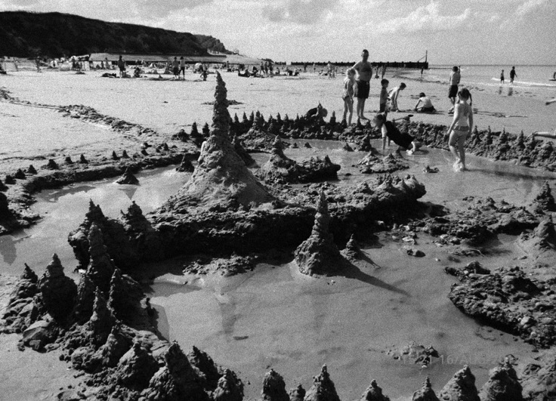
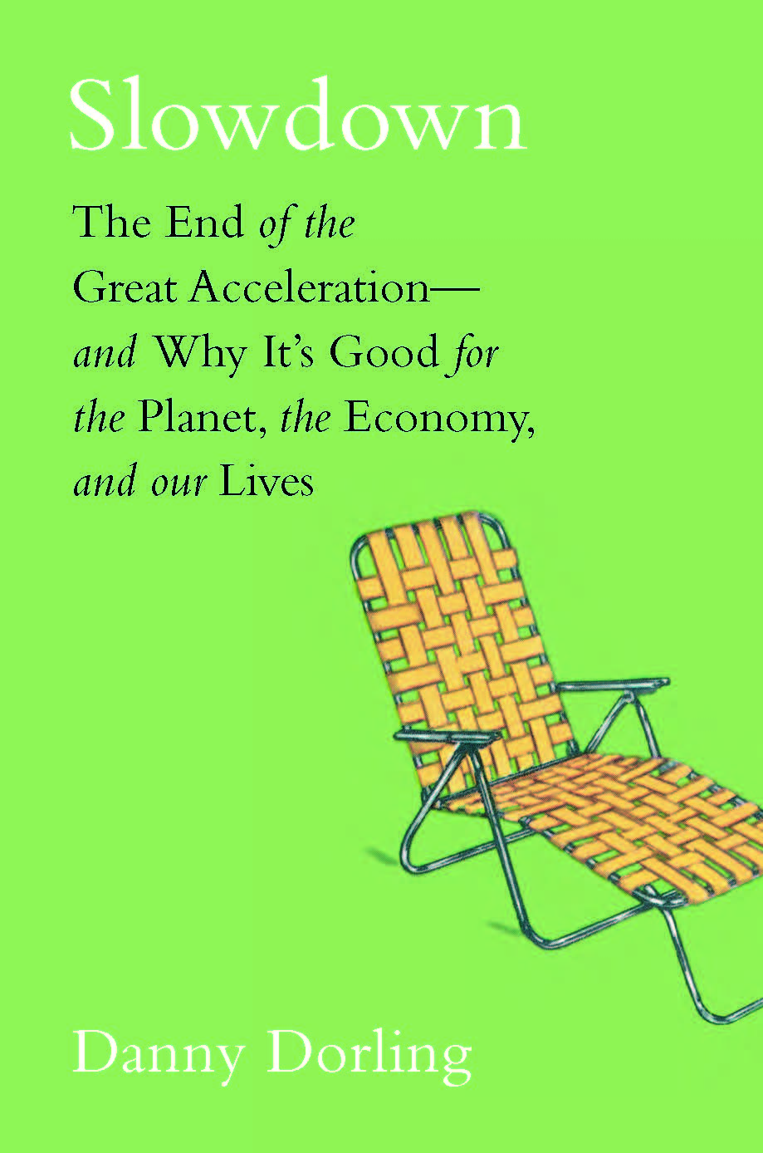
Slowdown: The End of the Great Acceleration— and Why it’s Good for the Planet, the Economy, and Our Lives
Danny Dorling - with illustrations by Kirsten McClure
62 animated slides for use in teaching

Slide 2
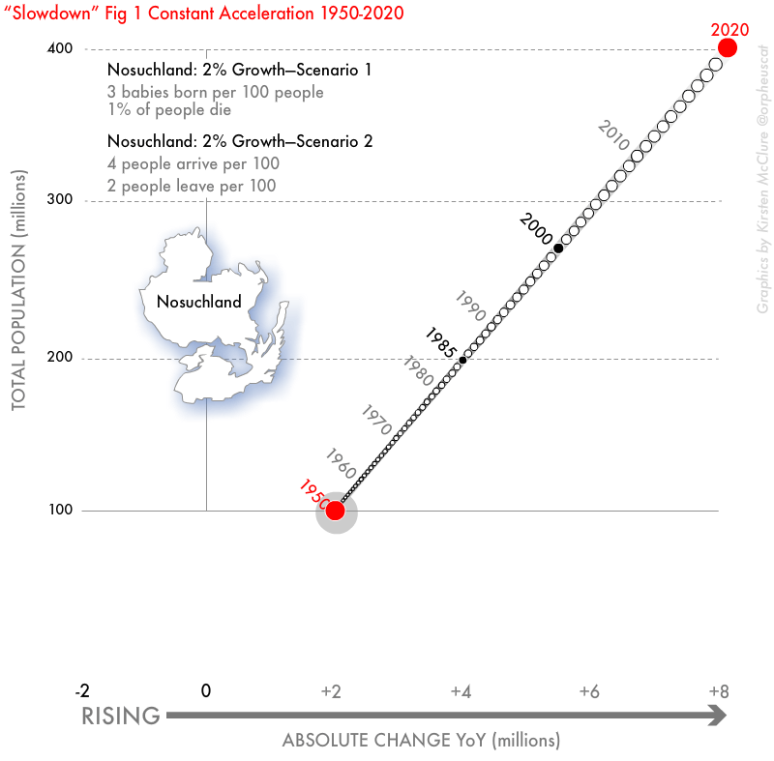
In the ‘Origin of Species’, Charles Darwin described how a population explosion occurs and called the time of population explosion “ favourable seasons”.
Charles was not to know it, but such circumstances arose for his own species at around the time of his own birth.
However, the favourable seasons for human population growth were not experienced favourably, with times of great social dislocation from small scale enclosure to global colonisation.

Slide 3
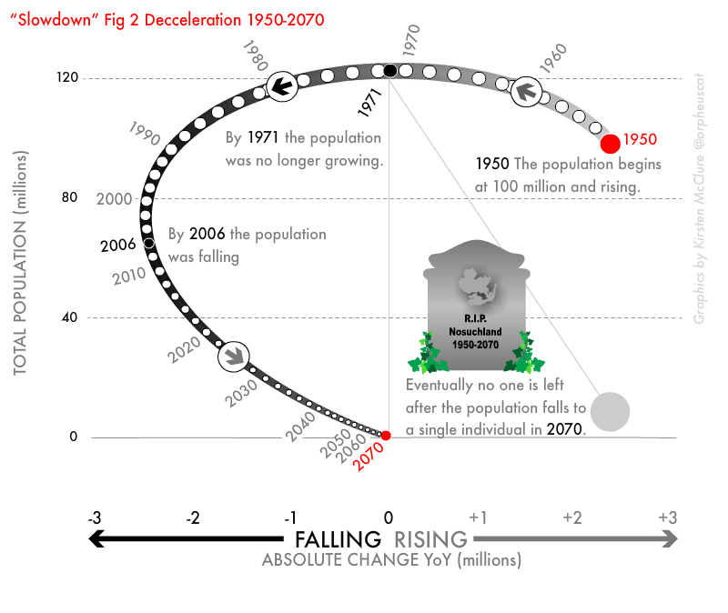
Now those seasons are over, we have experienced the first ever sustained slowdown in the rate of global human population growth.
This has been the case for at least one human generation.
However, we are not just slowing down in terms of how many children we have, but in almost everything else we do other than in the rise in global temperatures that we are recording and that we have to live with.

Slide 4
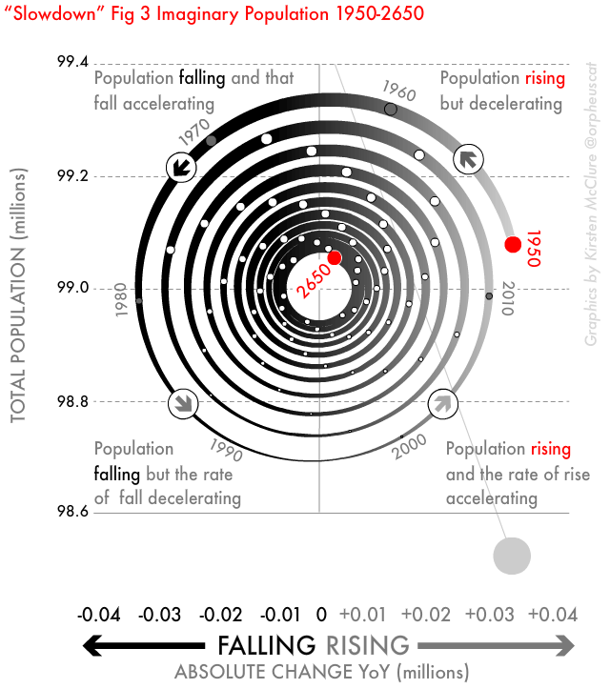
It can be argued that there is even a slowdown in such unexpected areas as debt, publishing, and in the total amount useful information being produced.
If this is true that humanity is slowing down in almost everything that we do – what does this mean?
What measurements suggest that slowdown is true? And if so much is still rising, albeit at slower and slower rates - is that such a great change?

Slide 5
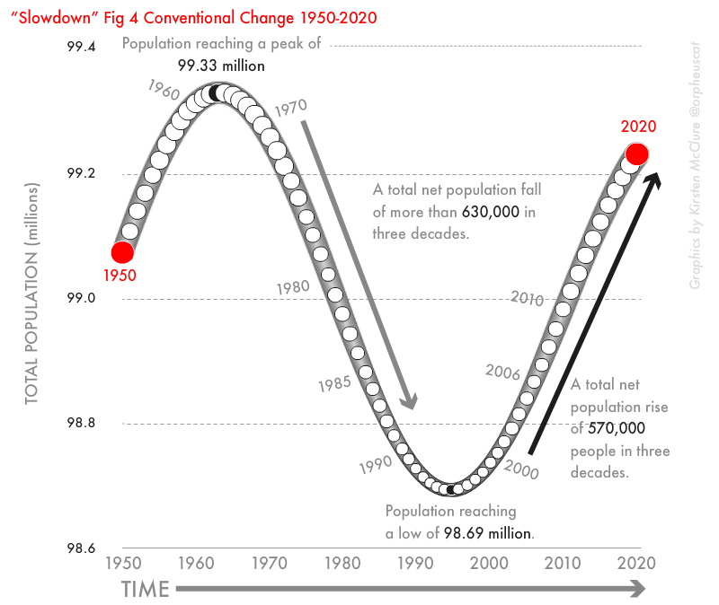
Finally how might the slowdown impact on economic thought?
In many ways economics was the science of the great acceleration; a science that makes most sense when markets are expanding and demand is rising.
What kind of an economics is needed in a world where enormous and accelerating growth has stopped being the normality?

Slide 6
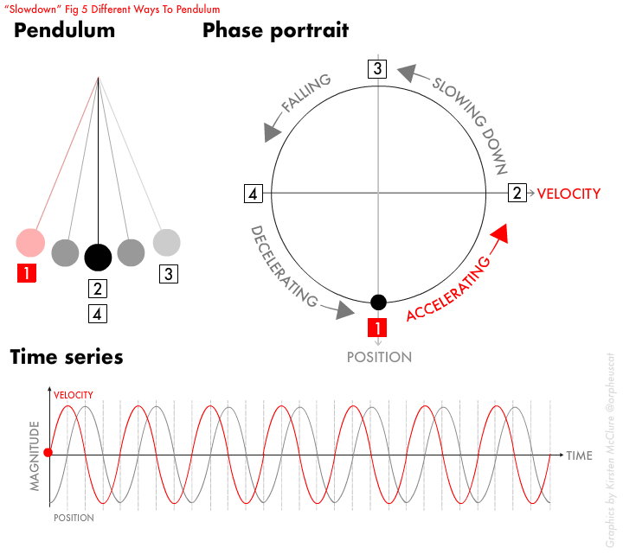

Slide 7
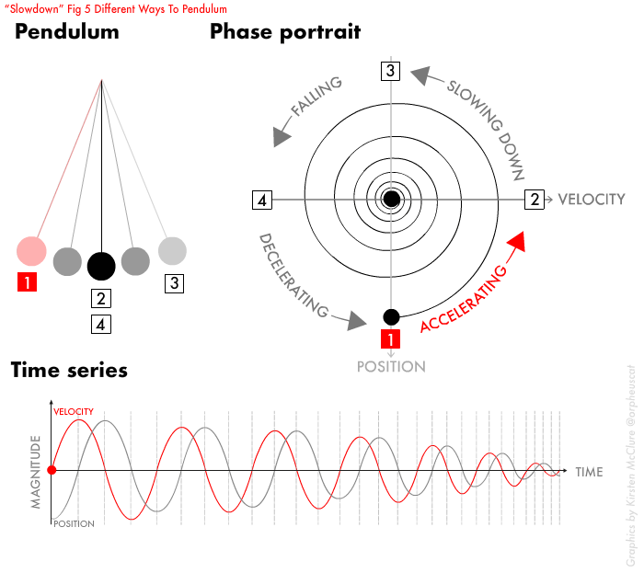

Slide 8
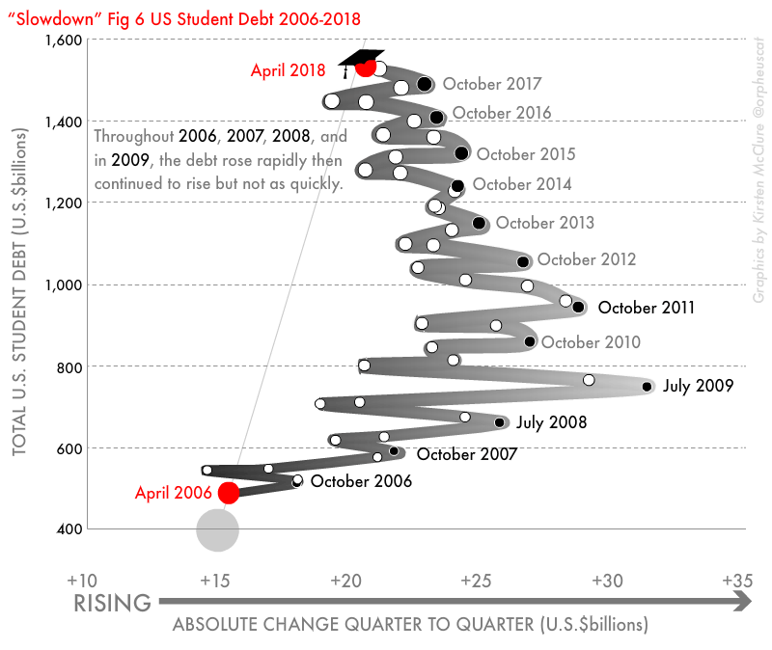

Slide 9
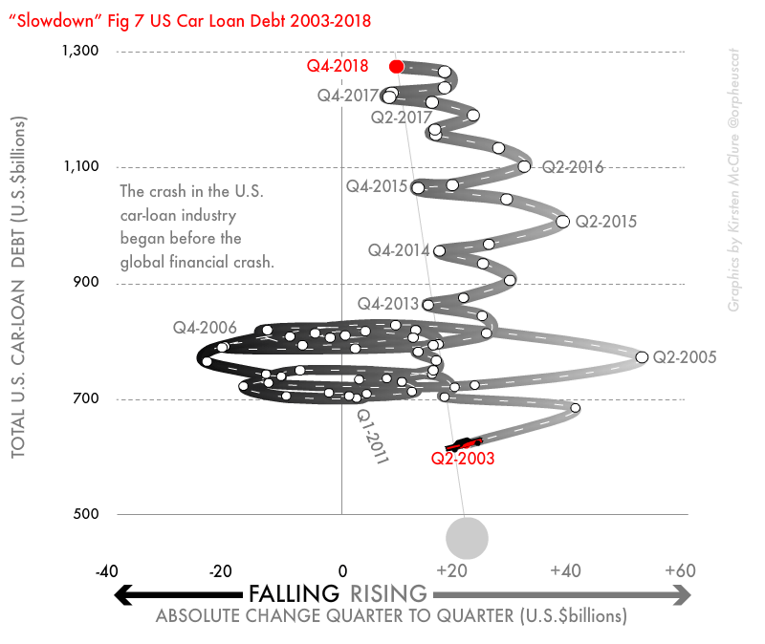

Slide 10
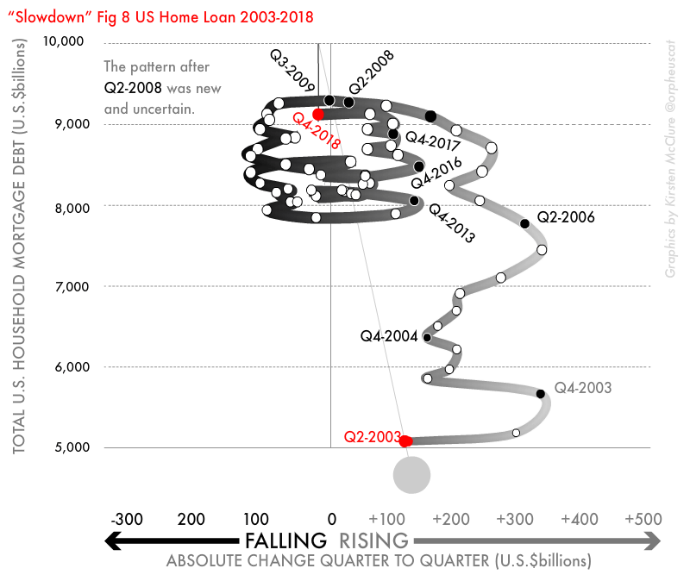

Slide 11
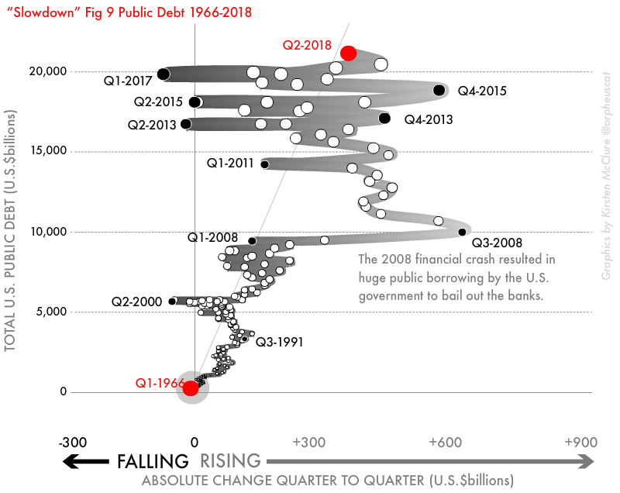

Slide 12
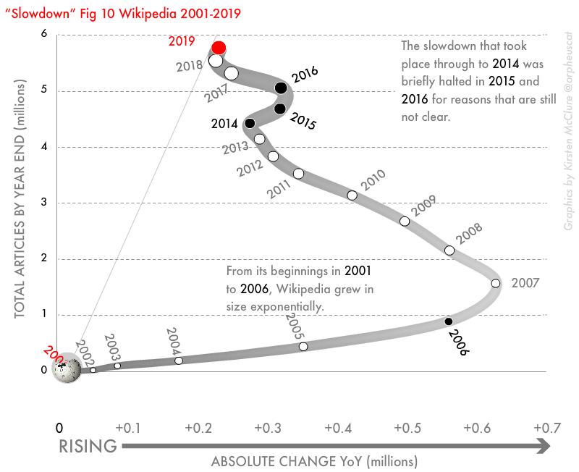

Slide 13
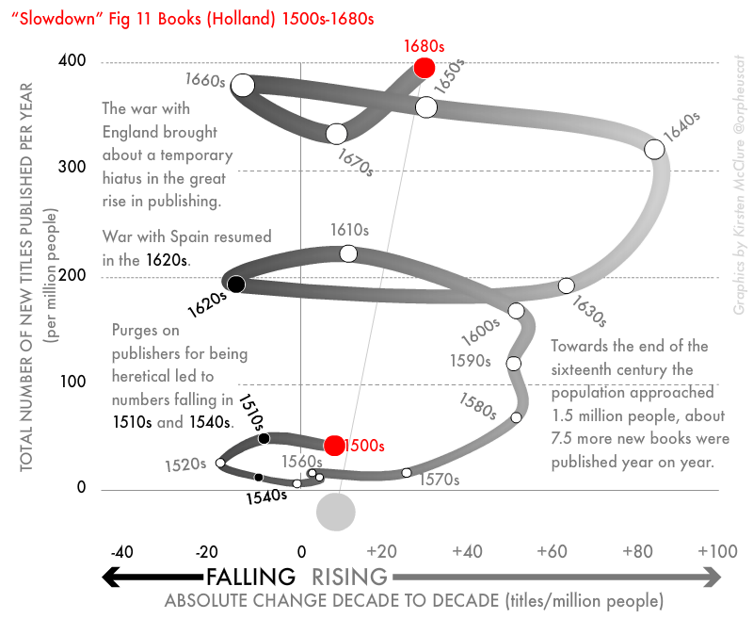

Slide 14
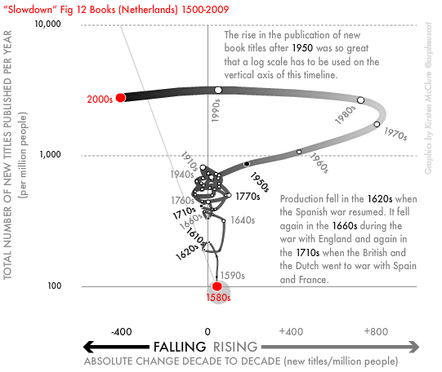

Slide 15
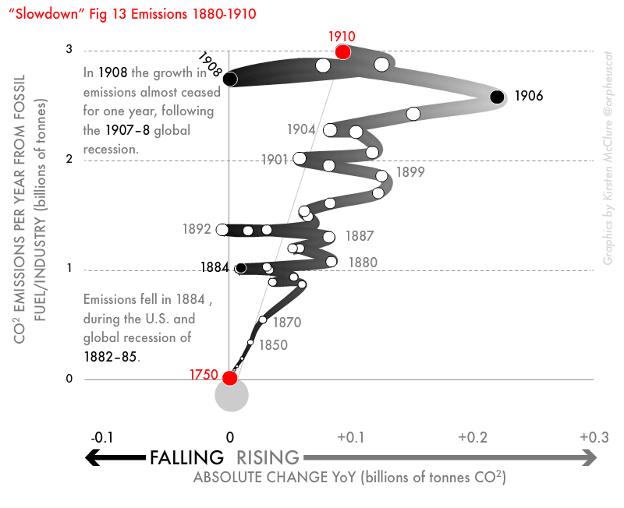

Slide 16
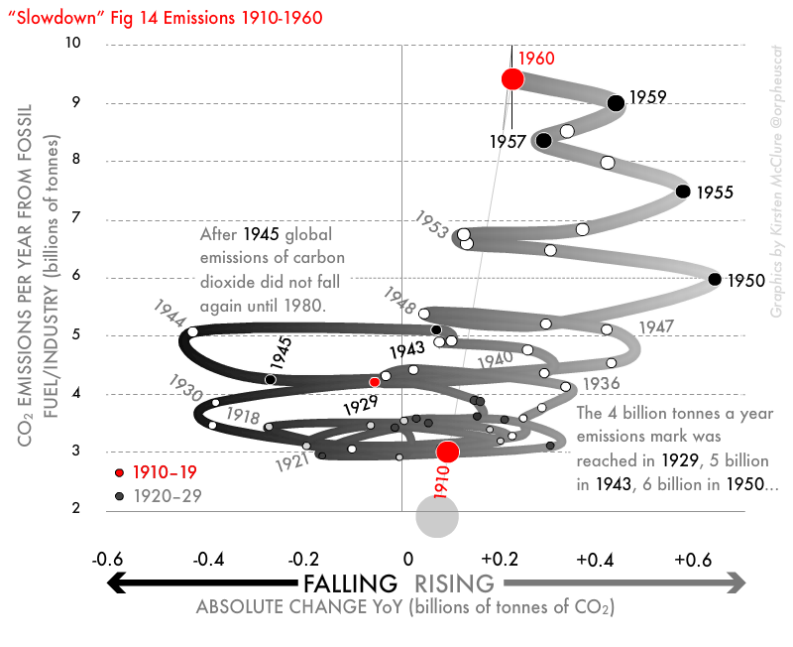

Slide 17
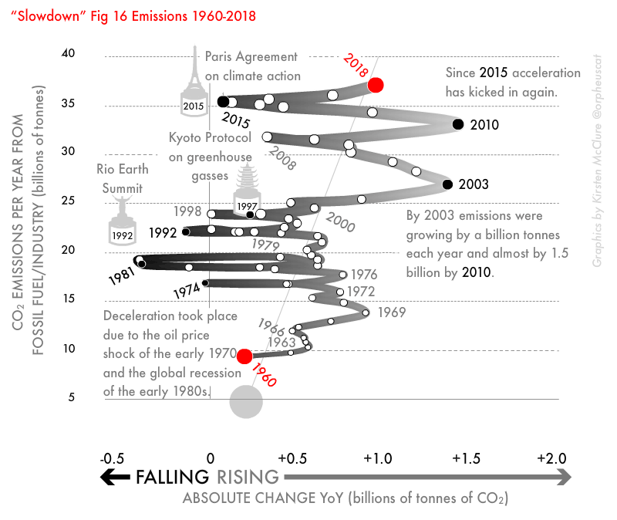

Slide 18
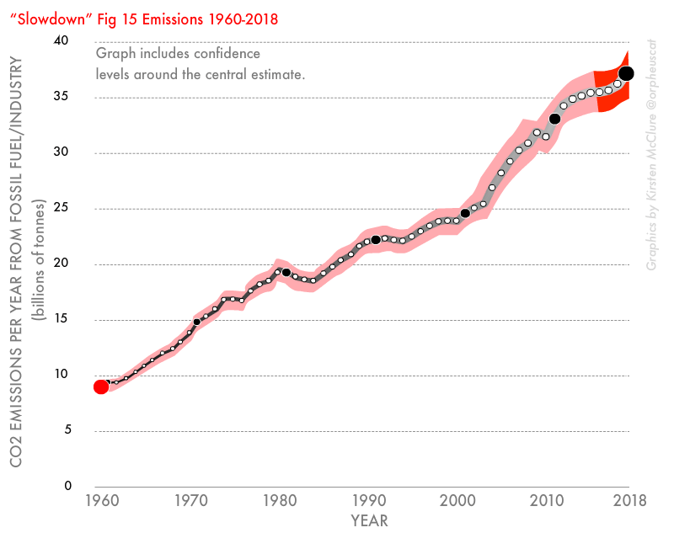

Slide 19
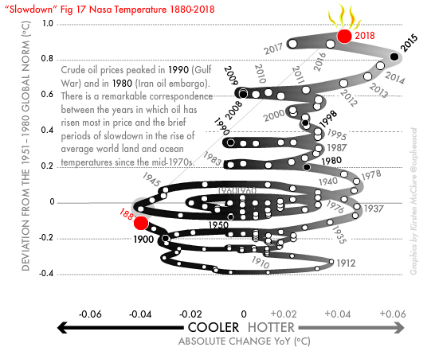

Slide 20
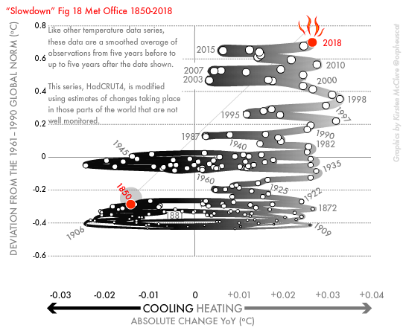

Slide 21
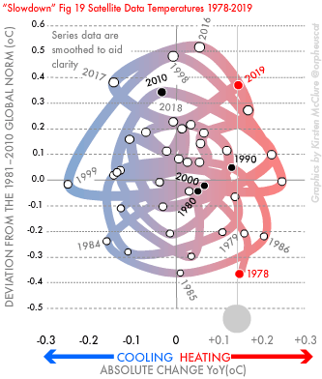

Slide 22
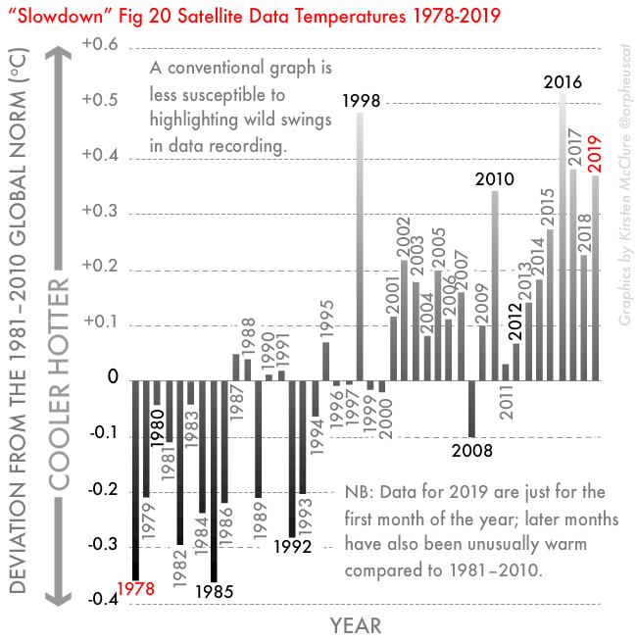

Slide 23
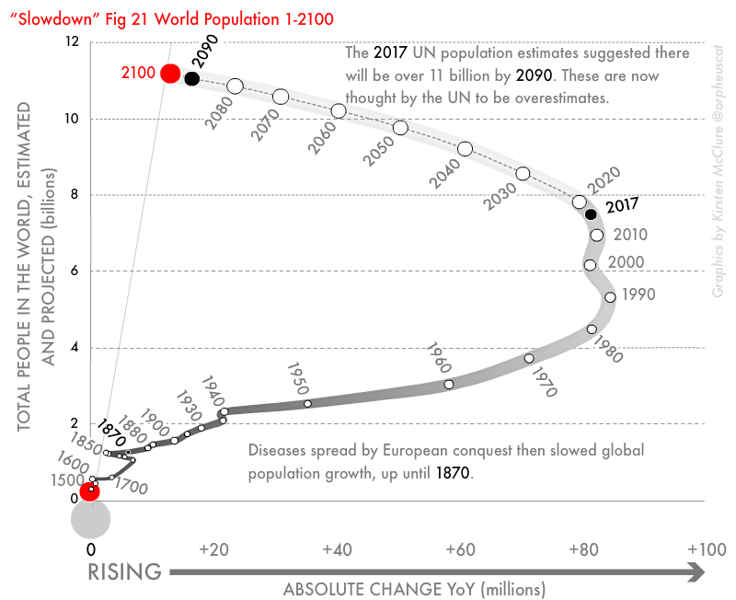

Slide 24
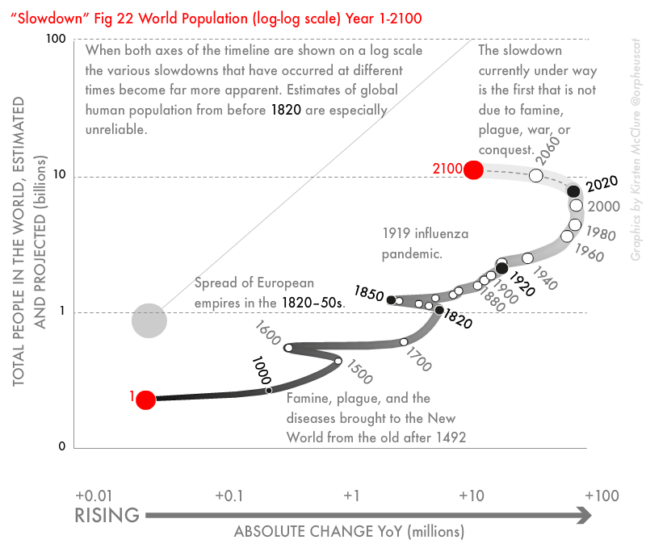

Slide 25
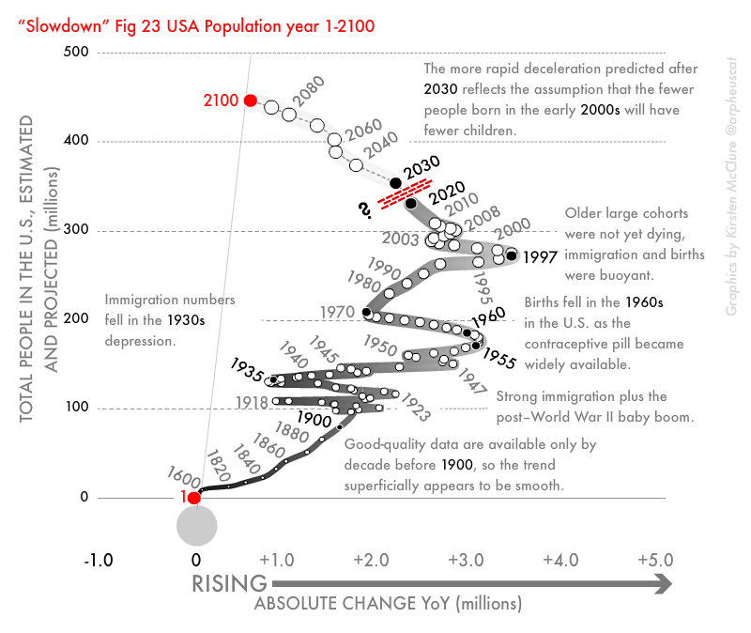

Slide 26
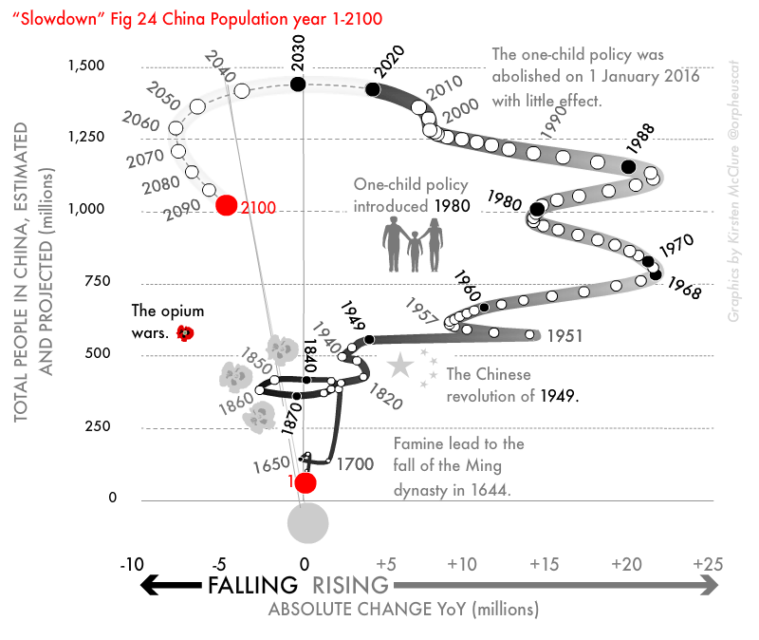

Slide 27
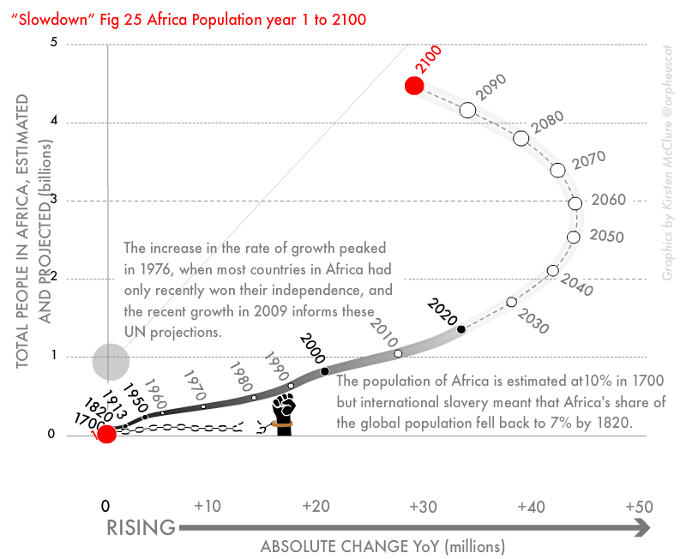

Slide 28
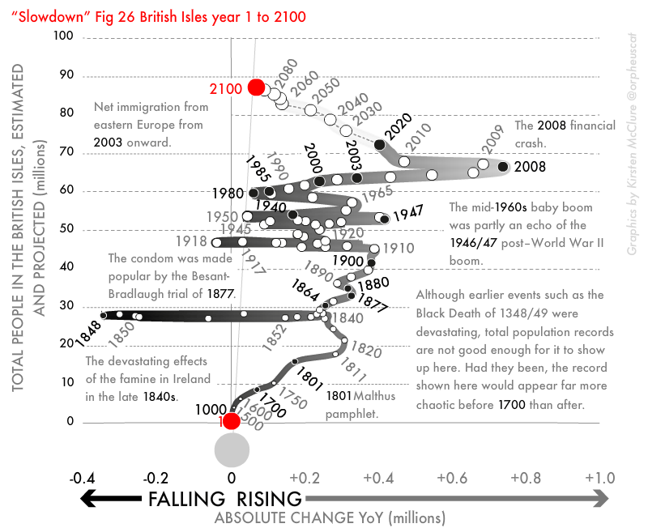

Slide 29
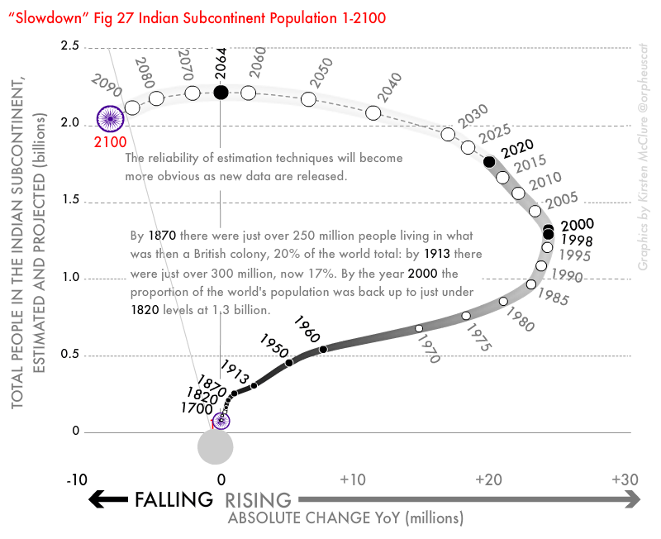

Slide 30
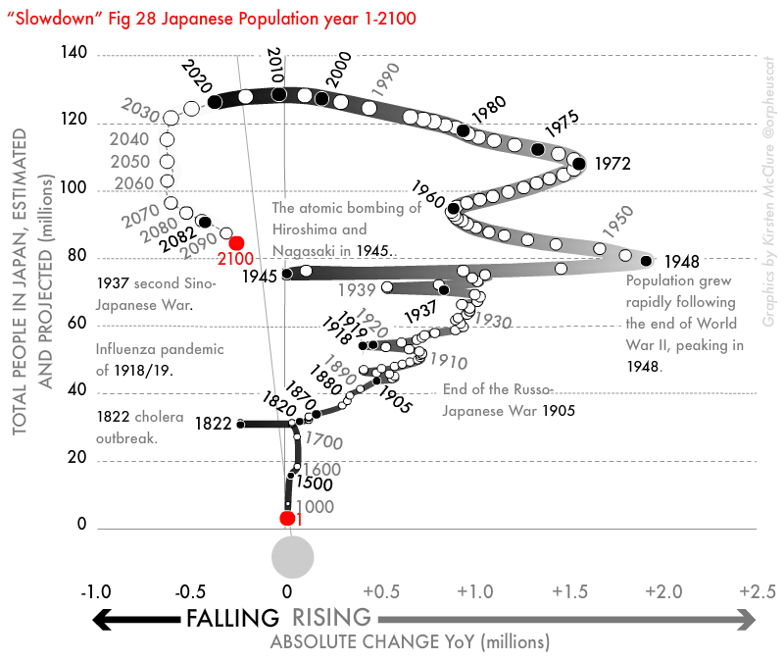

Slide 31
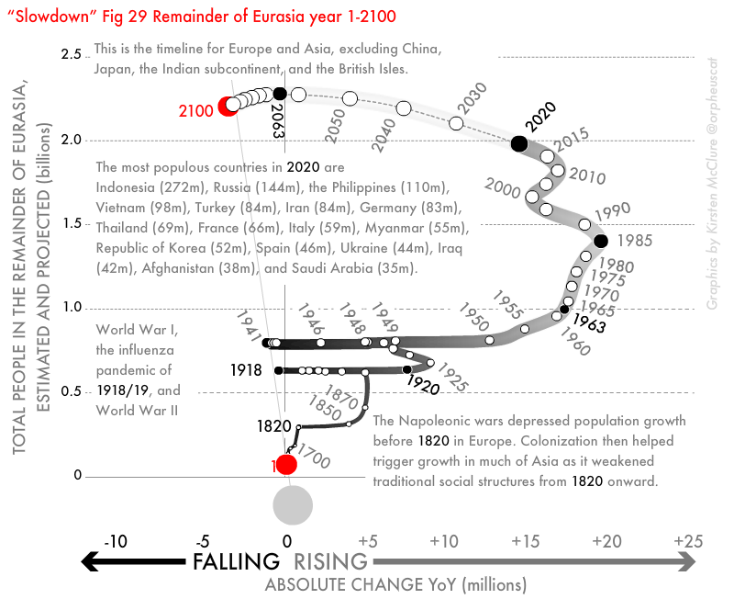

Slide 32
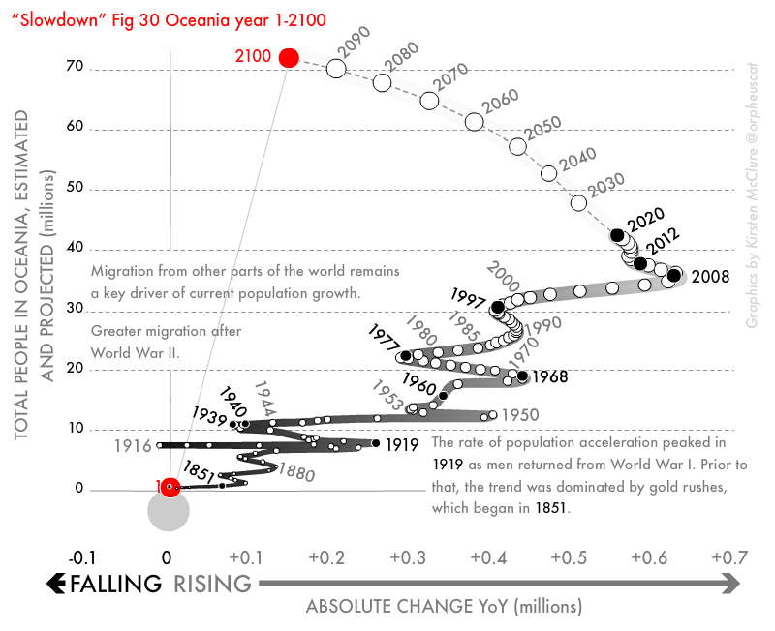

Slide 33
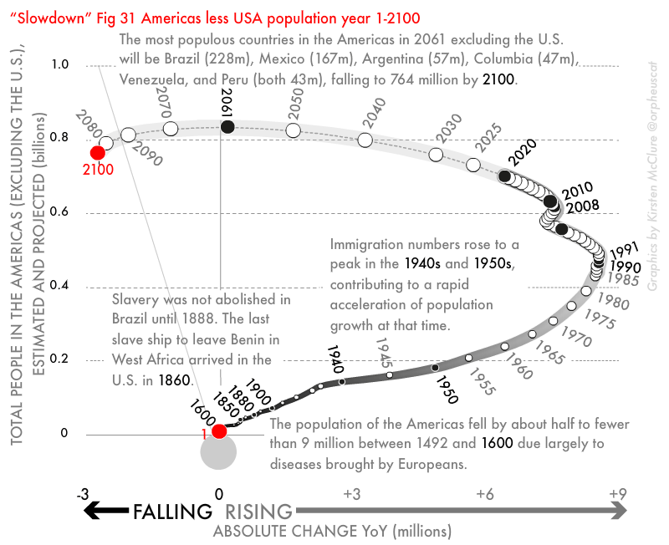

Slide 34
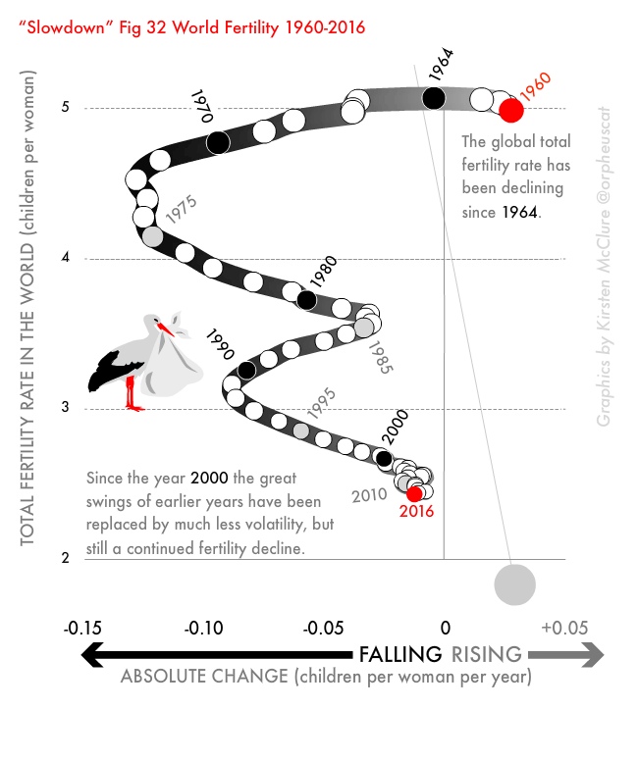
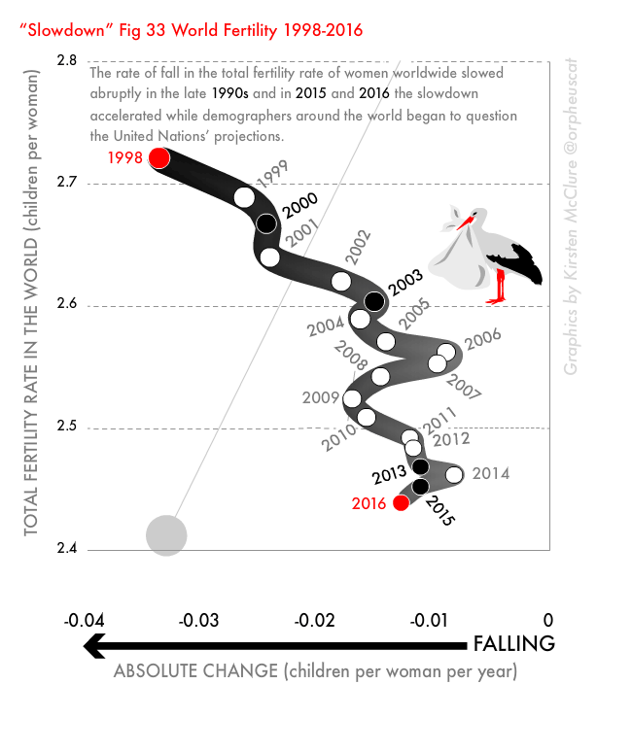

Slide 35
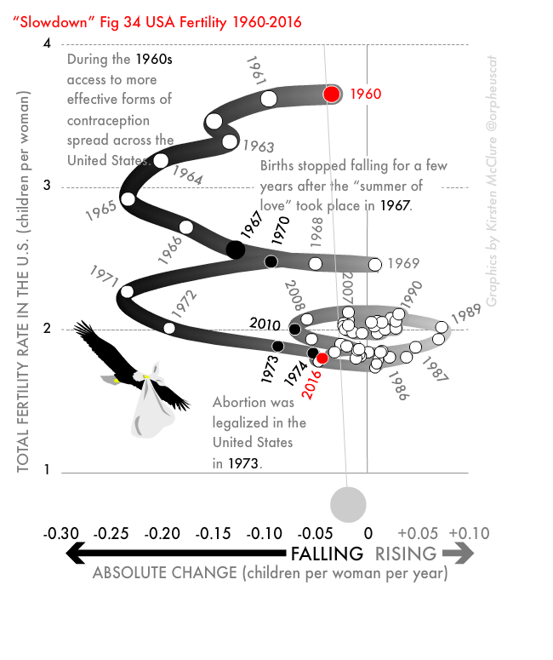
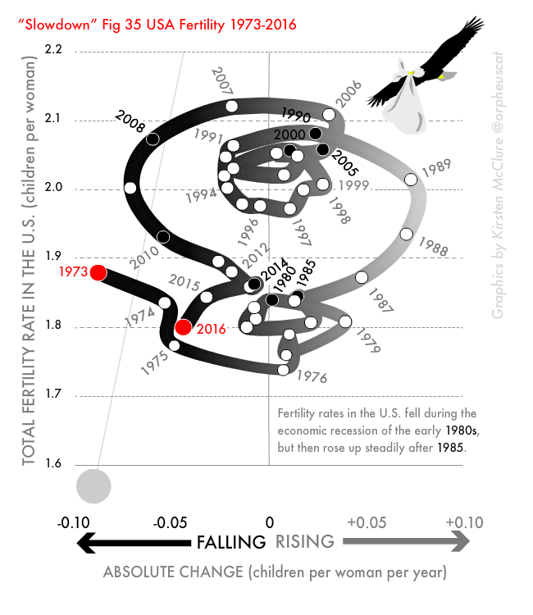

Slide 36
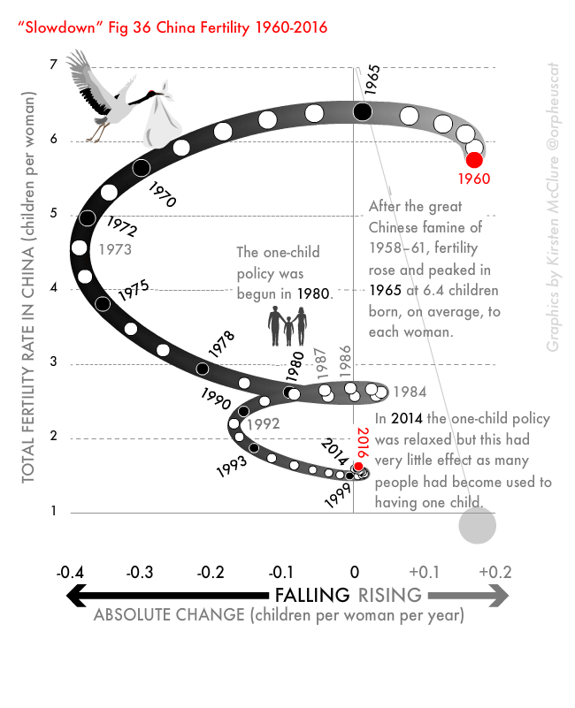
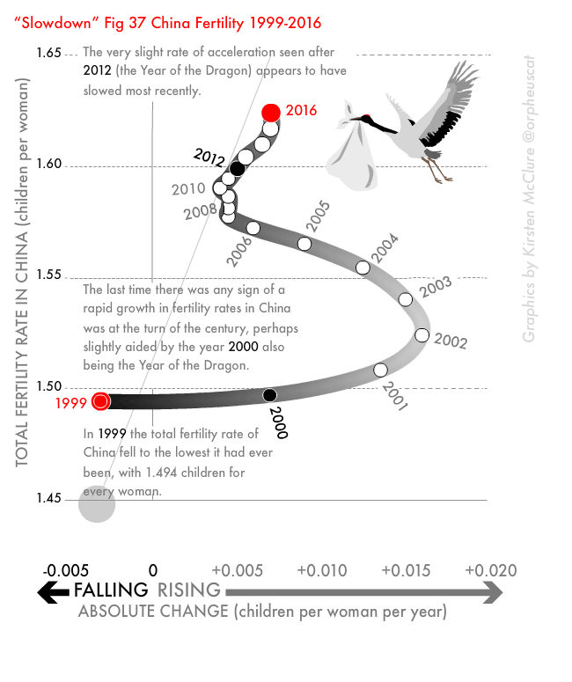

Slide 37
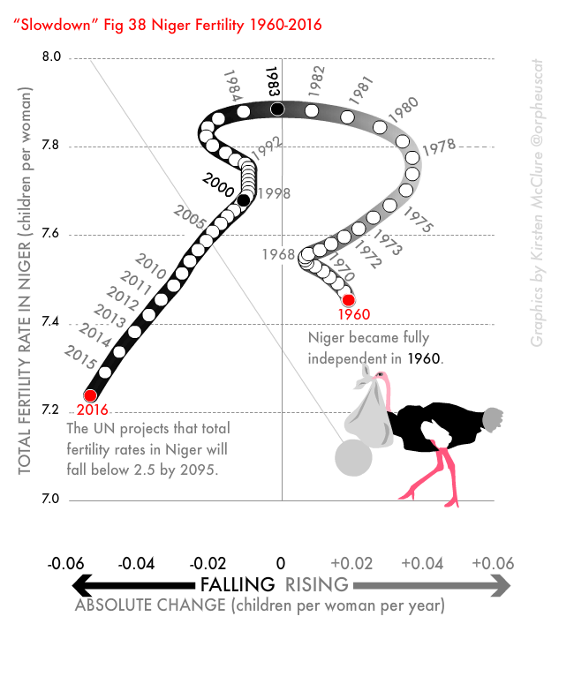
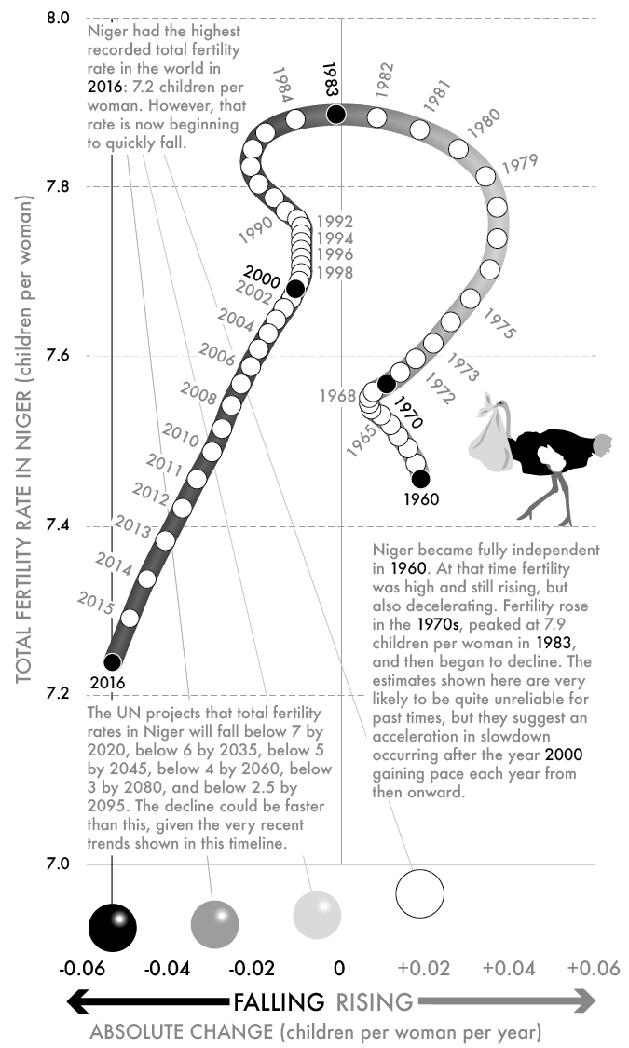

Slide 38
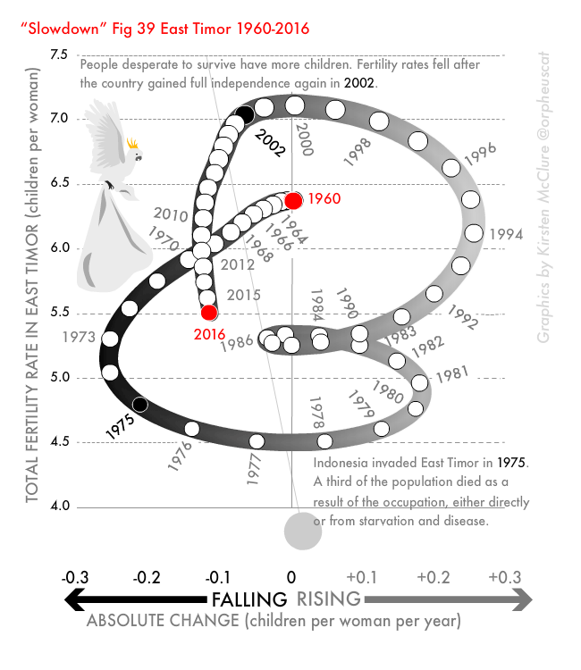
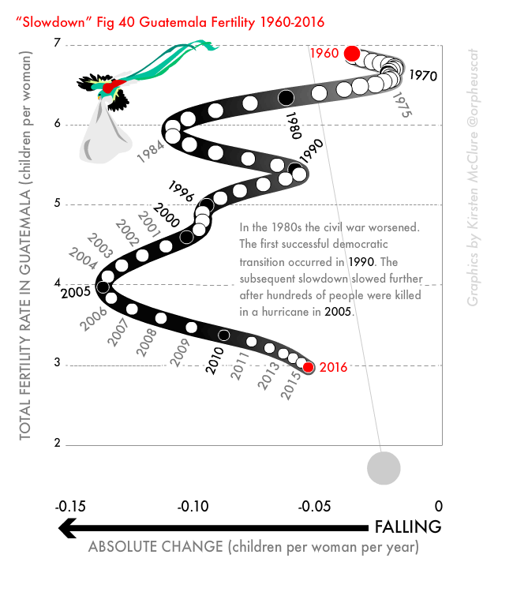

Slide 39
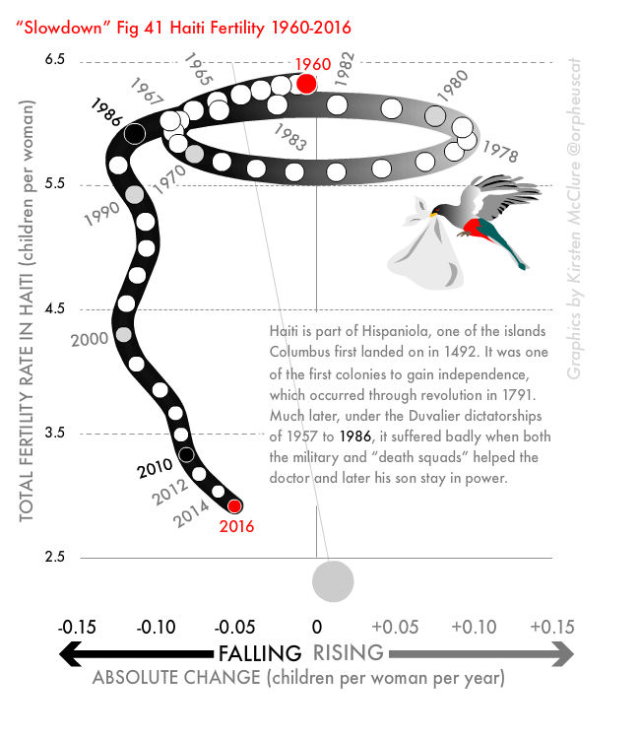
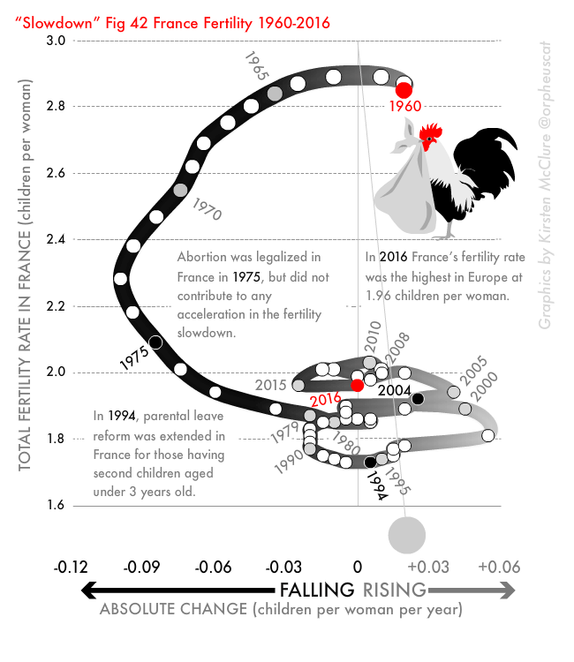

Slide 40
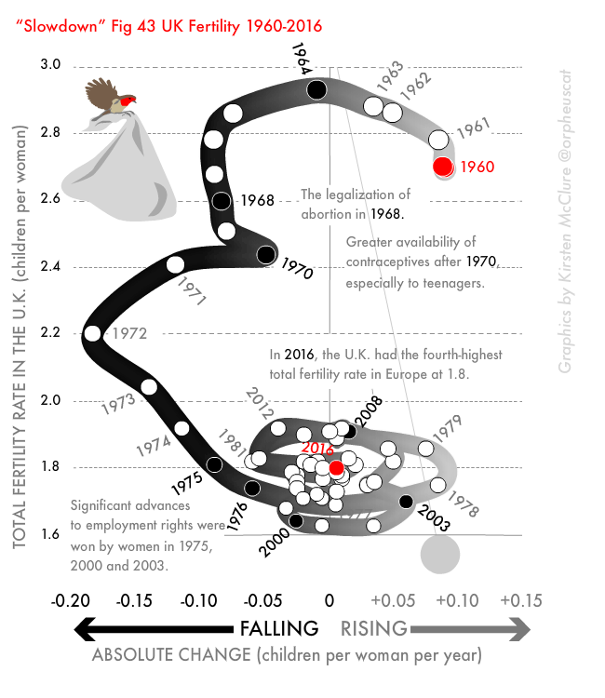
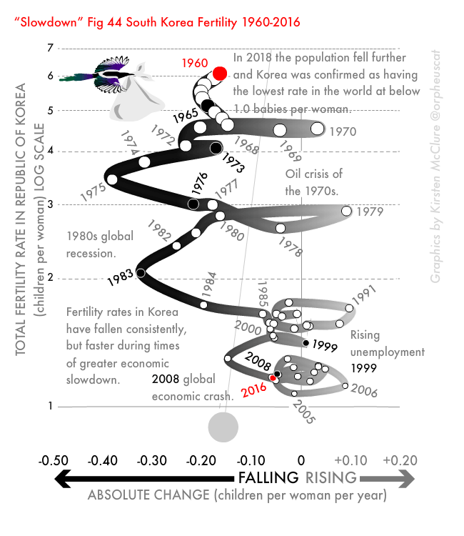

Slide 41
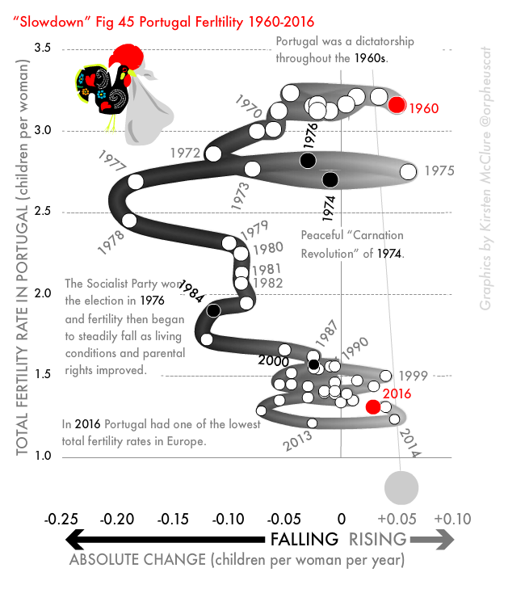
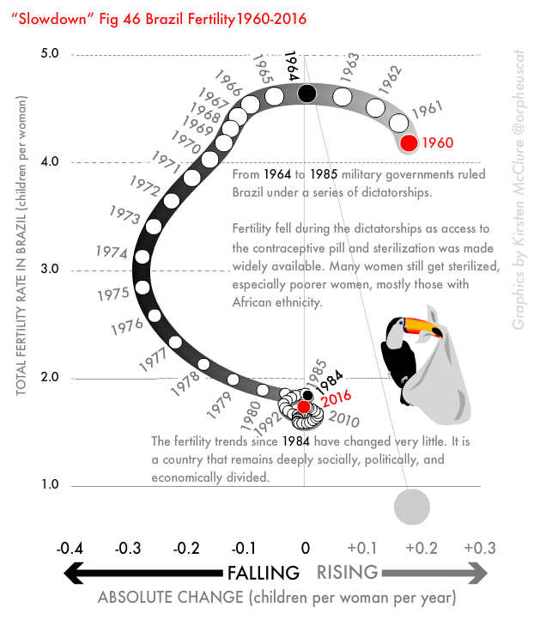

Slide 42


Slide 43


Slide 44


Slide 45


Slide 46


Slide 47


Slide 48


Slide 49


Slide 50


Slide 51


Slide 52


Slide 53


Slide 54


Slide 55


Slide 56


Slide 57


Slide 58


Slide 59


Slide 60


Slide 61


Slide 62
Conclusion - Slowdown: (The End of the Great Acceleration—and Why It’s Good for the Planet, the Economy, and Our Lives)
Great economic inequalities will be hard to sustain during and following slowdown. As things change less, it will become much more difficult to make money out of a shrinking and aging population who may also become savvier and harder to fool with the allure of the “new”.
Slowdown means goods lasting longer; it means less waste. It means that many of the things that we currently think of as great social and environmental problems will not be problematic in future. We will, of course, have new problems—most of which we cannot even imagine right now.

