Slide 1
Birth …and the suburban pied piper
The Population of the UK
A different view of life in the United Kingdom
by Danny Dorling and Benjamin D. Hennig
Chapter 2

Slide 2
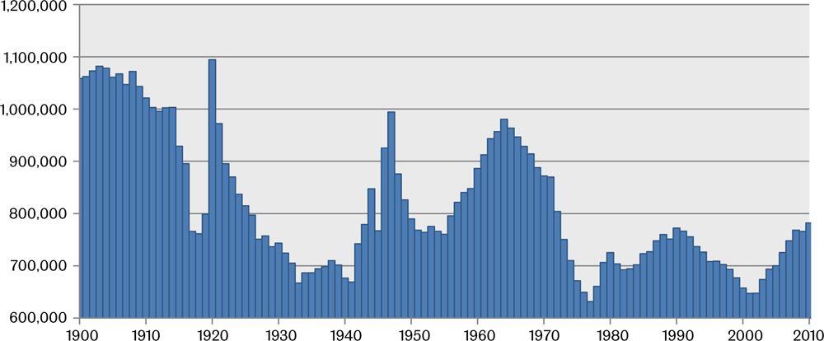
Number of live births in Britain, 1900-2010
Data source: ONS and GRO (Scotland) websites
Birth…and the suburban pied piper
Figure 2.1

Slide 3
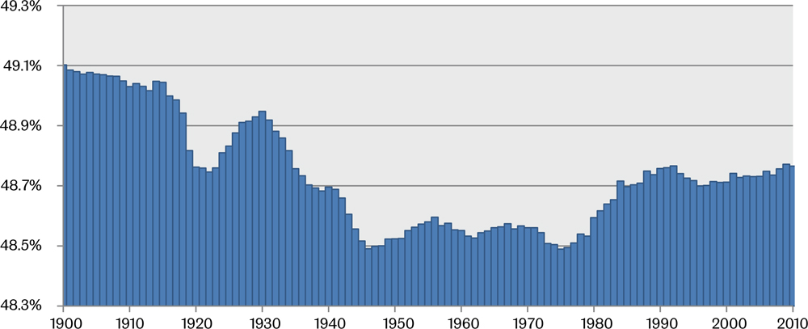
Proportion of live births that were female in Britain, 1900-2010
Data source: ONS and GRO (Scotland) websites
Birth…and the suburban pied piper
Figure 2.2

Slide 4
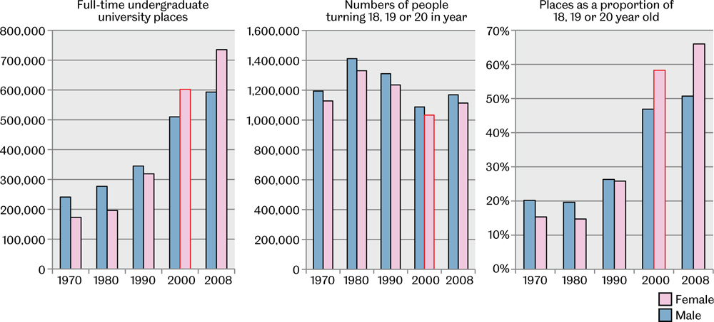
Students in the UK, cohort size and proportions, 1970-2008
Figures are by entry year; women born in 1982 have their three bars outlined in red
Data source: Social Trends 32 and 41 and ONS and GRO (Scotland) websites
Birth…and the suburban pied piper
Figure 2.3

Slide 5
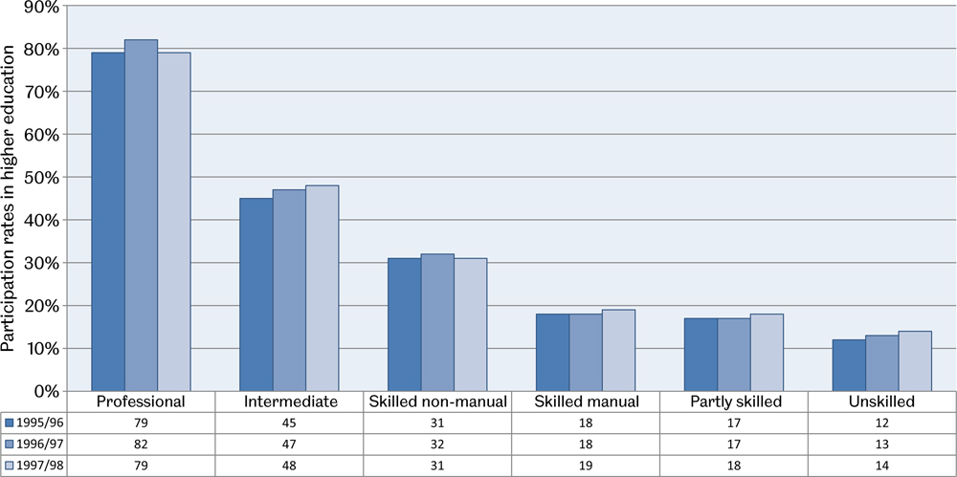
Participation in higher education by social class, 1995-1998
Social class is assigned through information collected by the Youth Cohort Survey on the occupation (using Standard Occupational Classification categories) of parent or guardian with the highest income in the household - Data source: Department for Education and Skills; Office for National Statistics; Universities and Colleges Admission Service; Social Trends 30; HEFCE Consultation paper, Supply and demand in higher education, HEFCE 01/62, 2001
Birth…and the suburban pied piper
Figure 2.4

Slide 6
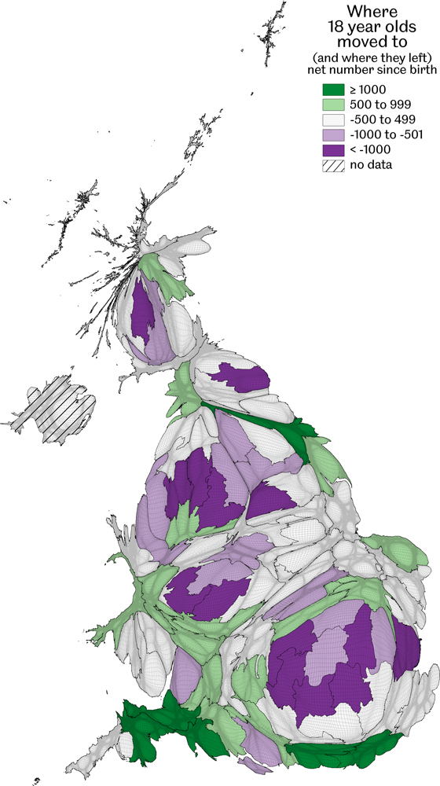
Where 18 year olds moved to (and where they left)
Net number since birth; Counts by European Constituency area
Data source: Estimated from school rolls of 15 year olds in 1997 less the count of babies in the 1981 Census
Birth…and the suburban pied piper
Figure 2.5

Slide 7
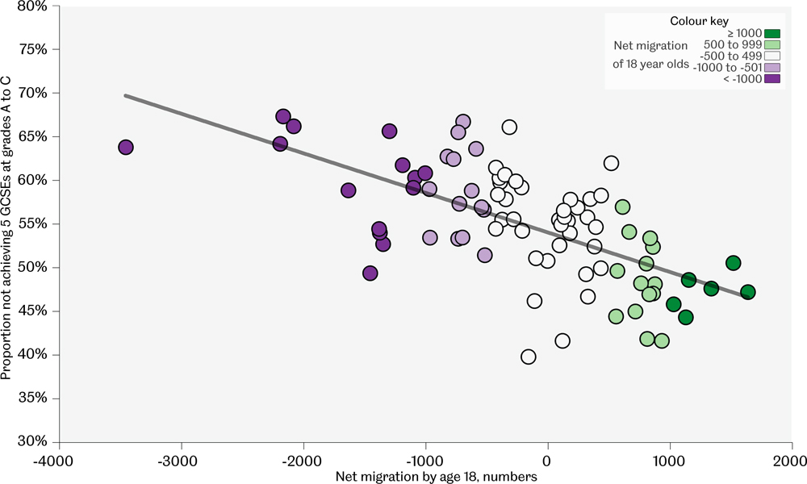
Net migration to age 18 (1982-2000) by GCSEs at age 15/16
Each point is a 1999 European parliamentary constituency in Britain
Data source: 1981, 1991 and 2001 Censuses, Analysis of national school league tables for Britain 1993-99
Birth…and the suburban pied piper
Figure 2.6

Slide 8
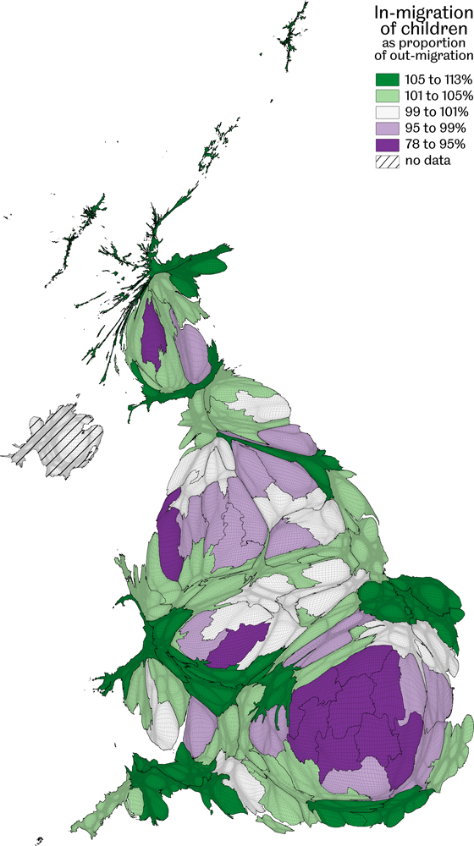
In-migration of children
Shown as a proportion of out-migration
Data source: 1991 Census special migration statistics children aged 1-15
Birth…and the suburban pied piper
Figure 2.7

Slide 9
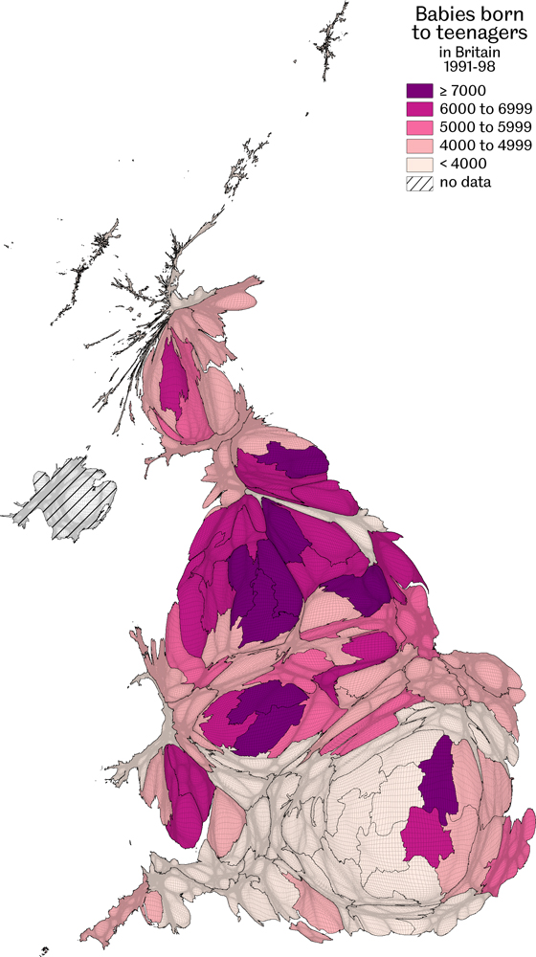
Babies born to teenagers, 1991-98
Counts by European Constituency area
Data source: Birth records by mother's age at birth
Birth…and the suburban pied piper
Figure 2.8

Slide 10
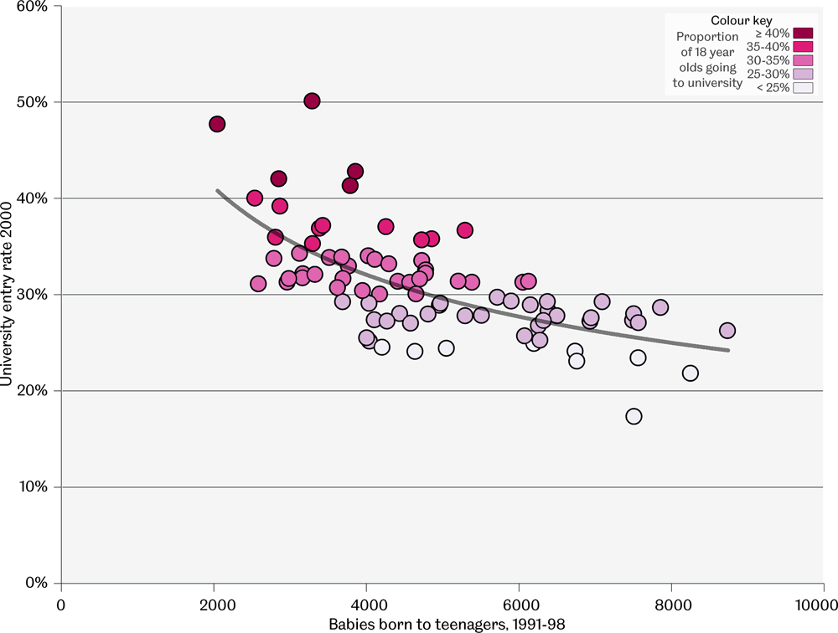
Babies born to teenagers and university entry rates
Each point is a 1999 European parliamentary constituency area
Data source: ONS and GRO (Scotland) websites; successful UCAS under age 21 applicants from National Statistics website and estimated for Scotland and Northern Ireland; birth records by mother's age at birth
Birth…and the suburban pied piper
Figure 2.9

Slide 11
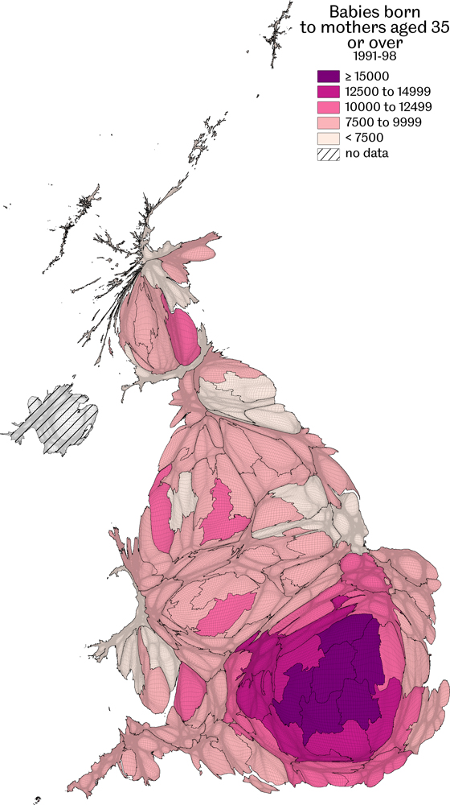
Babies born to mothers aged 35 or over 1991-98
Counts by European Constituency area
Data source: Birth records by mother's age at birth
Birth…and the suburban pied piper
Figure 2.10

Slide 12
Key Point Summary
• The number of babies born alters over time, as does the proportion born female/male
• Children migrate in directions which are predictable in aggregate, out of city centres
• Older mothers in the UK are found to give birth most often in the South East of England
Birth…and the suburban pied piper

