Slide 1
Abroad…the Kingdom’s place in the world
The Population of the UK
A different view of life in the United Kingdom
by Danny Dorling and Benjamin D. Hennig
Chapter 10

Slide 2
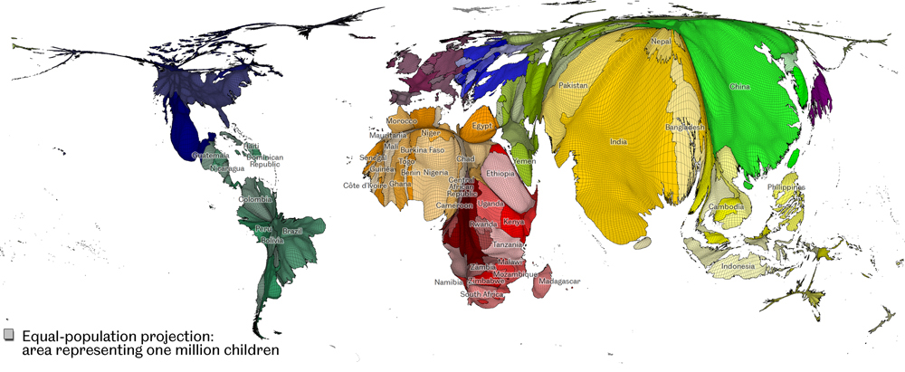
A different view of the world - its children in 2010
The cartogram gives every child living in the world the same amount of space on the map. In the cartogram, each equally-sized grid cell from the real world is resized according to the number of children living in that space. Named countries are those included in the surveys reported in this chapter - Data source: SEDAC Columbia University (2010)
Abroad…the Kingdom’s place in the world
Figure 10.1

Slide 3
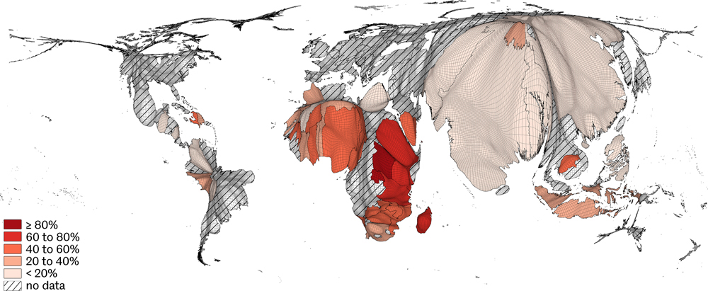
Severe water deprivation for children in the world
Data source: UNICEF report, 2000
Abroad…the Kingdom’s place in the world
Figure 10.2

Slide 4
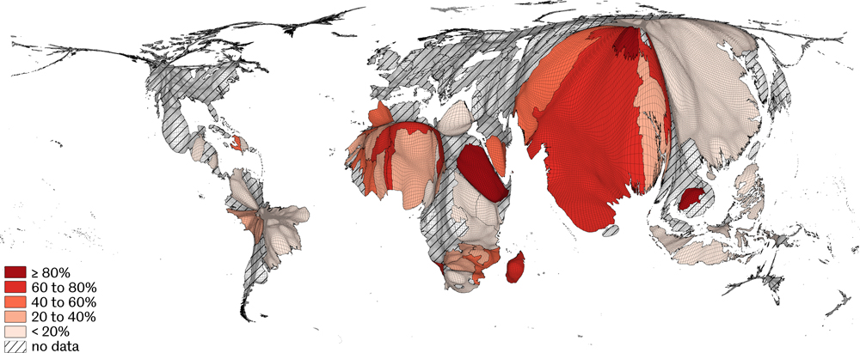
Severe sanitation deprivation for children in the world
Data source: UNICEF report, 2000
Abroad…the Kingdom’s place in the world
Figure 10.3

Slide 5
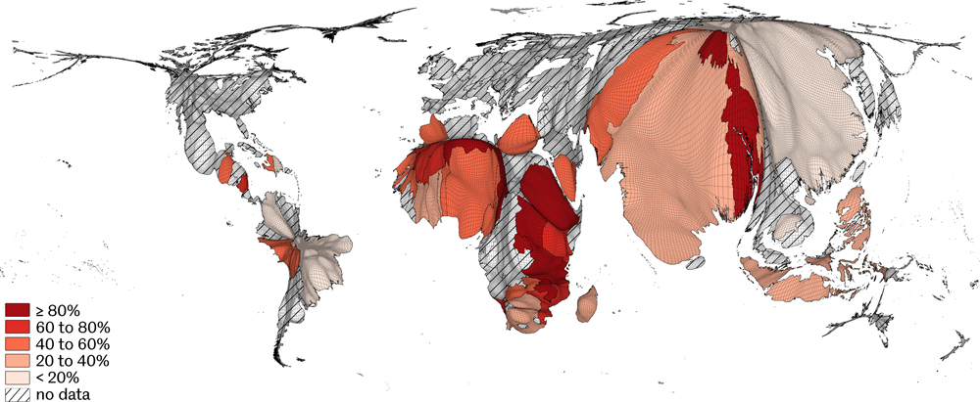
Severe shelter deprivation for children in the world
Data source: UNICEF report, 2000
Abroad…the Kingdom’s place in the world
Figure 10.4

Slide 6
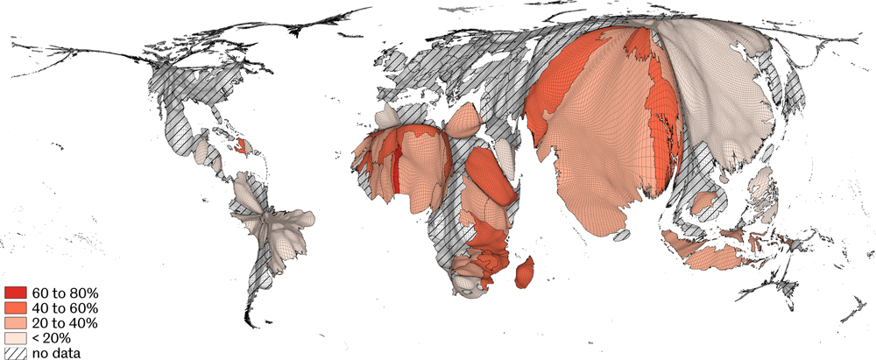
Severe information deprivation for children in the world
Data source: UNICEF report, 2000
Abroad…the Kingdom’s place in the world
Figure 10.5

Slide 7
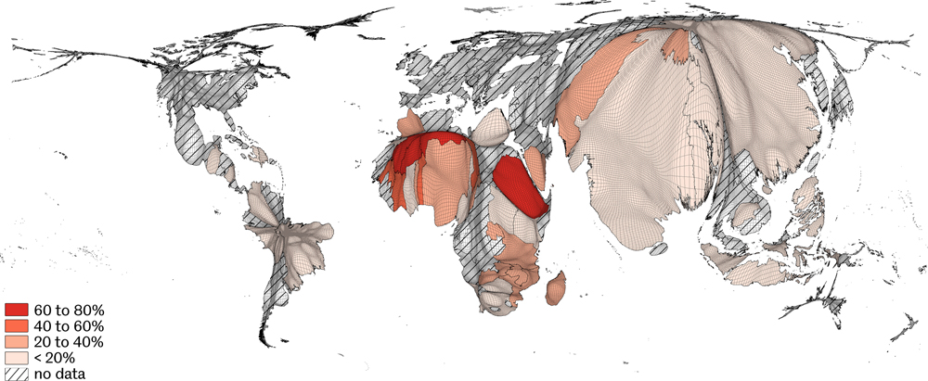
Severe education deprivation for children in the world
Data source: UNICEF report, 2000
Abroad…the Kingdom’s place in the world
Figure 10.6

Slide 8
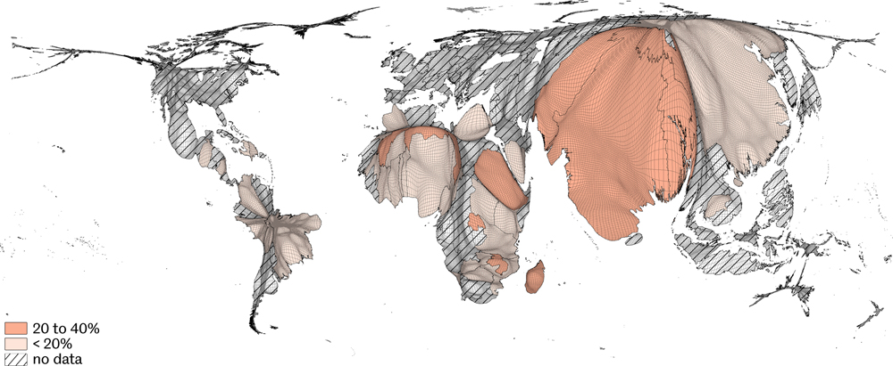
Severe food deprivation for children in the world
Data source: UNICEF report, 2000
Abroad…the Kingdom’s place in the world
Figure 10.7

Slide 9
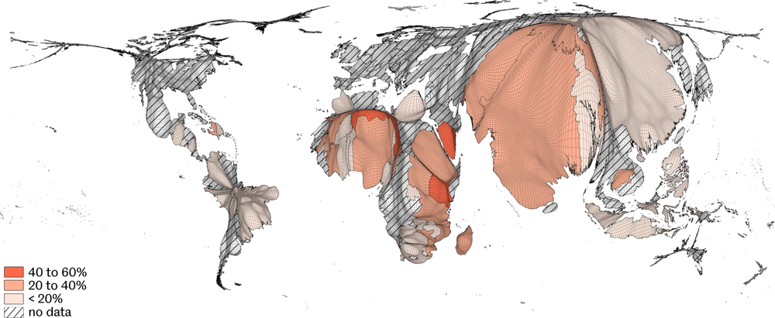
Severe health care deprivation for children in the world
Data source: UNICEF report, 2000
Abroad…the Kingdom’s place in the world
Figure 10.8

Slide 10
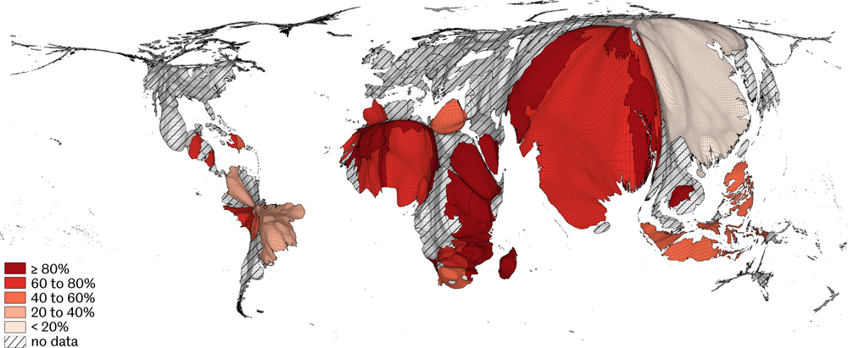
Severe overall deprivation for children in the world
Data source: UNICEF report, 2000
Abroad…the Kingdom’s place in the world
Figure 10.9

Slide 11
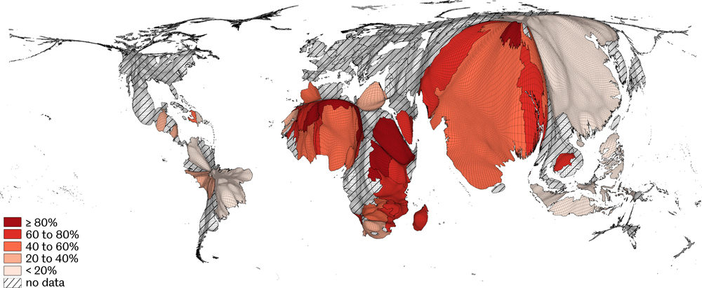
Absolute overall deprivation for children in the world
Data source: UNICEF report, 2000
Abroad…the Kingdom’s place in the world
Figure 10.10

Slide 12
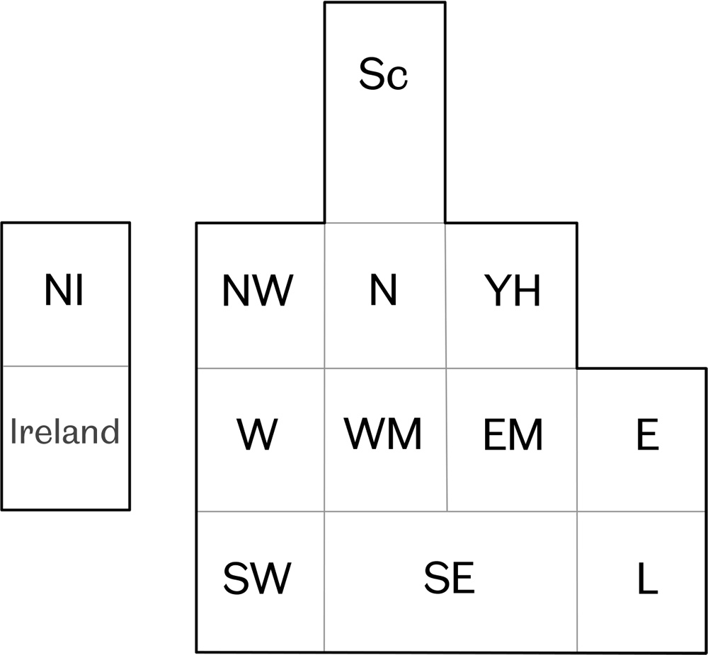
Regional cartogram of the children of the British Isles
The UK represented by 14 squares - Data Source: UK Census 2001
Region | Children2001 (millions)
Northern Ireland | 0.45
North East | 0.56
Wales | 0.66
East Midlands | 0.94
South West | 1.06
Yorkshire and Humber | 1.14
East of England | 1.21
West Midlands | 1.23
North West | 1.57
London | 1.62
Scotland | 1.65
South East | 1.79
UK (total) | 13.9
Abroad…the Kingdom’s place in the world
Figure 10.11

Slide 13
Key Point Summary
• The majority of children in the word still lack what in Britain is usually taken for granted
• The economic success of the United Kingdom is partly reliant on other places being insecure
• The majority of the world’s children are poor partly because of actions of people in Britain
Abroad…the Kingdom’s place in the world

